Slide 1
WRF - HYDRO

Slide 2
WRF – Hydro
WRF-Hydro, an open-source community model, is used for a range of projects, including flash flood prediction, regional hydroclimate impacts assessment, seasonal forecasting of water resources, and land-atmosphere coupling studies. It was designed to link multi-scale process models of the atmosphere and terrestrial hydrology to provide:
An extensible multi-scale and multi-physics land-atmosphere modeling capability for conservative, coupled and uncoupled prediction of major water cycle components such as precipitation, soil moisture, snowpack, ground water, streamflow, and inundation
Accurate and reliable streamflow prediction across scales
A research modeling testbed for evaluating and improving physical process and coupling representations

Slide 3
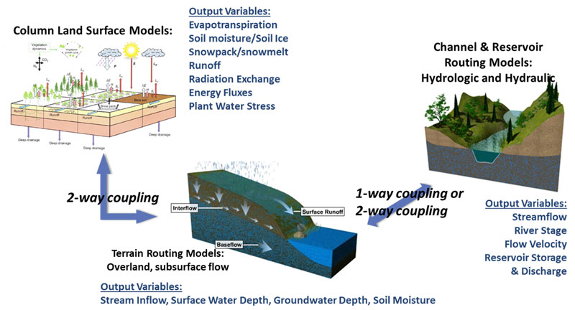
WRF – Hydro

Slide 4
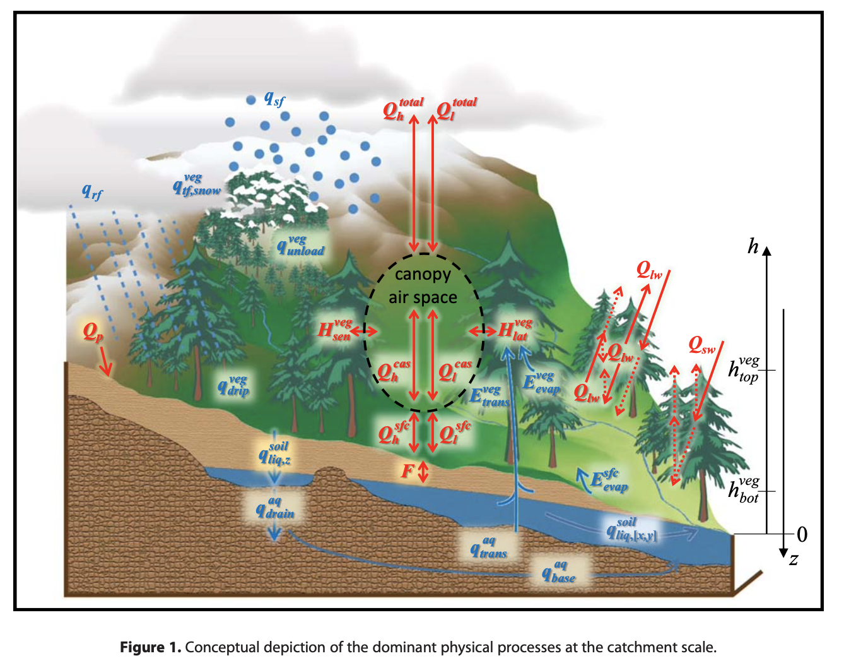
WRF – Hydro

Slide 7
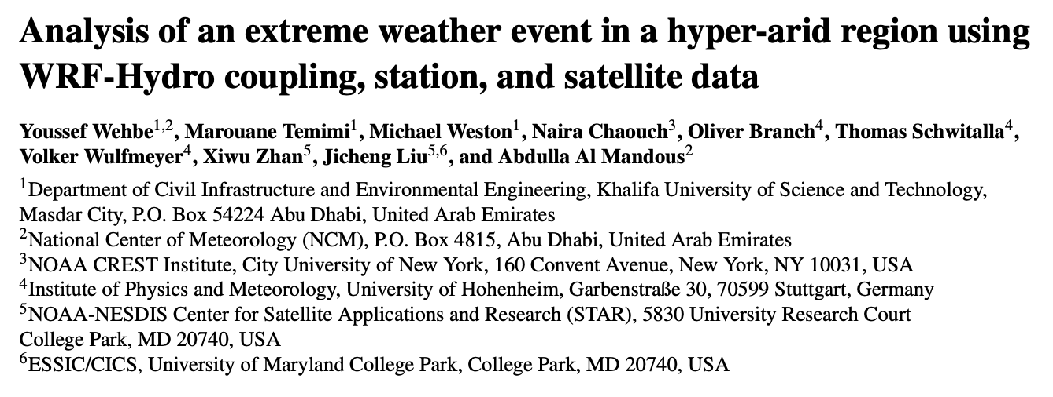

Slide 8
WRF Hydro – Descarga
Compilar WRF MOSIT, con el objetivo de compilar las librerias
https://github.com/HathewayWill/WRF-MOSIT
Descargar WRF-HYDRO version 5.1.2 (no es la mas reciente)
https://github.com/NCAR/wrf_hydro_nwm_public/releases
Descargar WRF version 4.1.2 (no es la más reciente)
https://github.com/wrf-model/WRF/archive/refs/tags/v4.1.2.tar.gz
Descargar WPS version 4.1 (no es la más reciente)
https://github.com/wrf-model/WPS/archive/refs/tags/v4.1.tar.gz

Slide 9
WRF Hydro - variables de entorno:
export DIR=/home/mzapata/WRFHYDRO_COUPLED/Libs
export CC=gcc
export CXX=g++
export FC=gfortran
export FCFLAGS=-m64
export F77=gfortran
export FFLAGS=-m64
export JASPERLIB=$DIR/grib2/lib
export JASPERINC=$DIR/grib2/include
export LDFLAGS=-L$DIR/grib2/lib
export CPPFLAGS=-I$DIR/grib2/include
export PATH=$DIR/NETCDF/bin:$PATH
export NETCDF=$DIR/NETCDF
export LIBS="-lnetcdf -lz"
export PATH=$DIR/MPICH/bin:$PATH

Slide 10
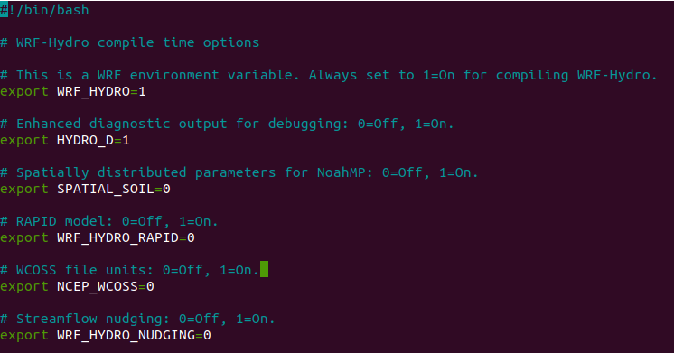
WRF Hydro – Compilación
tar -xvzf WRF-4.1.2.tar.gz
mv WRF-4.1.2 WRF
tar -xvzf wrf_hydro_nwm_public-5.1.2.tar.gz
cd WRF/
rm -r hydro/
cp -r ../wrf_hydro*/trunk/NDHMS hydro
cd hydro/template/
nano setEnvar.sh
source WRF/hydro/template/setEnvar.sh
./configure 34 1
./compile em_real
tar -xvzf WPS-4.1.tar.gz
mv WPS-4.1 WPS
./configure 3
./compile

Slide 11
WRF Hydro – Compilación
Update LD_LIBRARY_PATH and PATH
export LD_LIBRARY_PATH=/home/mzapata/WRFHYDRO_COUPLED/Libs/NETCDF/lib:$LD_LIBRARY_PATH
export LD_LIBRARY_PATH=/home/mzapata/WRFHYDRO_COUPLED/Libs/grib2/lib:$LD_LIBRARY_PATH
export PATH=/home/mzapata/WRFHYDRO_COUPLED/Libs/MPICH/bin:$PATH
export PATH=/home/mzapata/WRFHYDRO_COUPLED/Libs/grib2/lib:$PATH
Fix libraries errors and mpirun binaries (modify ~/.bashrc):

Slide 12
Descargar y descomprimir
https://github.com/NCAR/wrf_hydro_nwm_public/releases/download/v5.1.2/front_range_CO_example_testcase_coupled.tar.gz
tar -xvzf fron_range_CO_example_testcase_coupled.tar.gz
Ejecutar WPS
mkdir run/wps/
Run Geogrid using example_case_coupled/namelist.wps
Run Ungrib and Metgrid using example_case_coupled/WRF_FORCING
Ejecutar ARW
mkdir run/arw/
cp <path_compile_model>/run/* run/arw, cp <path_compile_model>/hydro/template/*.TBL run/arw
cp example_case_coupled/namelist.input hydro.amelist run/arw/
cp run/wps/geo_em* run/arw/ cp run/wps/geo_em* run/arw/
cp –r example_case_coupled/DOMAIN run/arw/
<path_compile_model>/main/real.exe
mpirun –np 6 <path_compile_model>/main/wrf.exe

Slide 13
WRF – Hydro Pre-Processing
git clone https://github.com/NCAR/wrf_hydro_gis_preprocessor.git
python Build_Routing_Stack.py
-i /Volumes/phd_data/workshop/hydro_exm/wps/geo_em.d01.nc
-d /Volumes/phd_data/workshop/hydro_exm/wps/magdalena_hydro_dem.tif
-R 4 -t 20 -o magdalena_test.zip
Required Parameters
-i -WRF/WPS GEOGRID file (geo_em.d0*.nc)
-d -High-resolution Elevation raster file (Esri GRID, GeoTIFF, VRT, etc.).
-R -Regridding Factor – nesting relationship of routing:land surface model grid cells.
-t -Minimum basin area threshold (in routing grid cells).
-o -Output ZIP File containing all script outputs.
https://github.com/NCAR/wrf_hydro_gis_preprocessor/tree/master

Slide 14
WRF Hydro – hydro.namelist
!!!! SYSTEM COUPLING !!!!
!Specify what is being coupled with WRF-Hydro: 1=HRLDAS, 2=WRF, 3=NASA/LIS, 4=CLM
sys_cpl = 1
!!!! MODEL INPUT DATA FILES !!!
!Specify land surface model gridded static input data file...(e.g.: "geo_em.d03.nc")
GEO_STATIC_FLNM = "./DOMAIN/geo_em.d01_dfw_lsm500m.nc"
!Specify the static high-resolution routing terrain input data file...(e.g.: "Fulldom_hires_hydrofile.nc")
GEO_FINEGRID_FLNM = "./DOMAIN/Fulldom_hires_c4_1_rt100m_acc2.nc"
!Specify the name of the restart file if starting from restart...comment out with '!' if not...
!RESTART_FILE = 'HYDRO_RST.2019-04-22_10:00_DOMAIN1'

Slide 15
WRF Hydro – hydro.namelist
!!!! MODEL SETUP AND I/O CONTROL !!!!
!Specify the domain or nest number identifier...(integer)
IGRID = 1
!Specify the restart file write frequency...(minutes, value of -99999 provides monthly restart files)
rst_dt = -99999
! rst_dt = 1
!CASA: out_dt = 1 min
!Specify the output file write frequency...(minutes)
out_dt = 1440 ! minutes
!Specify the number of output times to be contained within each output history file...(integer)
! SET = 1 WHEN RUNNING CHANNEL ROUTING ONLY/CALIBRATION SIMS!!!
! SET = 1 WHEN RUNNING COUPLED TO WRF!!!
SPLIT_OUTPUT_COUNT = 1

Slide 16
WRF Hydro – hydro.namelist
!Switch to overwrite the restart or initialization of soil variables with values from the routing restart file (=0-no reset, 1-yes reset using routing restart)
rst_typ = 0
!Switch to set restart accumulation variables = 0 (0-no reset, 1-yes reset to 0.0)
RSTRT_SWC = 1
!Switches to specify if routing restart files are to be read in/output in a flat binary format (=0 no, 1-yes read/write in binary format)
rst_bi_in = 0 ! read restart in binary format
rst_bi_out = 0 ! output restart in binary format

Slide 17
WRF Hydro – hydro.namelist
!Routing output netcdf file control...(=0 no files written, =1 files are written) here I turned everything to 1
CHRTOUT_DOMAIN = 1 ! Netcdf point timeseries output at all channel points
CHRTOUT_GRID = 1 ! Netcdf grid of channel streamflow values
LSMOUT_DOMAN = 1 ! Netcdf grid of variables passed between LSM and routing components
RTOUT_DOMAIN = 1 ! Netcdf grid of terrain routing variables on routing grid
output_gw = 1 ! Netcdf grid of groundwater-baseflow bucket information
outlake = 1 ! Netcdf point timeseries output of lake information
!Specify the minimum stream order to output to netcdf point file...(integer)
!Note: lower value of stream order produces more output.
order_to_write = 4

Slide 18
WRF Hydro – hydro.namelist
!!!! PHYSICS OPTIONS AND RELATED SETTINGS !!!!
!Switch for terrain adjustment of incoming solar radiation: 0=no, 1=yes
!Note: This option is not yet active in Verion 3.0...
! WRF has this capability so be careful not to double apply the correction!!!
TERADJ_SOLAR = 0
!Specify the grid spacing of the terrain routing grid...(meters)
DXRT = 100 (Importante modificar)
!Specify the integer multiple between the land model grid and the terrain routing grid...(integer)
AGGFACTRT = 5
!Specify the routing model timestep...(seconds)
DTRT = 1
sk_iDTFRAC = 1
sk_fRETDEPRTFAC = 1
sk_fOVRGHRTFAC = 1
! SKIM REFKDT is in GENPARAM.TBL

Slide 19
WRF Hydro – hydro.namelist
!Switch activate saturated subsurface routing...(0=no, 1=yes)
SUBRTSWCRT = 1
!Switch activate surface overland flow routing...(0=no, 1=yes)
OVRTSWCRT = 1
!Switch to specify channel routing Routing Option: 1=Seepest Descent (D8) 2=CASC2D
rt_option = 1
!Switch to activate channel routing option...((0=no, 1=yes)
CHANRTSWCRT = 1
!Switch specify channel routing option: 1=Muskingam-reach, 2=Musk.-Cunge-reach, 3=Diff.Wave-gridded
channel_option =3
!Specify the reach file for reach-based routing options...(Only req'd for channel_options 1&2)
route_link_f = ""

Slide 20
WRF Hydro – hydro.namelist
!Switch to activate baseflow bucket model...(0=none, 1=exp. bucket, 2=pass-through)
GWBASESWCRT = 0
!Specify baseflow/bucket model initialization...(0=cold start from table, 1=restart file)
GW_RESTART = 0
!Groundwater/baseflow mask specified on land surface model grid...(Only required if baseflow bucket model is active)
gwbasmskfil = "./DOMAIN/baseflow_mask.txt"
/

