Slide 1
Parametrizaciones físicas

Slide 2
RECAP
Gridded Terrestrial data:
MODIS
USGS
Geogrid
Metgrid
Real
ARW-Model
Gridded Meteorological data:
Global Forecast System
Final Analysis
ERA5 – ERA interim
Ungrib
WRF Pre-processing System (WPS)
Post Procesamiento

Slide 3
DUDAS ?

Slide 4
¿Por qué parametrizar?
Las parametrizaciones aproximan los procesos físicos que ocurren a pequeña escala, son de alta complejidad, o con pobre conocimiento para ser representado de manera explícita en un NWP. Para simplificar dichos procesos es necesario incluir algunos parámetros.
Microfísica de nubes.
Radiación de onda larga y corta.
Capa límite.
Interacción suelo-vegetación-atmósfera.
Cumulus

Slide 5
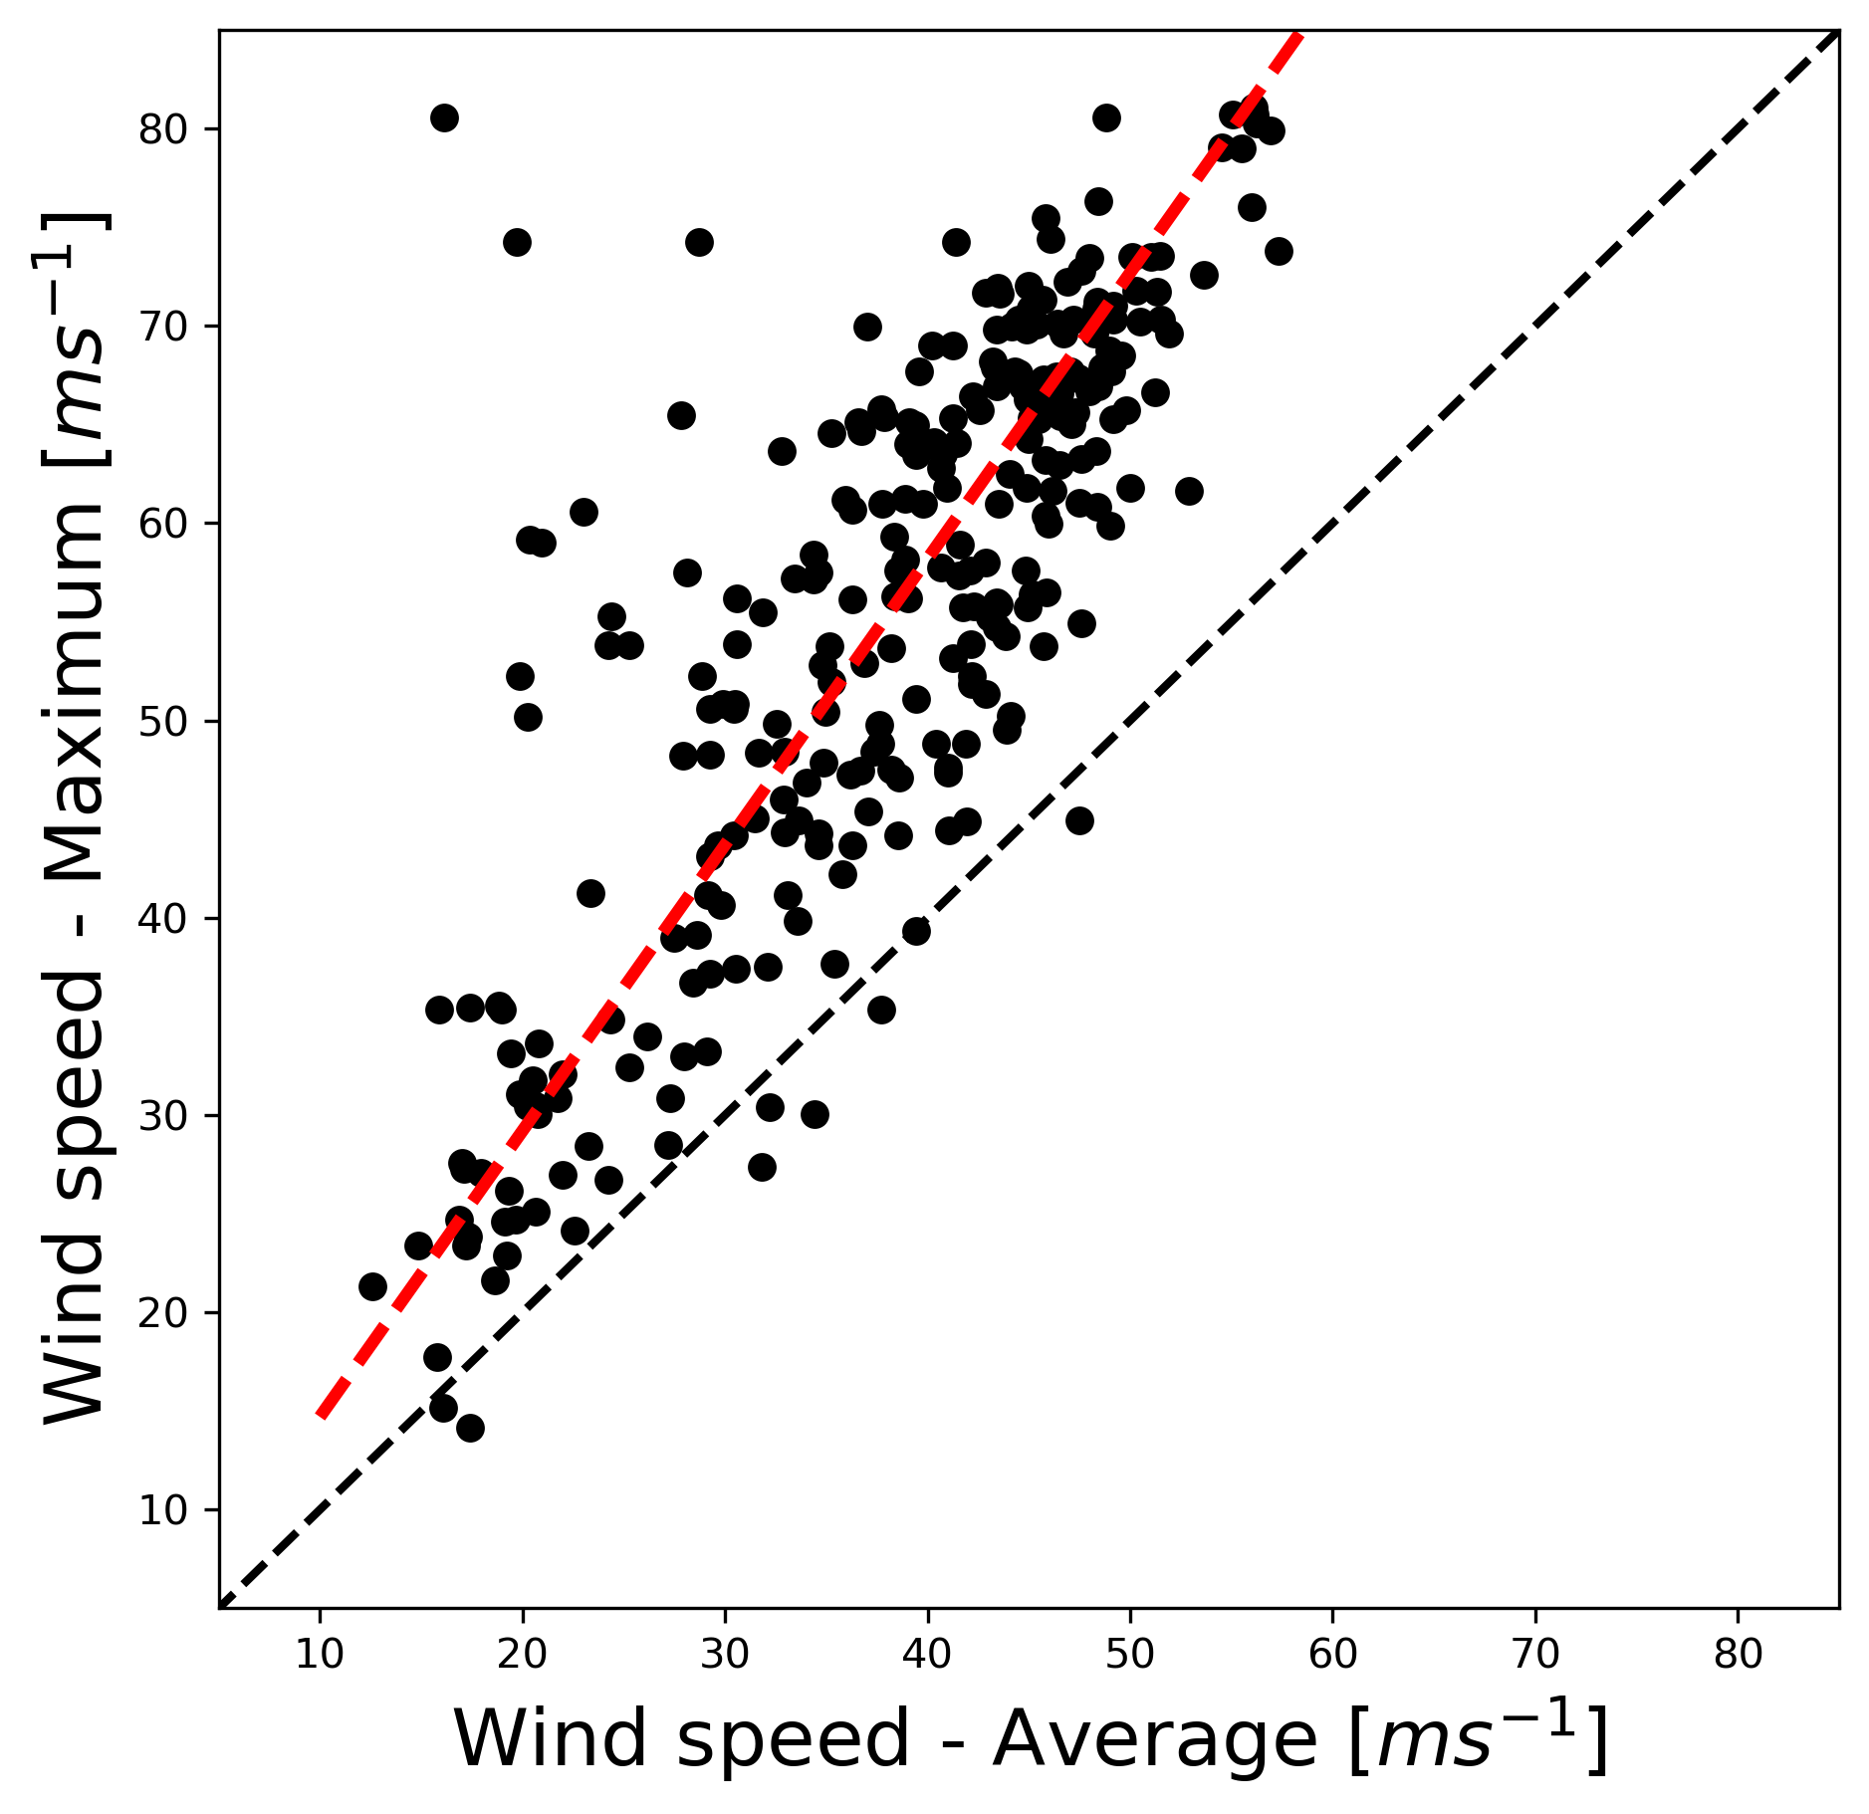
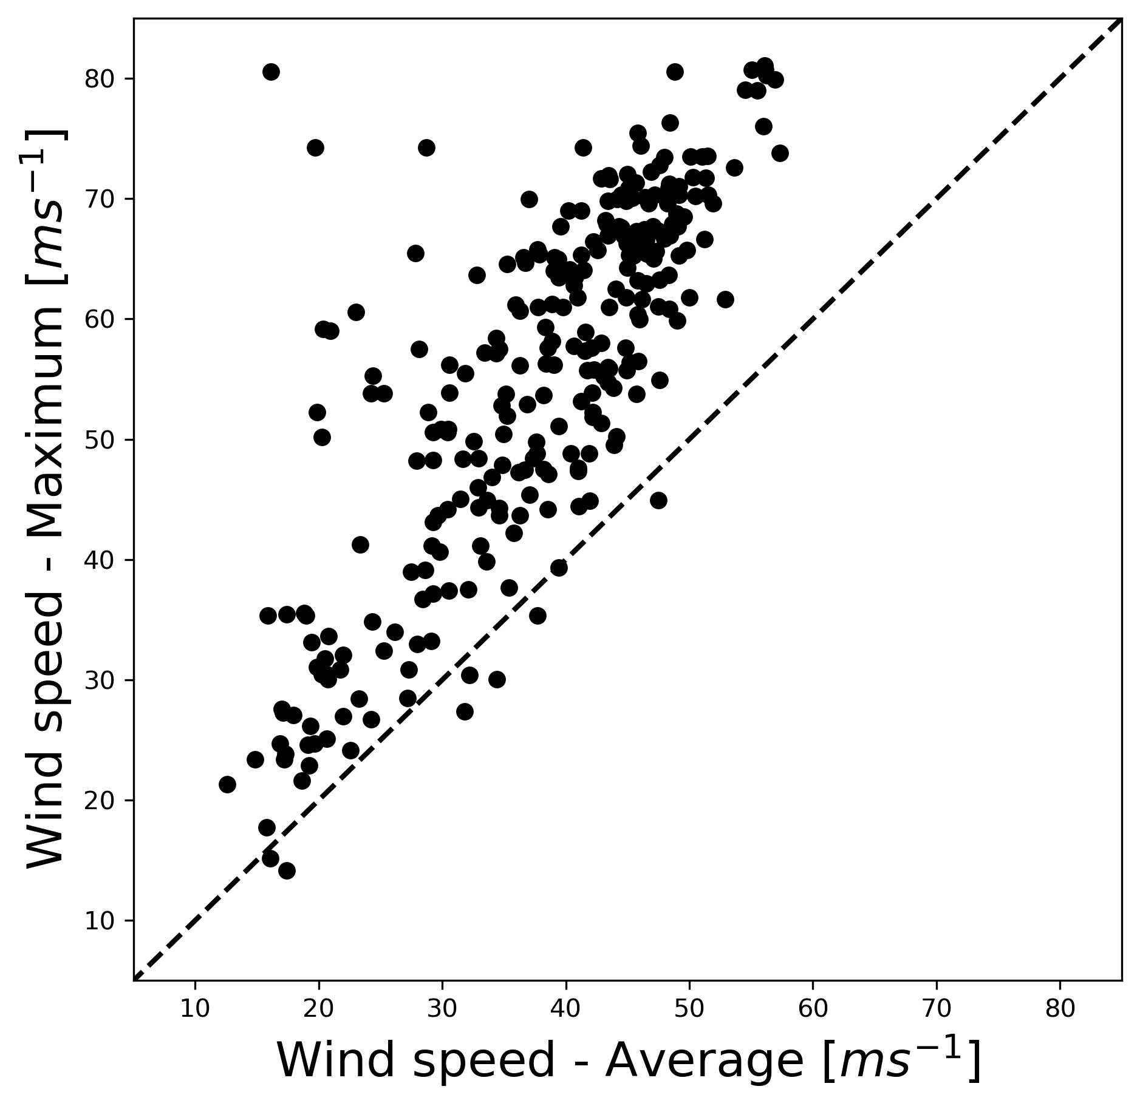
¿ Que es una parametrización - Ejemplo ?
¿Cuál es la relación entre la velocidad del viento medio (6 horas ) y las ráfagas de viento máximo de 5 minutos?
$$W_{max}=f(W_{mean})$$
W_{max}
W_{mean}
Parametrización:
m y b son parámetros
$$W_{max}=m{∗W}_{mean}+b$$

Slide 6
Resultados de mi primera parametrización

Slide 7
WRF Parametrizaciones Físicas
Radiación
Longwave (ra_lw_physics)
Shortwave (ra_sw_physics)
Surface interaction
Land surface models (sf_surface_physics)
Ocean surface
PBL (bl_pbl_physics)
Cumulus (cu_physics)
Microphysics (mp_physics

Slide 8
Interaction Between parametrizations
Cloud Deintraiment
Microphysics
Cumulus
Cloud Effects
Entrainment
Flux mass
Radiation
PBL
Non Convective Rain
Convective Rain
Emission
Albedo
Surface Fluxes
Downward SW LW
Surface
Surface: T, W and Q
LSM
Land
mask
Ocean

Slide 9
Surface Parametrization
Atmosphere
Land Surface
Ocean
Land Surface
Impacto de la ocurrencia del paso de huracanes en la dinámica oceánica
Impacto de estos cambios en los acumulados de precipitación
Pronóstico de huracanes en el Caribe basado en los resultados del modelo acoplado
Atmosphere
Atmosphere
Escenarios teóricos de uso del suelo y topografía
Coupler OASIS
Surface
Ocean
A simple slab ocean ML module is activated. The MLD is 50m depth
Land Surface Models (LSM)
NOAH-LSM
Rapid Update Cycle
Thermal Diffusion

Slide 10
Land Surface Models

Slide 11
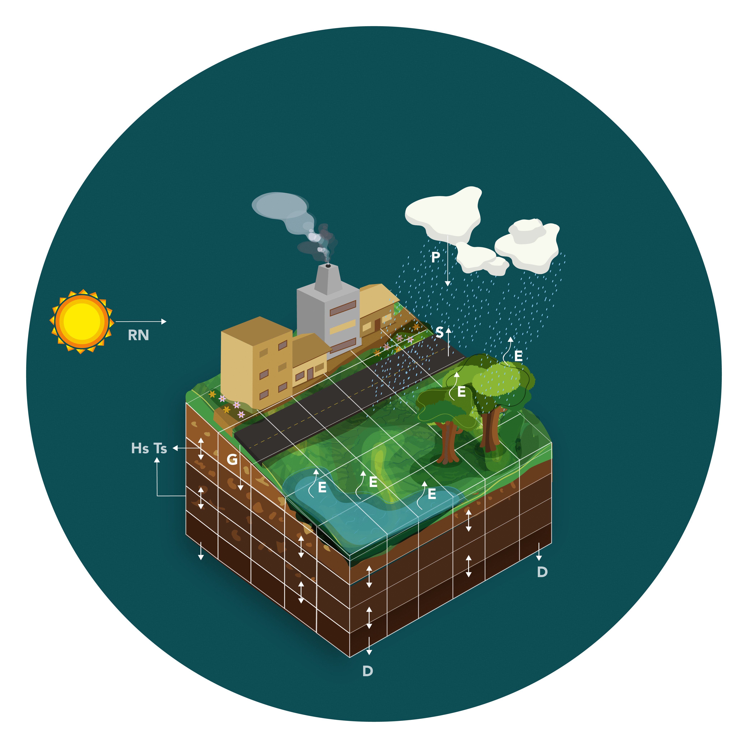
Land Surface or LSM (sf_surface_physics)
Parametrización encargada de cuantificar los intercambios de masa, energía y momentum entre la superficie de la tierra y la atmósfera.
Variables de pronóstico:
Flujo de Calor sensible
Flujo de Calor latente
Temperatura del suelo (Diferentes capas)
Humedad del suelo (Diferentes capas)

Slide 12
Ecuaciones – Balance de energía
Método de las diferencias potenciales. Transpiración e definida por:
Resistencia estomática: Cantidad de agua que dejan escapar
Número de raíces: Cantidad de agua disponible
$$E_{g}=(1−veg)\frac{ρ (e(T_{g})−e(T_{a}))}{r_{a}}$$
Evapotranspiración
$$E=E_{g}+E_{tr}+E_{v}$$
Flujo de energía al interior del suelo
$$\frac{∂G}{∂t}=R_{n}−H−λE$$
$$E_{g}=Suelo desnudo$$
$$E_{tr}=Transpiracion$$
$$E_{v}=Vegetacion$$
$$Veg=Factor de sombra$$
$$e=Presion de vapor$$
$$E_{v}=veg\frac{ρ (e(T_{g})−e(T_{a}))}{r_{a}}$$
La radiación neta puede ser un dato de entrada suministrado por un modelo radiativo (Parametrización) o se puede proponer un modelo sencillo
Radiación
Neta
$$ρ=Densidad del aire$$
$$C_{p}=Calor especifico del aire$$
$$V_{a}=Velocidad del aire$$
$$r_{ga}=Resistencia aerodinamica$$
$$T=Temperatura$$
$$H=Flujo de Calor Sensible$$
Flujo de Calor sensible
$$H=\frac{ρC_{p}V_{a}(T_{a}−T_{g})}{r_{ga}}$$
$$R_{n}=R_{s}\left(1−α\right)+ε_{a}σT_{a}^{4}−∈_{g}σT_{g}^{4}$$
$$α=Albedo$$
$$R_{s}=Emitida por el Sol$$
$$∈_{a}T_{a}=Emisividad y temperatura atmos$$
$$∈_{g}T_{g}=Emisividad y temperatura sfc$$
$$σ=Constante SB$$
Método de las diferencias potenciales. Separan el flujo de calor sensible entre el suelo (g) y el aire (a) y el flujo de calor sensible entre la vegetación (v) y el aire (a)

Slide 13
Ecuaciones – Balance de agua
Mismo enfoque Balance de energía
$$W_{max}=0.2vegLAI$$
Modelo de tanque cuya capacidad máxima es el único parámetro, al cual llamaremos W_{max}
Almacenamiento de humedad del suelo
Evapotranspiración
Escorrentía en la superficie de las hojas
$$D=vegP−E_{v}$$
$$\frac{∂S}{∂t}=P−R−E+D$$
$$θ=Contenido de Humedad$$
$$K=Conductividad Hidraulica$$
$$B=Constante \left(Tipo suelo\right)$$
$$D=Escorrentia Vegetacion$$
$$LAI=leaf area index$$
Forzador
Precipitación
No interceptada
Escorrentía superficial
$$R={max⁡(0,P+D−E}_{g})$$
Los autores suponen que la cantidad de agua de escorrentía desemboca finalmente en el mar por la red de drenaje, sin tener en cuenta la interacción de este exceso de agua con el suelo por donde escurre
$$K=θ^{2b+3}$$
Cuando el tanque se llena o llega al punto de saturación el exceso de agua queda disponible para ser evaporada y lo que sobra se convierte en escorrentía superficial
Modelo de un único tanque cuyos parámetros son la porosidad del suelo o humedad de saturación

Slide 14
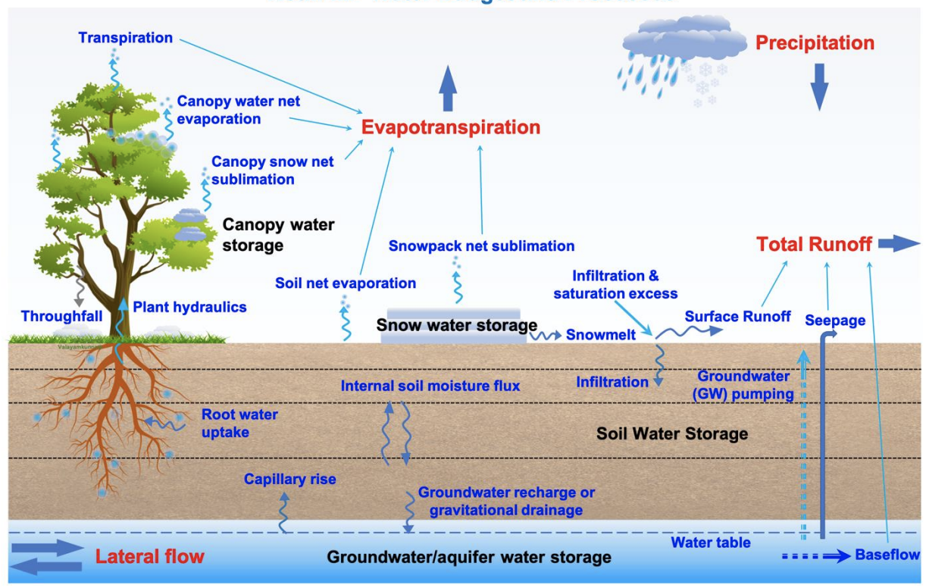

Slide 15
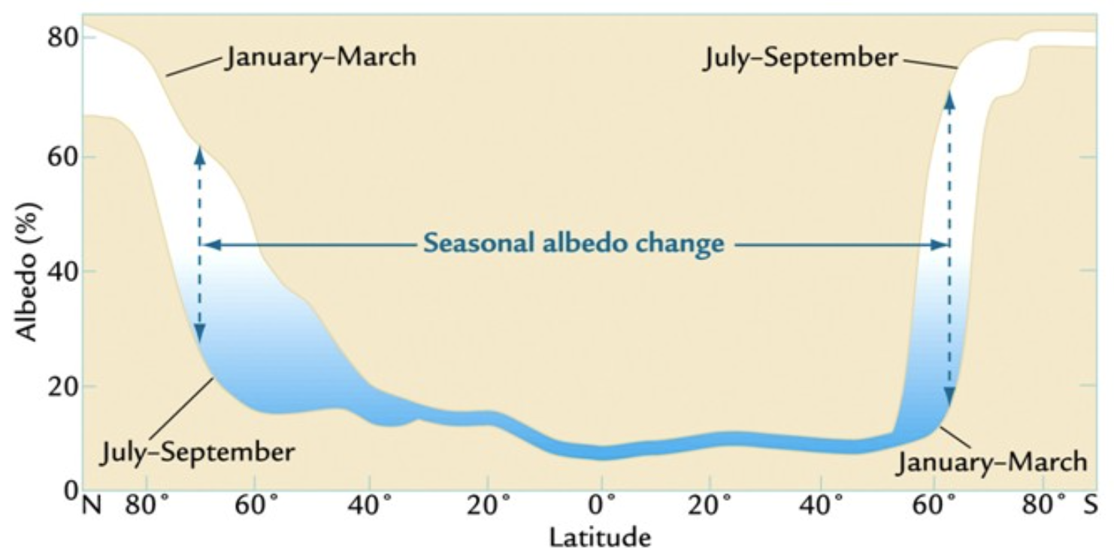
Seasonal Albedo change

Slide 16
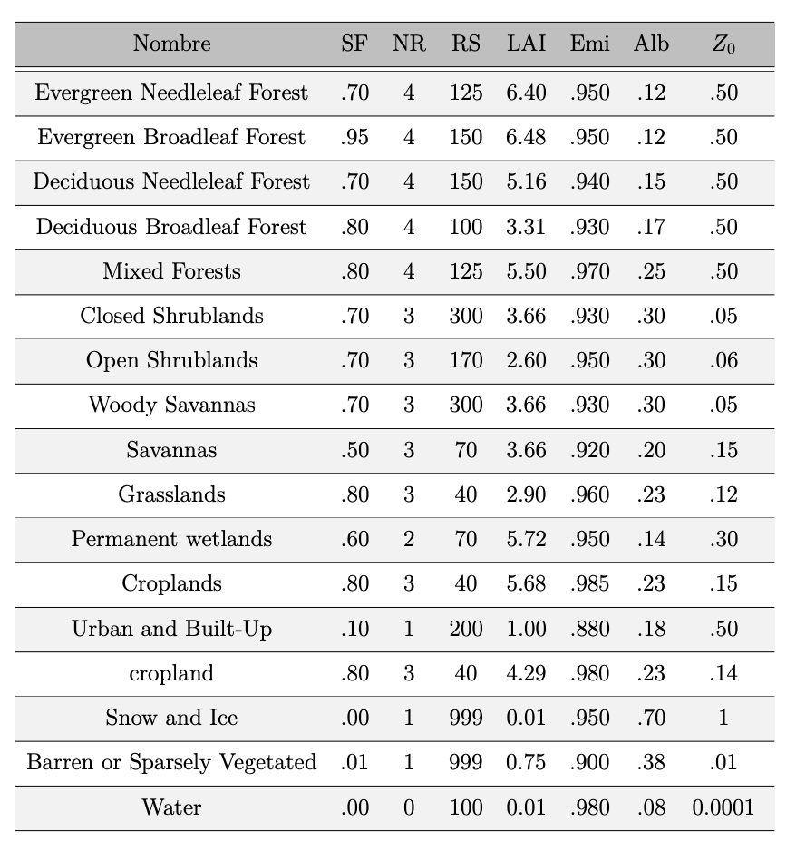
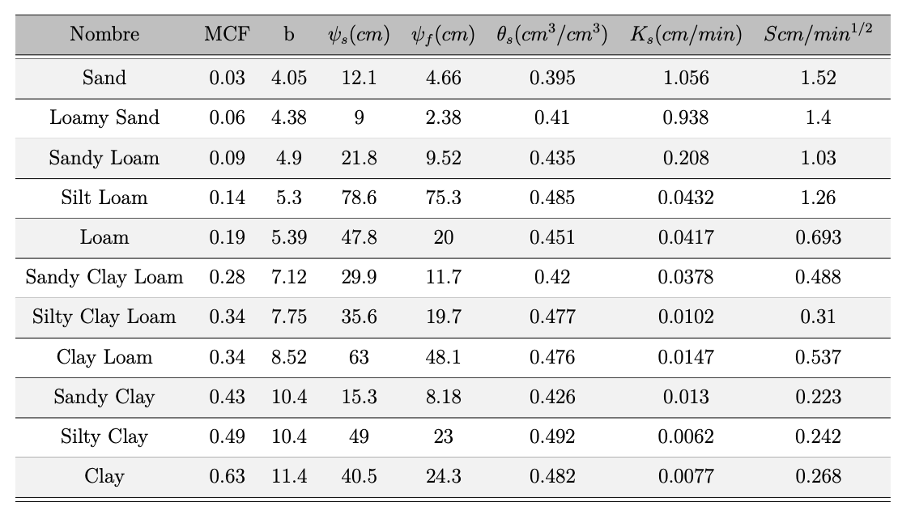
Parametros – Land Surface models
Parámetros Tipo de suelo **
** Los tipos de suelo sin son representativos de la región ?
Parámetros Uso del suelo

Slide 17
Diferencias entre parametrizaciones
Name | Reference | Layers | Forecast | Veg | Urban | Nieve
Themal Diffusion | Dudhia (1996) | 5 | 5
Pleim-Xiu | Xiu and Pleim (2001) | 2 | 5 | x
Rapid Update Cycle | Smirnova and Brown (1996) | 6 | 13 | x
Noah-LSM | Niu et al (2011) | 4 | 10 | x | x** | x
** Modificaciones en los parámetros asociados al suelo urbano, el tratamiento no es muy detallado

Slide 18
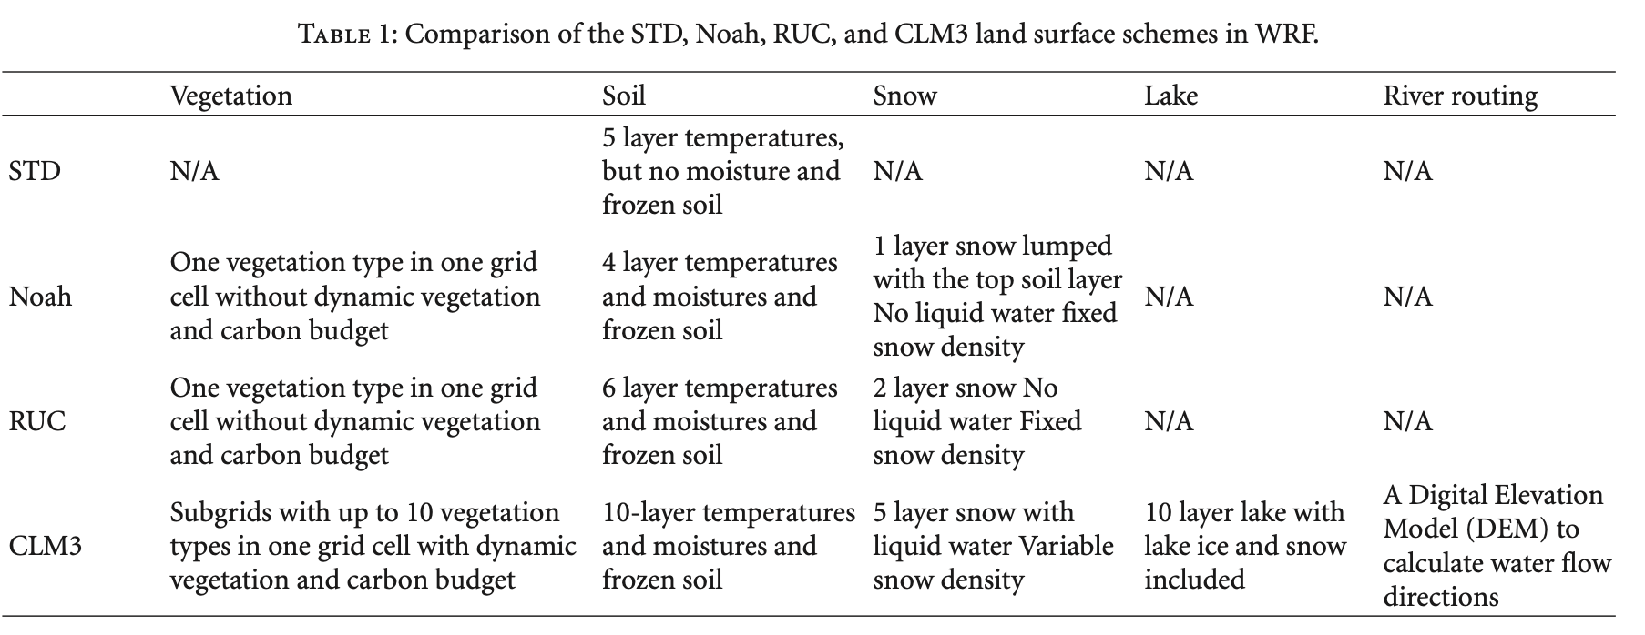
Diferencias entre parametrizaciones
** Without Dynamic vegetation and Carbon Budget

Slide 19
Ocean Model Options

Slide 20
Ocean options – No parametrization (Boundary)
29-Aug-2010
30-Aug-2010
31-Aug-2010
01-Sep-2010
SST Anomalies comparison: WRF Boundary from ERA5, CPL from CROCO

Slide 21
Ocean options – No parametrization (Boundary)
29-Sep-2016
01-Oct-2016
03-Oct-2016
04-Oct-2010
SST Anomalies comparison: WRF Boundary from ERA5, CPL from CROCO

Slide 22
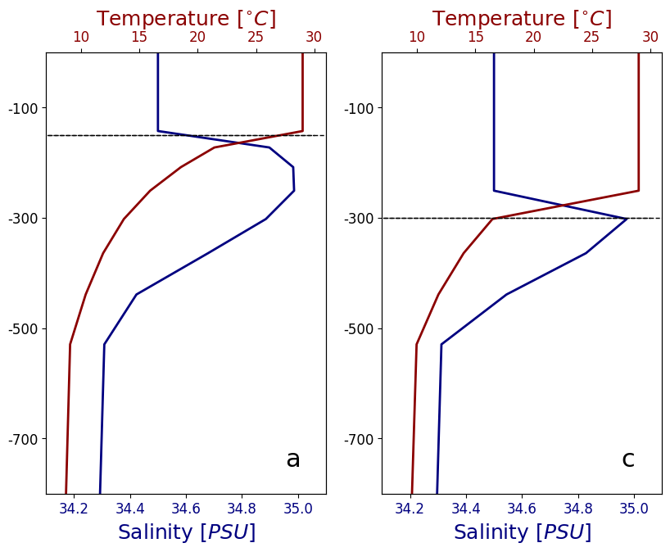
Ocean options – 1D Slab ocean mixed layer
When the surface layers of the ocean are heated during a period of calm, a marked temperature gradient may form all the way to the surface. If a wind then blows, the upper layer is stirred to form an almost homogeneous layer, with a sharp density gradient below it. We shall consider the motion of this layer, of depth h, assuming that it is well-mixed and moves as a slab, i.e., the horizontal velocity (u,v) and temperature T’

Slide 23
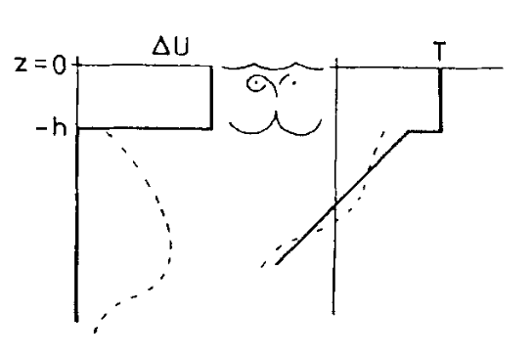
Ocean options – 1D Slab ocean mixed layer
$$i)\frac{∂(hu)}{∂t}−f\left(hv\right)=\frac{τ_{x}}{ρ} ii)\frac{∂(hv)}{∂t}+f\left(hu\right)=\frac{τ_{y}}{ρ}$$
$$iii)\frac{∂(hT)}{∂t}+\frac{∂}{dt}(0.5Γh^{2})=\frac{Q}{ρ}$$
$$u, v:Ocean speed in the mixed layer$$
$$T:Ocean temperature in the mixed layer$$
$$h:Mixed layer depth$$
$$f:Coriolis$$
$$τ_{x},τ_{y}:Wind stress$$
$$Q:Heat flux \left(Q_{l},Q_{s}, Q_{n}\right)$$
$$ρ:Ocean density$$
Schematic of the mixed-layer model. Heavy lines, mean velocity Au and mean temperature T, (Pollard, 1972)

Slide 24
Ocean options – 1D Slab ocean mixed layer
Algunos problemas de la parametrización:
No tiene en cuenta el ingreso de masas de agua (Masas de agua con menor temperatura y con mayor concentración de sal ) por debajo de la capa de mezcla, la temperatura solo es modificada por el flujo de energía en el océano.
No tiene en cuenta la advección de Calor.
No hay cambios en la rugosidad asociada al oleaje.
No tiene en cuenta en el efecto de la termoclina.
Solución
Modelo acoplado (Cuando sea necesario)

Slide 25
Coupling process sketch WRF-OASIS-CROCO
Wind Stress, E-P, R_{N}, LH, SH
Atmosphere
WRF
Ocean
CROCO
Coupler Oasis-MCT
SST
Atmosphere
boundary conditions
Oceanic
boundary conditions
$$Δt_{a}$$
$$Δt_{a}$$
$$Δt_{a}$$
$$Δt_{c}=600s$$
WRF
$$Δt_{c}=600s$$
WRF
CROCO
CROCO
$$Δt_{o}$$
$$Δt_{o}$$

Slide 26
Planetary Boundary Layer

Slide 27
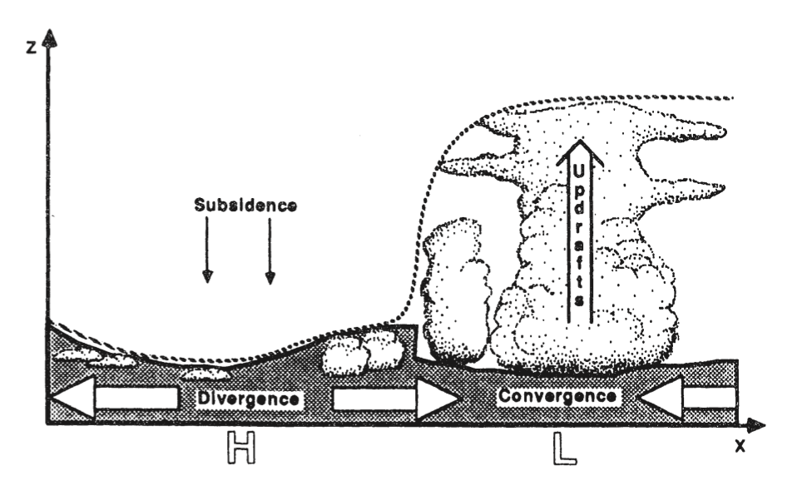
PBL – Planetary Boundary Layer
We can define the boundary layer as that part of the troposphere that is directly influenced by the presence of the earth's surface and responds to surface forcings with a timescale of about an hour or less (Stull, 1988).
Schematic of synoptic - scale variation of boundary layer depth between centers of surface high (H) and low (L) pressure. The dotted line shows the maximum height reached by surface modified air during a one-hour period. The solid line encloses the shaded region, which is most studied by boudary-Iayer meteonogists.
x

Slide 28
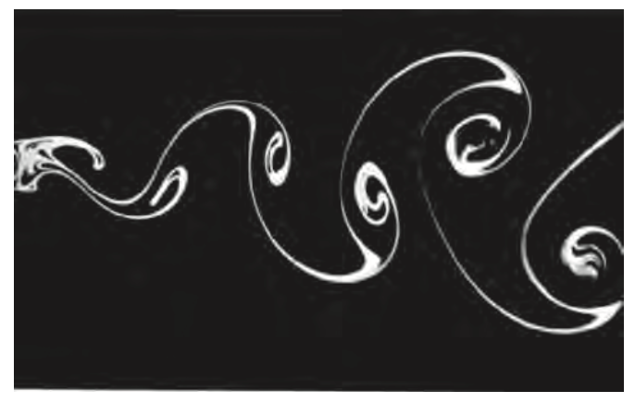
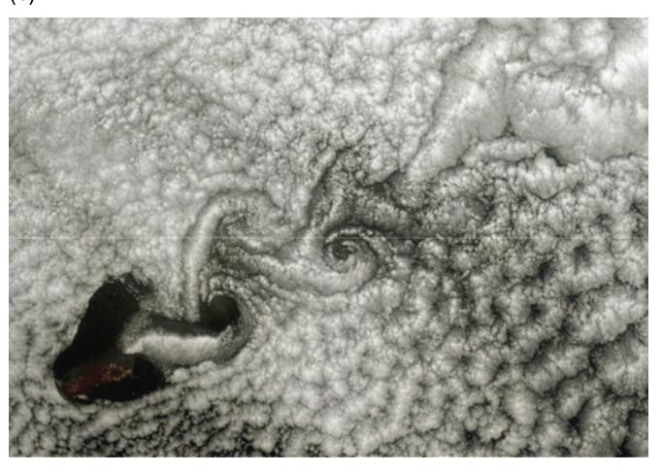
PBL – Planetary Boundary Layer
Turbulence is inspiringly complex, consisting of a superposition of swirls called eddies that interact nonlinearly to create quasi-random, chaotic motions (LES). An infinite number of equations is required to fully describe these motions. Hence, a complete solution has not been found. Turbulence is ubiquitous within the boundary layer and is responsible for efficiently dispersing the pollutants that accompany modern life (Wallace, 2010)
Karman vortex streets in (a) the laboratory, for water flowing past a cylinder [, and (b) in the atmosphere, for a cumulus-topped boundary layer flowing past an island [NASA MODIS imagery].

Slide 29
PBL – Planetary Boundary Layer
Significance of the Boundary Layer:
People spend most of their lives in the PBL.
Daily weather forecasts of dew, frost, and maximum and minimum temperatures are really PBL forecasts.
Pollution is trapped in the PBL
Crops are grown in the PBL. Pollen distributed by boundary layer circulations
Virtually all water vapor that reaches the Free Atmosphere is first transported through the PBL by turbulent and advective processes.
Thunderstorm and hurricane evolution are tied to the inflow of moist BL air.
Wind stress on the sea surface is the primary energy source for ocean currents
Turbulence and gustiness affects architecture in the design of structures.

Slide 30
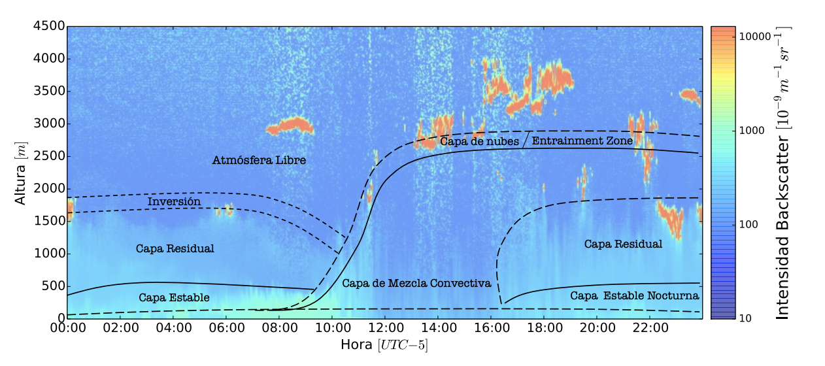
PBL – Planetary Boundary Layer
Sección transversal vertical de la evolución diurna ideal de la CLA sobre la superficie terrestre bajo condiciones de cielo despejado (Herrera, 2015).

Slide 31
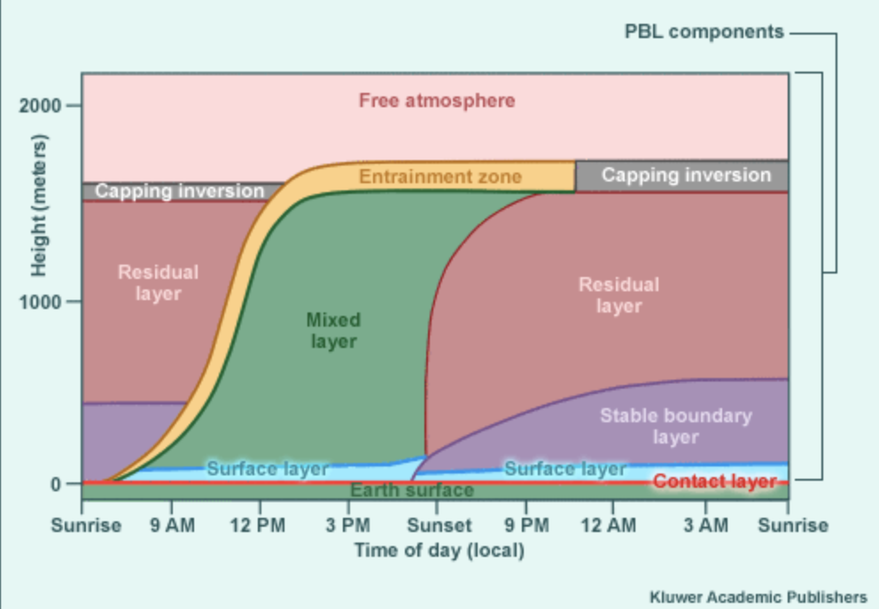
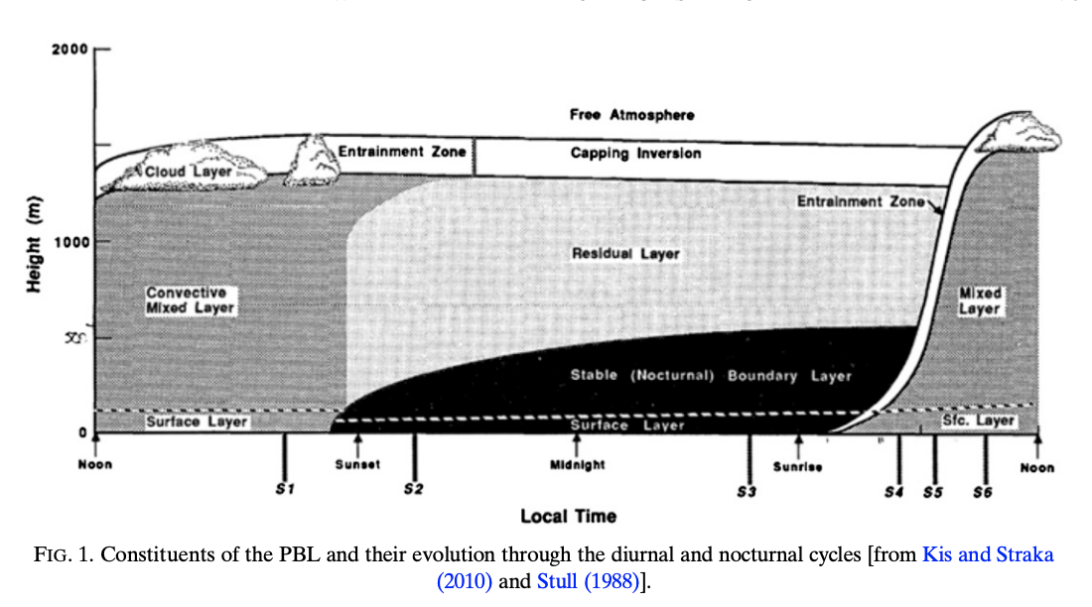
PBL – Planetary Boundary Layer

Slide 32
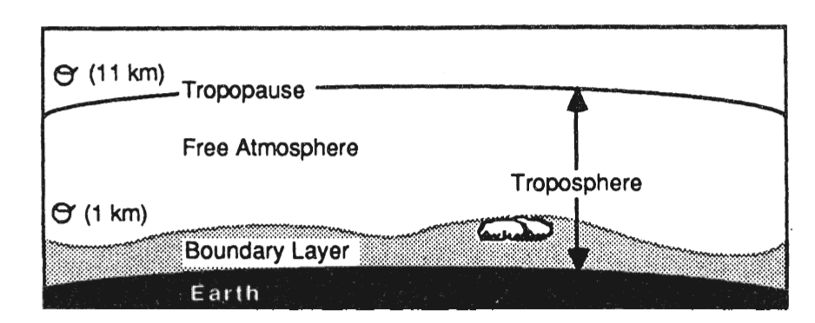
PBL – Planetary Boundary Layer
Capa Limite Atmosférica: capa adyacente a la superficie, fuertemente influenciada por las características del suelo y los procesos de interacción mecánicos y térmicos con la atmósfera.
Atmósfera Libre: cuyos procesos están dominados en gran medida por circulaciones de meso escala y escala sinóptica, impidiendo que los forzamientos a escala local tengan influencia en su dinámica.

Slide 33
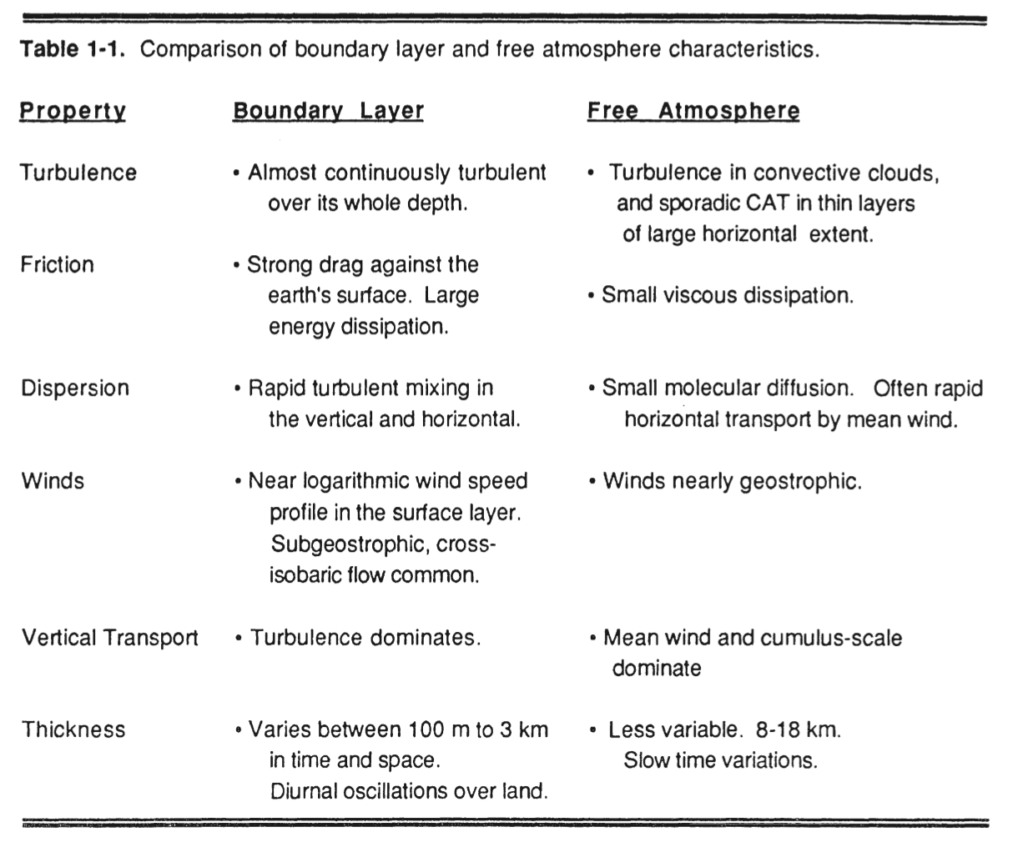
PBL – Planetary Boundary Layer

Slide 34
PBL – Planetary Boundary Layer
Los tres componentes principales de esta estructura son:
la Capa de Mezcla convectiva: En la mañana poco después del amanecer una Capa Convectiva comienza a desarrollarse; a medida que la radiación incidente aumenta, el calentamiento del suelo ocasiona inestabilidad térmica y convección cerca de la superficie, favoreciendo los procesos de mezcla. Sobre esta capa convectiva superficial se comienza a formar la Capa de Mezcla, dominada por movimientos convectivos y turbulencia, y en la cual los intercambios con la atmosfera libre alcanzan su punto máximo.
la Capa Residual: Justo sobre esta capa estable donde la turbulencia ha disminuido, los aerosoles, humedad y calor que fueron mezclados durante el desarrollo de la capa convectiva permanecen suspendidos en una capa remanente llamada Capa Residual.
Capa Estable: A medida que la radiación incidente va disminuyendo, la turbulencia y los flujos de calor sensible se debilitan y la Capa Convectiva se transforma gradualmente en una Capa Estable conocida como la Capa Limite Nocturna.

Slide 35
PBL – Planetary Boundary Layer
Capa de Mezcla convectiva:
Main mode of transport is through turbulence during the day when the surface is hotter than the overlaying atmosphere. Located between the surface layer and the area where dry free-atmosphere air is taken into the PBL. Vertical transports vary and depend upon the size and intensity of turbulent eddies. Has a well-defined top (or cap) characterized by a stable layer/temperature inversion.
Depending upon the model, the height of the PBL top is diagnosed using stability criteria in the bottom-most model layers.
Calculates or prescribes mixing coefficients for each layer between the surface layer and PBL top.
May allow mixing between non-adjacent layers in one time step or may limit mixing to adjacent layers only.
May emulate vertical mixing by small-scale eddies before the large-scale vertical temperature and moisture gradients would otherwise allow (allow for counter-gradient flux).

Slide 36
PBL – Planetary Boundary Layer
Entrainment Zone (EZ)
Area where parcels from the 'free atmosphere' can be brought into the PBL by turbulent mixing.
Not directly emulated, although a transition zone between the PBL and free atmosphere is usually present in NWP models, which may include a stable inversion layer.
Some models use a shallow convective scheme as an extension of the PBL scheme to handle EZ.
If model vertical resolution is too coarse, this may not be captured at all, and the inversion may be missed.

Slide 37
PBL – Planetary Boundary Layer
Residual Layer
The inactive (no new mixing) well-mixed layer remaining after sunset, after the atmosphere decouples from the surface. Any remaining turbulent mixing action becomes negligible shortly after sunset. Retains the characteristics of the daytime mixed layer, changed only by radiative cooling or horizontal advection. Remains until the next day's surface heating "recouples" the surface to the residual mixed layer, resulting in a rapid 'jump' in PBL height.
Usually well emulated as the land-surface decouples from the atmosphere but depends upon the adequacy of the model boundary layer structure.

Slide 38
PBL – Planetary Boundary Layer
Stable Boundary Layer (SBL)
Forms on clear, calm nights and when warmer air moves over colder surfaces. Grows mainly by conduction with air in the contact layer, with additional contribution from radiative cooling. Near sunset, the surface layer, contact layer, and SBL can merge. As night progresses and cooling by conduction from cool surface continues, the surface layer becomes a smaller fraction of the SBL, with constant, typically small and/or negative fluxes of moisture, heat, and momentum. There is no well-defined SBL top, but a gradual transition at the top of the nocturnal temperature inversion.
Estimating rates of conduction from the lowest model layers to the ground, using vertical gradients of temperature, moisture, and momentum.
Usually uses the same scheme as for a mixed layer.

Slide 39
PBL – Planetary Boundary Layer
The representation of turbulent mixing within the lower troposphere is needed to accurately portray the vertical thermodynamic and kinematic profiles of the atmosphere in mesoscale model forecasts. For meso scale models, turbulence is mostly a subgrid-scale process, but its presence in the planetary boundary layer (PBL) can directly modulate a simulation’s depiction of mass fields relevant for forecast problems.
One substantial source of forecast inaccuracy in mesoscale models is the representation of lower- tropospheric thermodynamic and kinematic structures.
Exchanges of moisture, heat, and momentum occur within the PBL through mixing associated with turbulent eddies. Such eddies operate on spatiotemporal scales that cannot be explicitly represented on grid scales and time steps employed in most mesoscale models.
Thus, examining the characteristics among the PBL schemes is a step toward identifying their potential weaknesses that may lead to forecast bias.

Slide 40
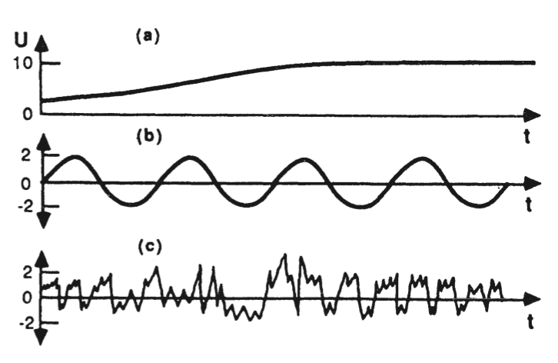
PBL – Planetary Boundary Layer
Major components:
The order of Turbulence Closure: The theoretical development of PBL parameterization schemes requires the decomposition of variables of the equations of motion into mean and perturbation components. The perturbation components represent deviations, or turbulent fluctuations, from the background mean state, which are inherent to turbulent motions within the PBL. Equations pertaining to turbulence modeling will always contain more unknown terms than known terms
Idealization of a) Mean wind alone. (b) waves alone. and (c) turbulence alone.

Slide 41
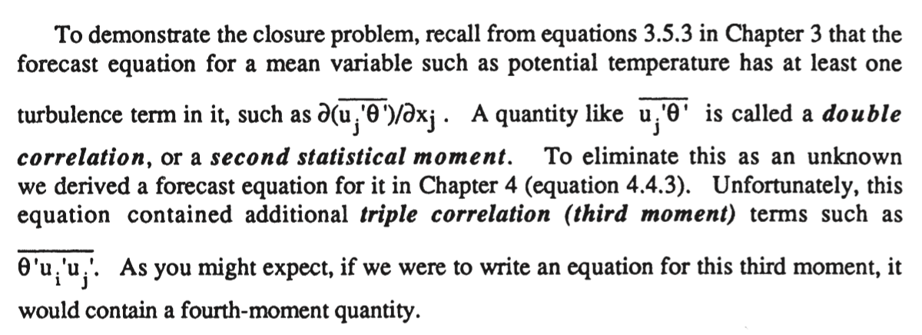
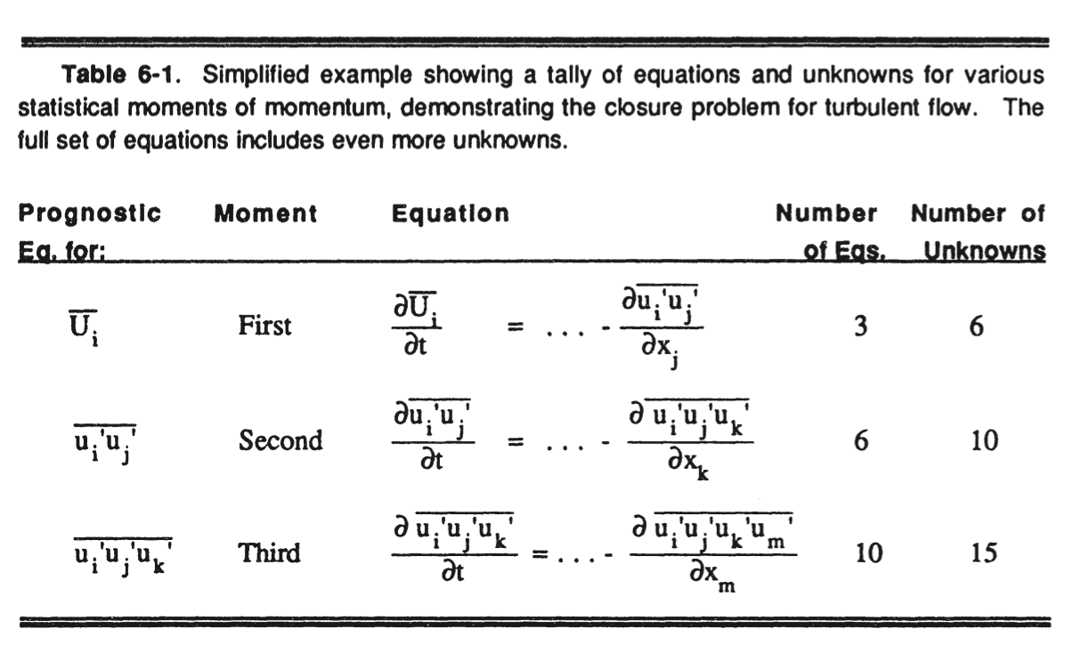
PBL – Planetary Boundary Layer

Slide 42
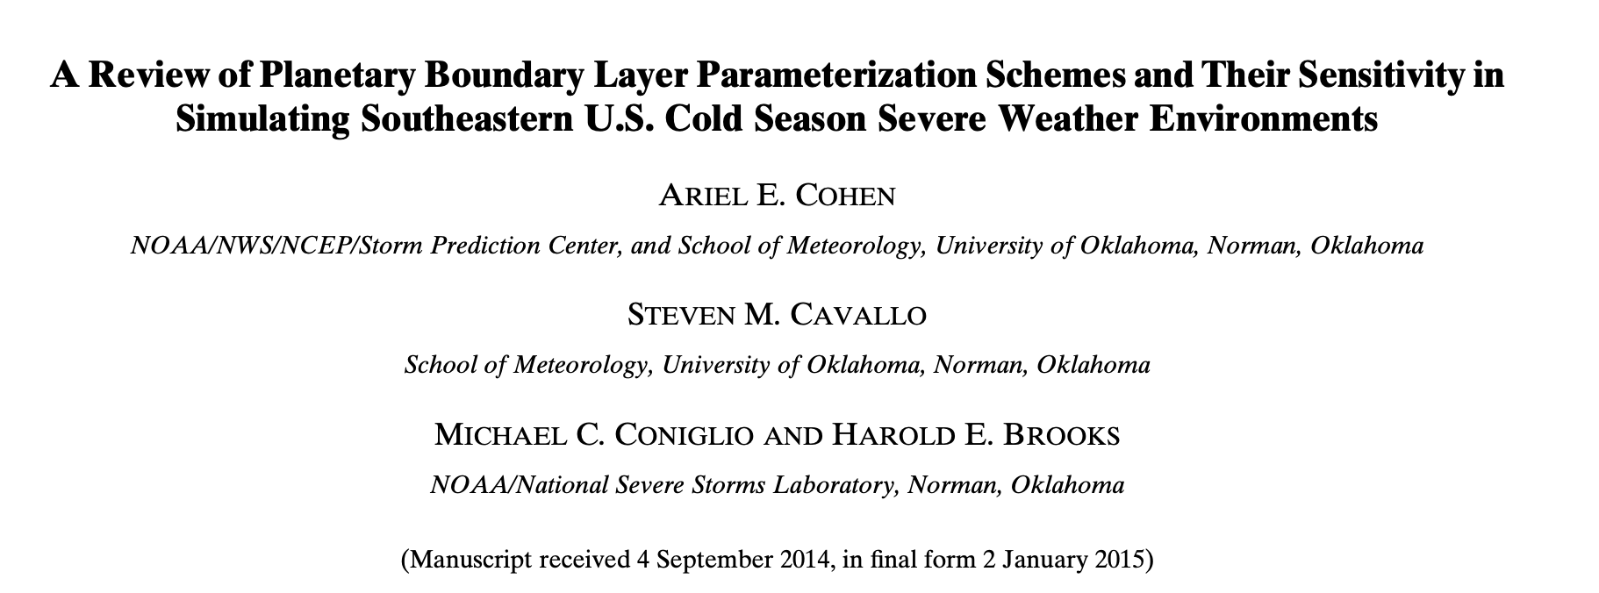
PBL – Planetary Boundary Layer

Slide 43
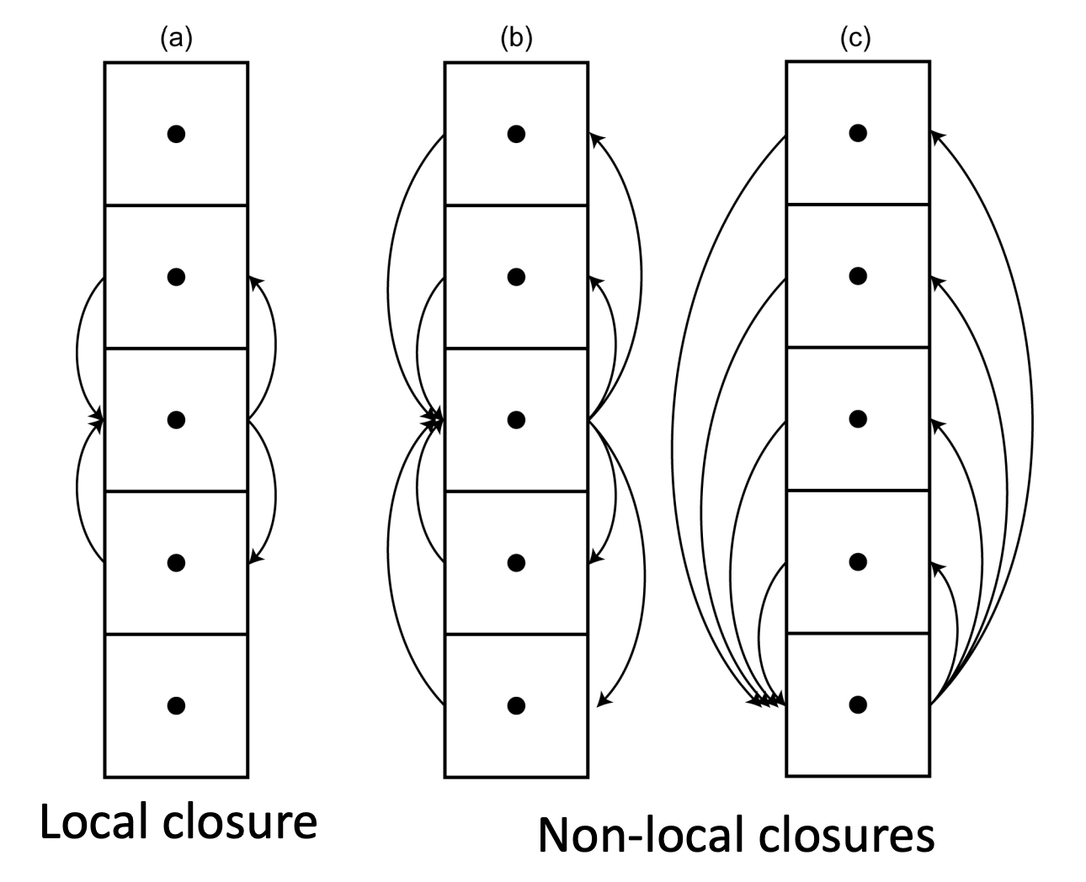
PBL – Planetary Boundary Layer
Major components:
Local versus nonlocal PBL parameterization schemes: One important way that PBL schemes differ is according to the depth over which these known variables are allowed to affect a given point, determined on the sole basis of the vertical gradient of the perturbation quantities at the point and not horizontal gradients.
In the case of local closure schemes, only those vertical levels that are directly adjacent to a given point directly affect variables at the given point.
On the other hand, multiple vertical levels (e.g., those within the PBL) can be used to determine variables at a given point in nonlocal closure schemes.

Slide 44
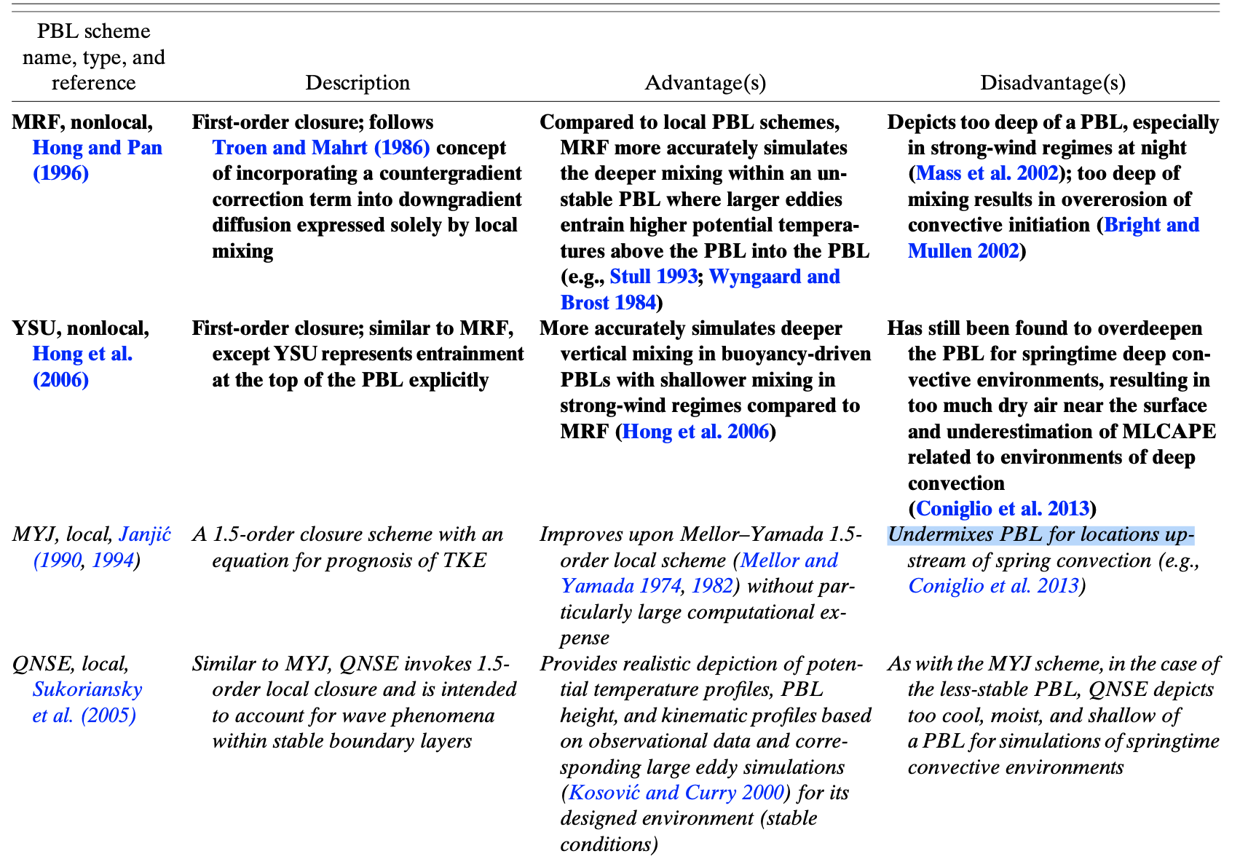
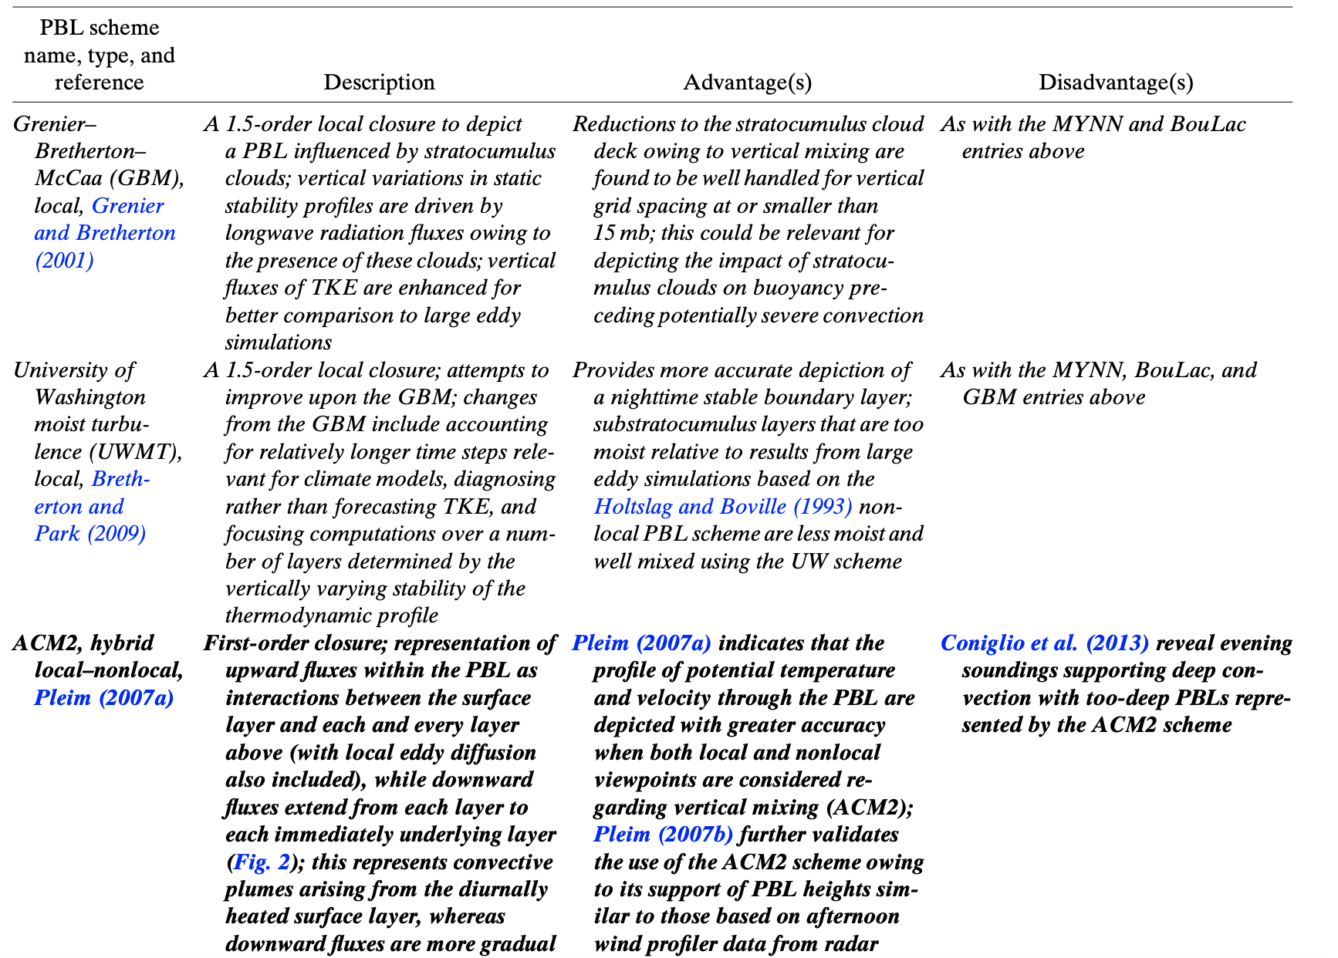
PBL – Planetary Boundary Layer
A Review of Planetary Boundary Layer Parameterization Schemes and Their Sensitivity in Simulating Southeastern U.S. Cold Season Severe Weather Environments

Slide 45
Cumulus

Slide 46
Convection - Cumulus
Convective parameterization (CP) is the method by which models account for convective effects through the redistribution of temperature and moisture in a grid column, which reduces atmospheric instability. By reducing thermodynamic instability, CP prevents the grid-scale microphysics scheme from creating unrealistic large-scale convection and overly active low-level cyclogenesis.
Convective parameterization (CP) schemes are primarily designed to:
Account for the vertical transport of latent heat, which drives the general circulation in the tropics.
Reduce thermodynamic instability so the grid-scale precipitation and cloud parameterization (microphysics) schemes do not try to create unrealistic large-scale convection and overly active low-level cyclogenesis. CP schemes reduce instability by rearranging temperature and moisture in a grid column

Slide 47
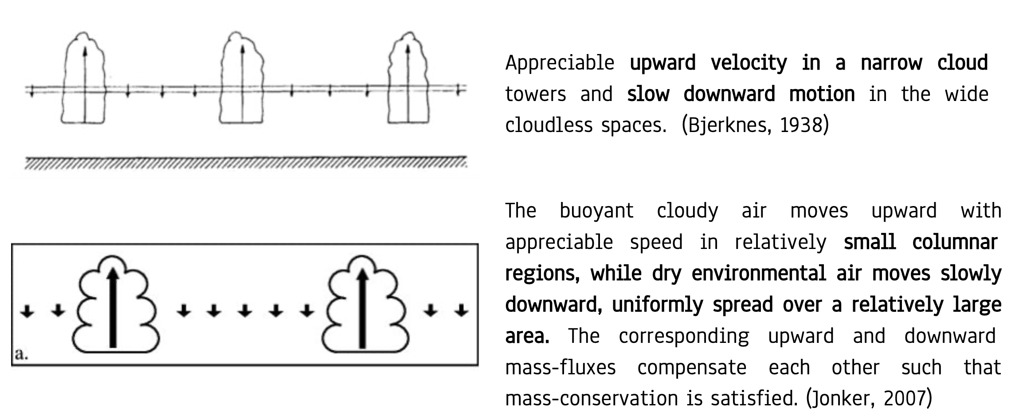
Convection - Cumulus traditional point of view

Slide 48
Convection - Cumulus Accurate point of view

Slide 49
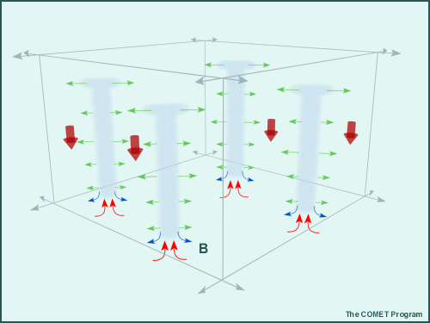
CUMULUS - Explicit Convection

Slide 50
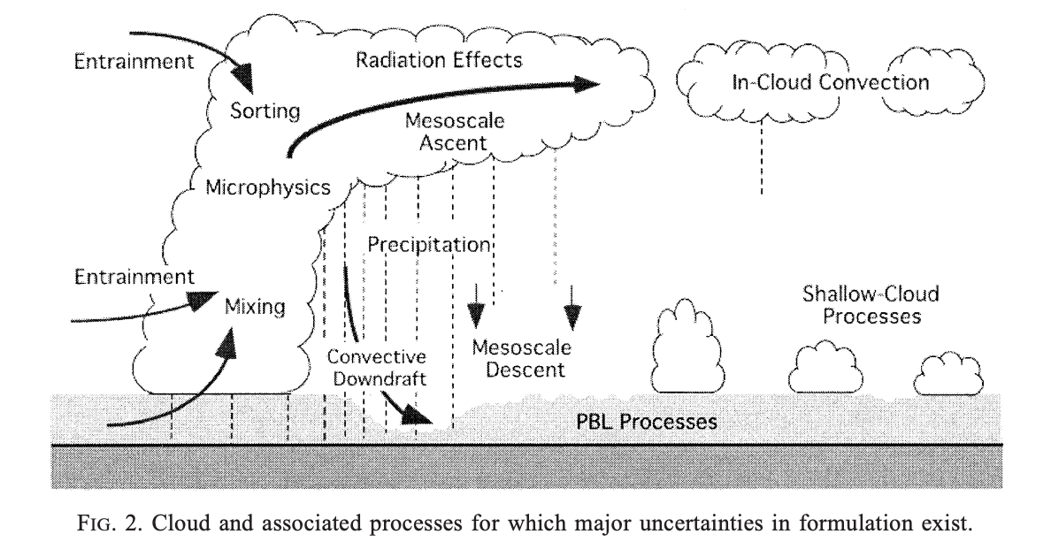
Convection - Cumulus

Slide 51
Convection - Cumulus
Detrainment
Los procesos convectivos en la atmósfera ocurren casi exclusivamente en escalas espaciales más pequeñas que las explícitamente resueltas por los NWP. En consecuencia, para incluir los efectos de la convección en los pronósticos meteorológicos, la ubicación, intensidad y momento de las nubes convectivas, así como la naturaleza de sus interacciones con una escala más grande, deben inferirse implícitamente a partir de variables de mayor escala (Kain and Fritsch, 1990).
Updraft
Downdraft
PBL
Entrainment
Variables de pronóstico:
Surface Sub grid Scale convective Rainfall
Cloud Detrainment
Surface

Slide 52
Convection - Cumulus
Objetivos:
Trigger de la convección: Definir si hay parcelas de aire inestables dentro del pixel, utilizando diferentes técnicas para definir la estabilidad de las parcelas
Transporte de masa debido a la convección: The determination of mass flux and mass detrainment associated with different types and organizations of cumulus updrafts and downdrafts.
Generación de líquido y hielo
Interacción con la capa límite: The mass exchange between the cloud layer and PBL through updrafts and downdrafts. At least in the Tropics, PBL processes are known to be crucial in regulating moist convection above
Interacción con la radiación: Radiation and clouds interact only through grid-scale prognostic variables. Naturally, what we should do is couple radiation and cloud processes on the cloud scale, which is subgrid scale in most climate models
Interacción con el flujo medio (flujo de mayor escala): The transport depends on the degree and geometry of the cloud organization

Slide 53
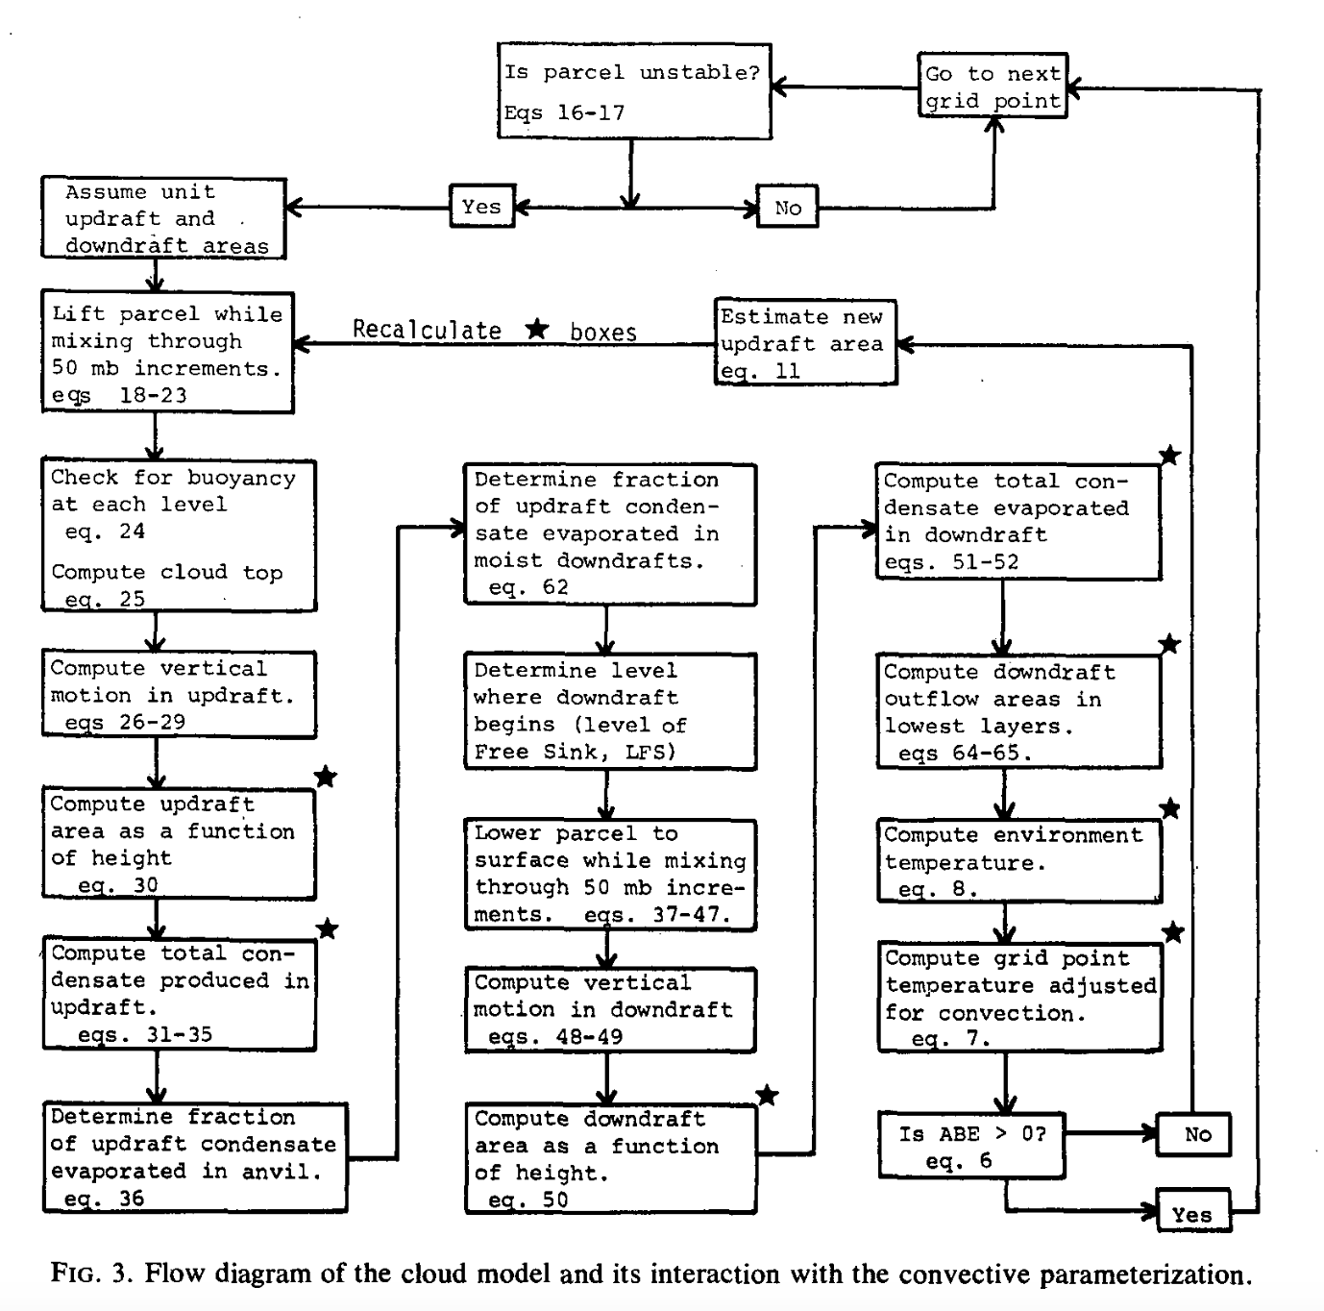
Convection - Cumulus
La parametrización de Cumulus puede separarse en tres etapas:
The convective trigger function.
The mass flux formulation.
The closure assumptions.

Slide 54
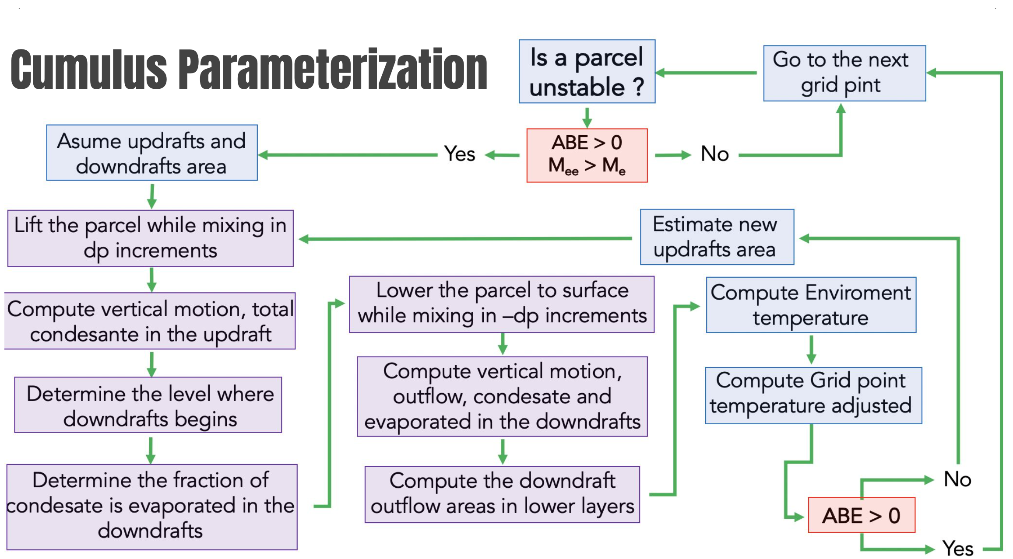
Cumulus Parametrization

Slide 55
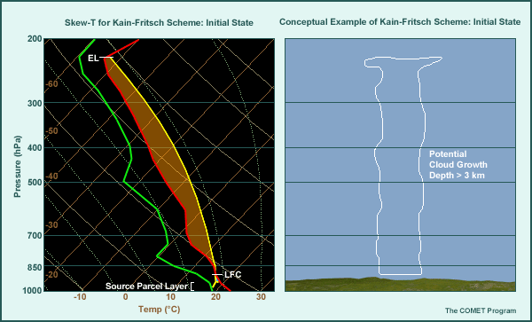
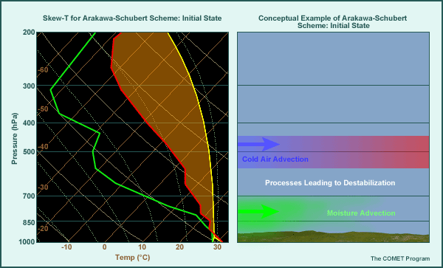
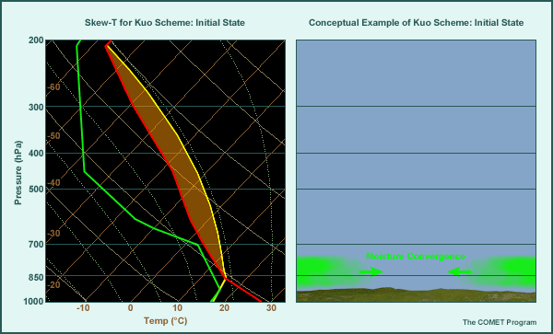
Convection - Cumulus
What triggers convection in a grid column
Presence of some convective available potential energy (CAPE) in sounding
Not too much convective inhibition (CIN) in sounding
Minimum cloud depth from parcel ascent
Moisture convergence

Slide 56
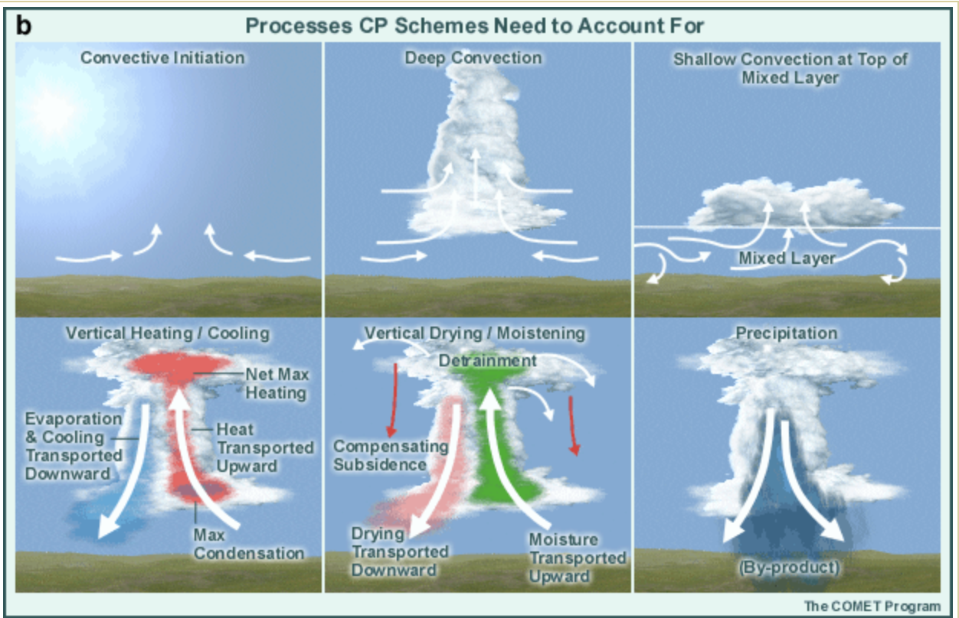
Convection - Cumulus

Slide 57
Convection - Cumulus
Recommendations about use:
For dx ≥ 10 km: probably need cumulus scheme
For dx ≤ 3 km: probably do not need scheme However, there are cases where the earlier triggering of convection by cumulus schemes help
For dx=3-10 km: No schemes are specifically designed with this range of scales in mind
dx >10 km
dx
dx <3 km

Slide 58
Convection - Cumulus

Slide 59
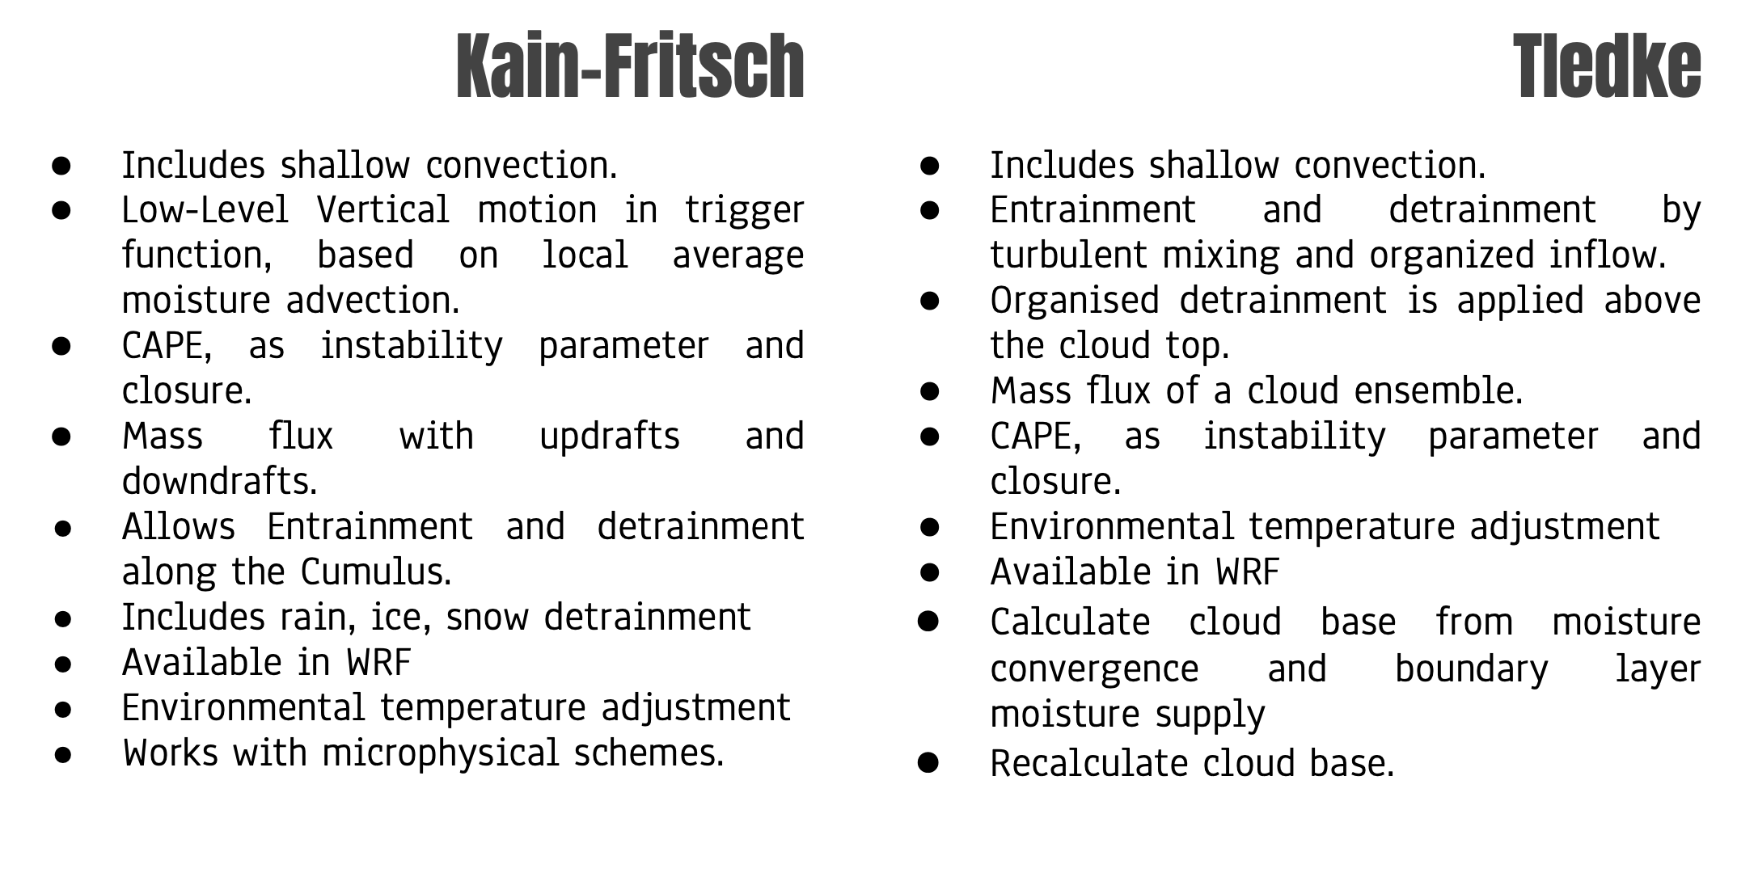
Kain Fritsch
Tiedke

Slide 60
CUDT
Cumulus time-step recommendation
Time steps between cumulus scheme calls
Typical value is 5 minutes

Slide 61
CUMULUS - Explicit Convection
However, high-resolution (one- to two-km) nonhydrostatic models can be run without CP schemes because the grid spacings are small enough to begin to resolve convective motions. For example, the resolution can be fine enough that entire grid boxes can be filled with updraft air and condensate while others are filled with downdrafts.
A rapid and tight coupling between the dynamics and the microphysics scheme results in
Explicitly simulated updrafts strong enough to lift hydrometeors up to the equilibrium level
Explicitly simulated downdrafts and their accompanying gust fronts

Slide 62
Convection - Cumulus

Slide 63
Convection - Cumulus

Slide 64
CUMULUS

Slide 65
Shortwave - Longwave Radiation

Slide 66
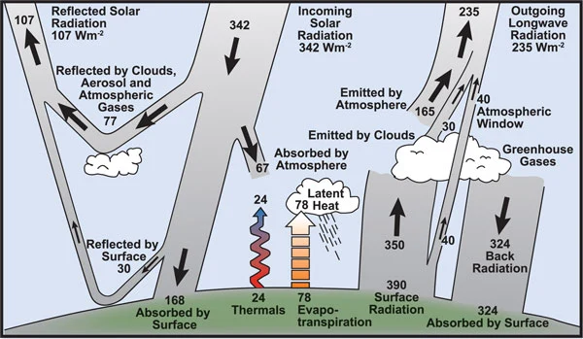

Slide 67
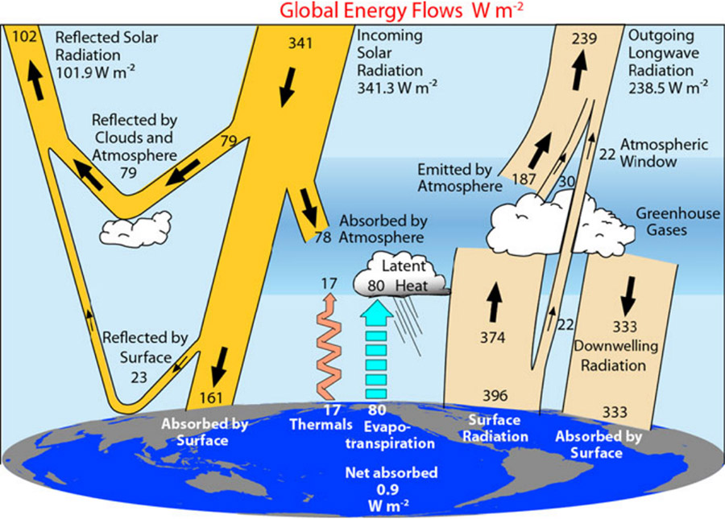

Slide 68
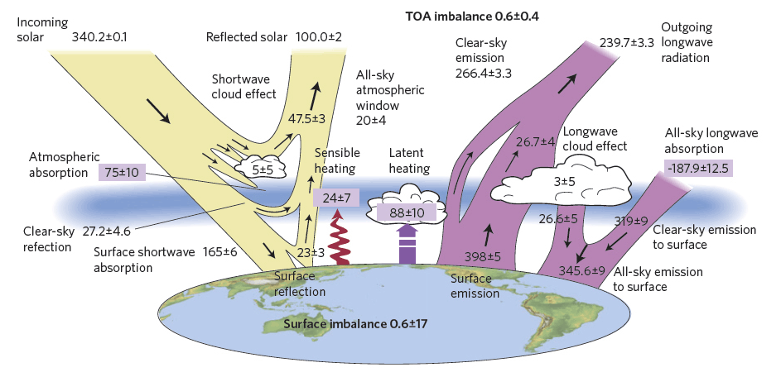

Slide 69
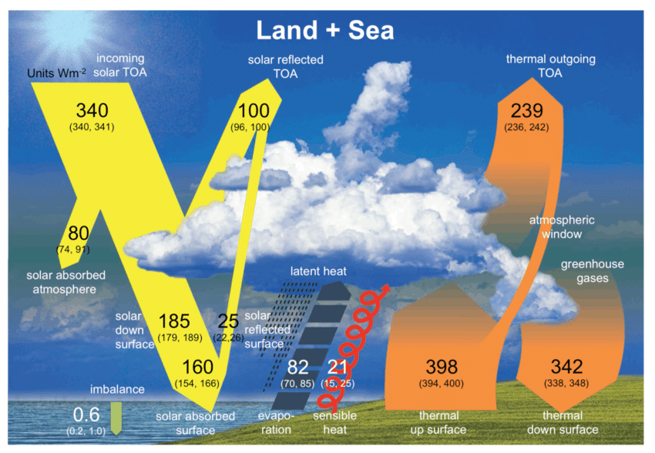

Slide 70
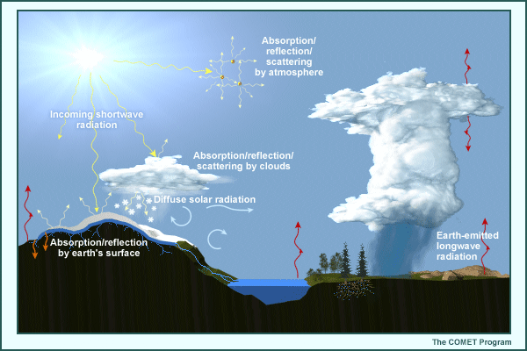

Slide 71
Shortwave - Longwave radiation
Shortwave (solar) and longwave (terrestrial) radiation processes occur on very small time and space scales and are strongly affected by the local composition of the atmosphere. Solar energy is spread through the ultraviolet, visible, and near-infrared frequencies, but peaks at visible wavelengths. As a direct beam of solar radiation moves down through the atmosphere, its intensity is reduced by:
absorption by various gases, clouds, and aerosols;
reflection and scattering by all gas molecules, clouds, and aerosols.

Slide 72
Shortwave Longwave radiation
The gross thermal structure of the atmosphere between 20 and 80 km is largely determined by the balance between the heating owing to absorption of solar radiation, and infrared cooling by carbon dioxide. Any effort to model this region of the atmosphere must therefore consider the important role played by CO₂ infrared emission.

Slide 73
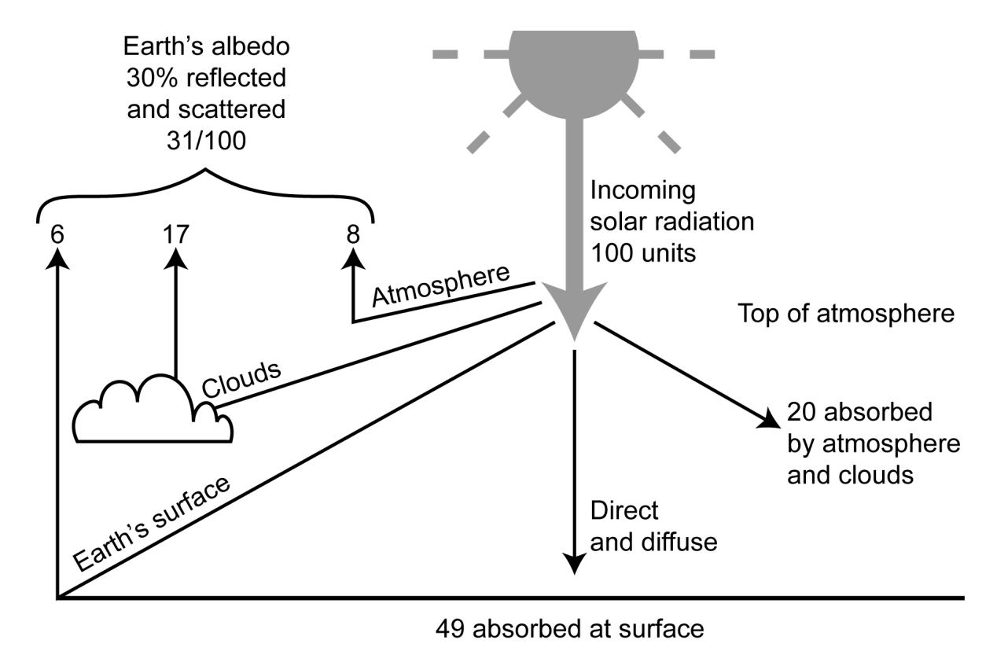
Shortwave radiation
Use astronomical equations to calculate the sun’s position as a function of time of day and day of the year.

Slide 74
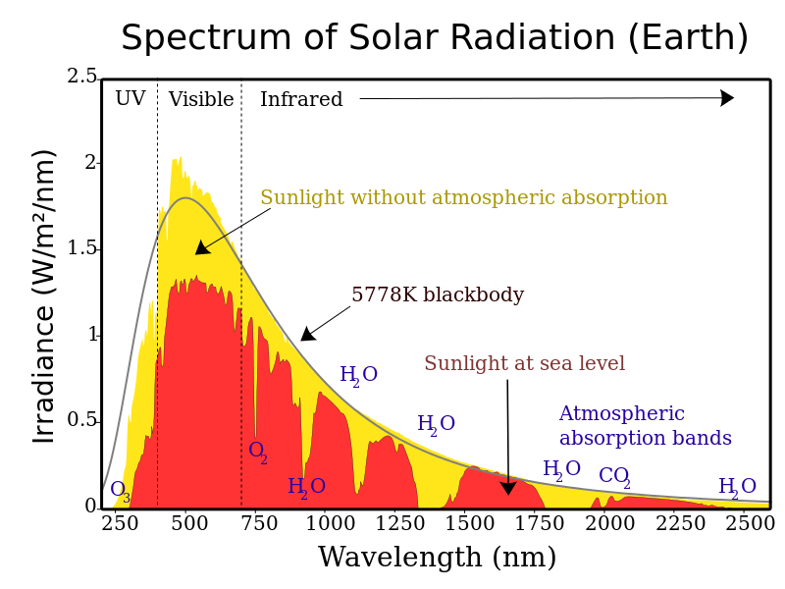
Shortwave radiation – Spectrum
The colored bands highlight specific wavelengths at which incoming shortwave solar radiation is absorbed by ozone, oxygen, water vapor, and carbon dioxide. In the real atmosphere, shortwave radiation is absorbed at preferred wavelengths called absorption lines.
The remaining differences between the yellow TOA energy spectrum and red surface spectrum in the graphic result from scattering and reflection by air molecules, aerosols, and clouds
Energy spectrum of the shortwave energy at the top of the atmosphere compared to that reaching the earth's surface under average conditions.

Slide 75
Longwave radiation – Spectrum
The graphic shows the absorption lines for longwave radiation between 3.7 and 16.7 microns
Earth-emitted longwave radiation (and the small amount of near-infrared solar radiation) is also affected at preferred absorption lines, which are irregularly spaced through the longwave spectrum. Absorption of longwave radiation is a function of pressure, temperature, and the amount of the absorbing gas. The absorbed longwave radiation is reemitted both upward and downward, but at a different wavelength and intensity based on the temperature of the absorber

Slide 76
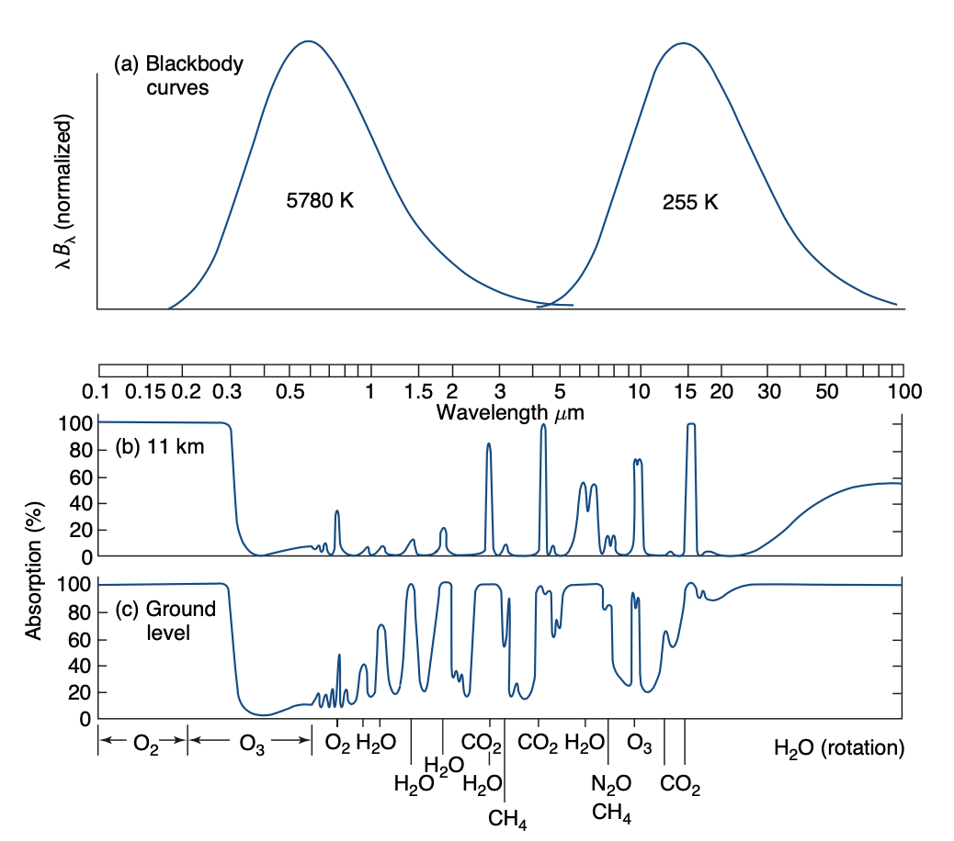
Longwave Shortwave Spectrum – Pressure lev
b) Spectrum of monochromatic absorptivity of the part of the atmosphere that lies above the 11-km level.
c) Spectrum of monochromatic absorptivity of the entire atmosphere.

Slide 77
Longwave Shortwave – Parametrization
Breaking the atmosphere into vertical layers (as for the dynamical calculations) and predicting, diagnosing, or prescribing the amount of cloud, absorbing gas, and/or aerosols in each layer.
The effect of all absorbers, scatterers, and reflectors in each layer is then estimated to determine the amount of incoming radiation absorbed by each layer and the total amount of shortwave radiation reaching the surface.
The amount of longwave radiation absorbed and reemitted by each model layer is calculated, based on the mean layer temperature, pressure, and amount of absorbing substance. Because absorbed shortwave radiation affects the layer temperature, its effects on longwave emission are included as well.

Slide 78
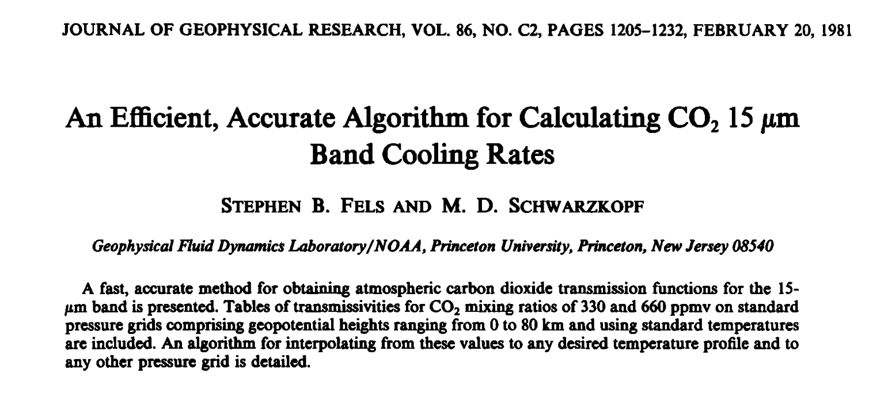
The heart of this report is a description of an algorithm for calculating CO₂ transmission functions and an extensive set of tables which are crucial to the algorithm

Slide 79
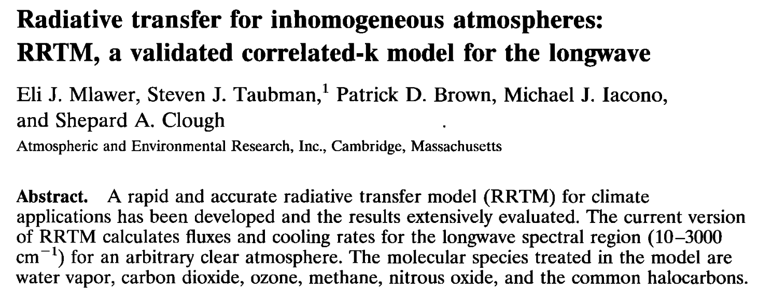
In the current version of RRTM, absorption due to water vapor, carbon dioxide, ozone, nitrous oxide, methane,CFC-11, CFC-12, CFC-22, andCC14 is considered

Slide 80
The K distributions and Correlation method
The correlated-k method is an approximate technique for the accelerated calculation of fluxes and cooling rates for inhomogeneous atmosphere.
The radiative transfer operations for a given homogeneous layer and spectral band are carried out using a small set of absorption coefficients that are representative of the absorption coefficients for all frequencies in the band.
The spectral absorption coefficient k(v) varies irregularly with wave number.

Slide 81
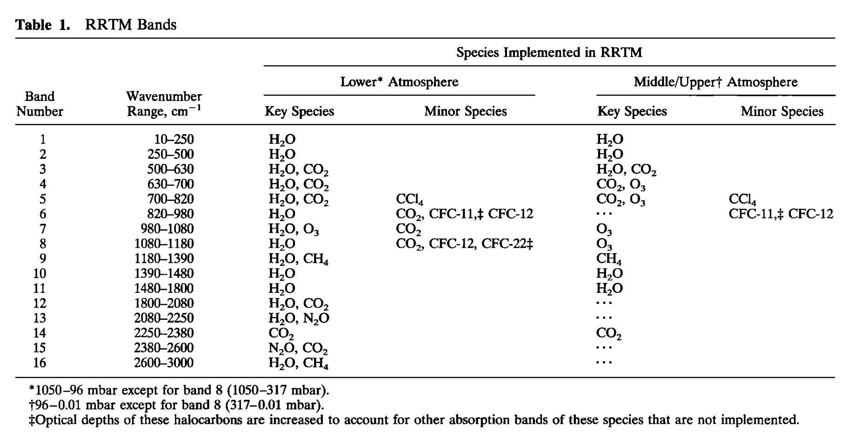

Slide 82
RADT
Radiation time-step recommendation
Radiation is too expensive to call every step
Frequency should resolve cloud-cover changes with time
radt=1 minute per km grid size is about right (e.g. radt=10 for dx=10 km)

Slide 83
Slope effects on shortwave
Represents the effect of slope on surface solar flux accounting for diffuse/direct effects.
Slope_rad = 1: activates slope effects, may be useful for complex terrain and grids < 2km.
Topo_shading = 1: shading of neighboring grids by mountains, may be useful for grids < 1km.

Slide 84
Shortwave – Longwave radiation

Slide 85
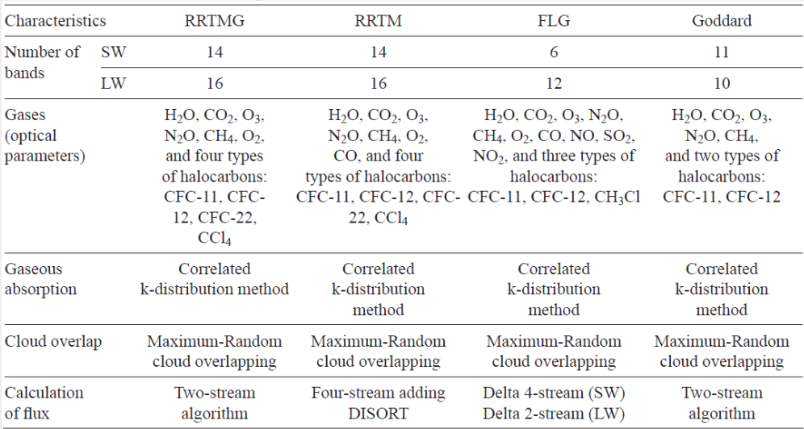
Shortwave – Longwave radiation

Slide 86
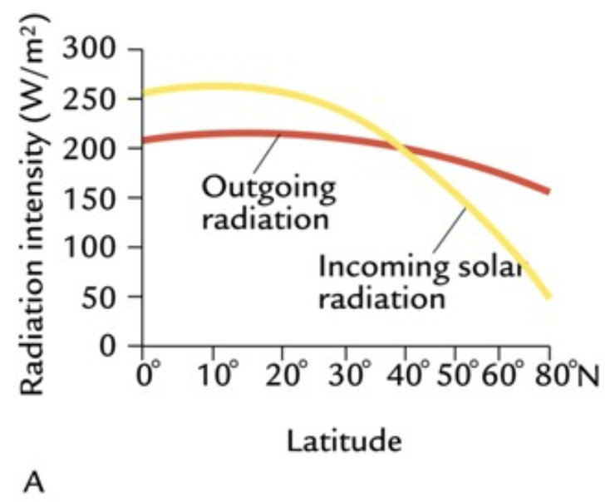
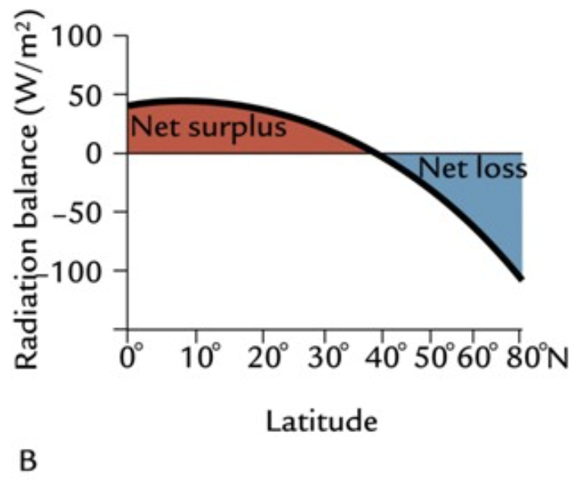
Global energy budget
Latitudes < 35 have excess incoming solar radiation over outgoing back radiation.
Excess heat is stored in the upper oceans, it drives general circulation of ocean and atmosphere

Slide 87
Example

Slide 88
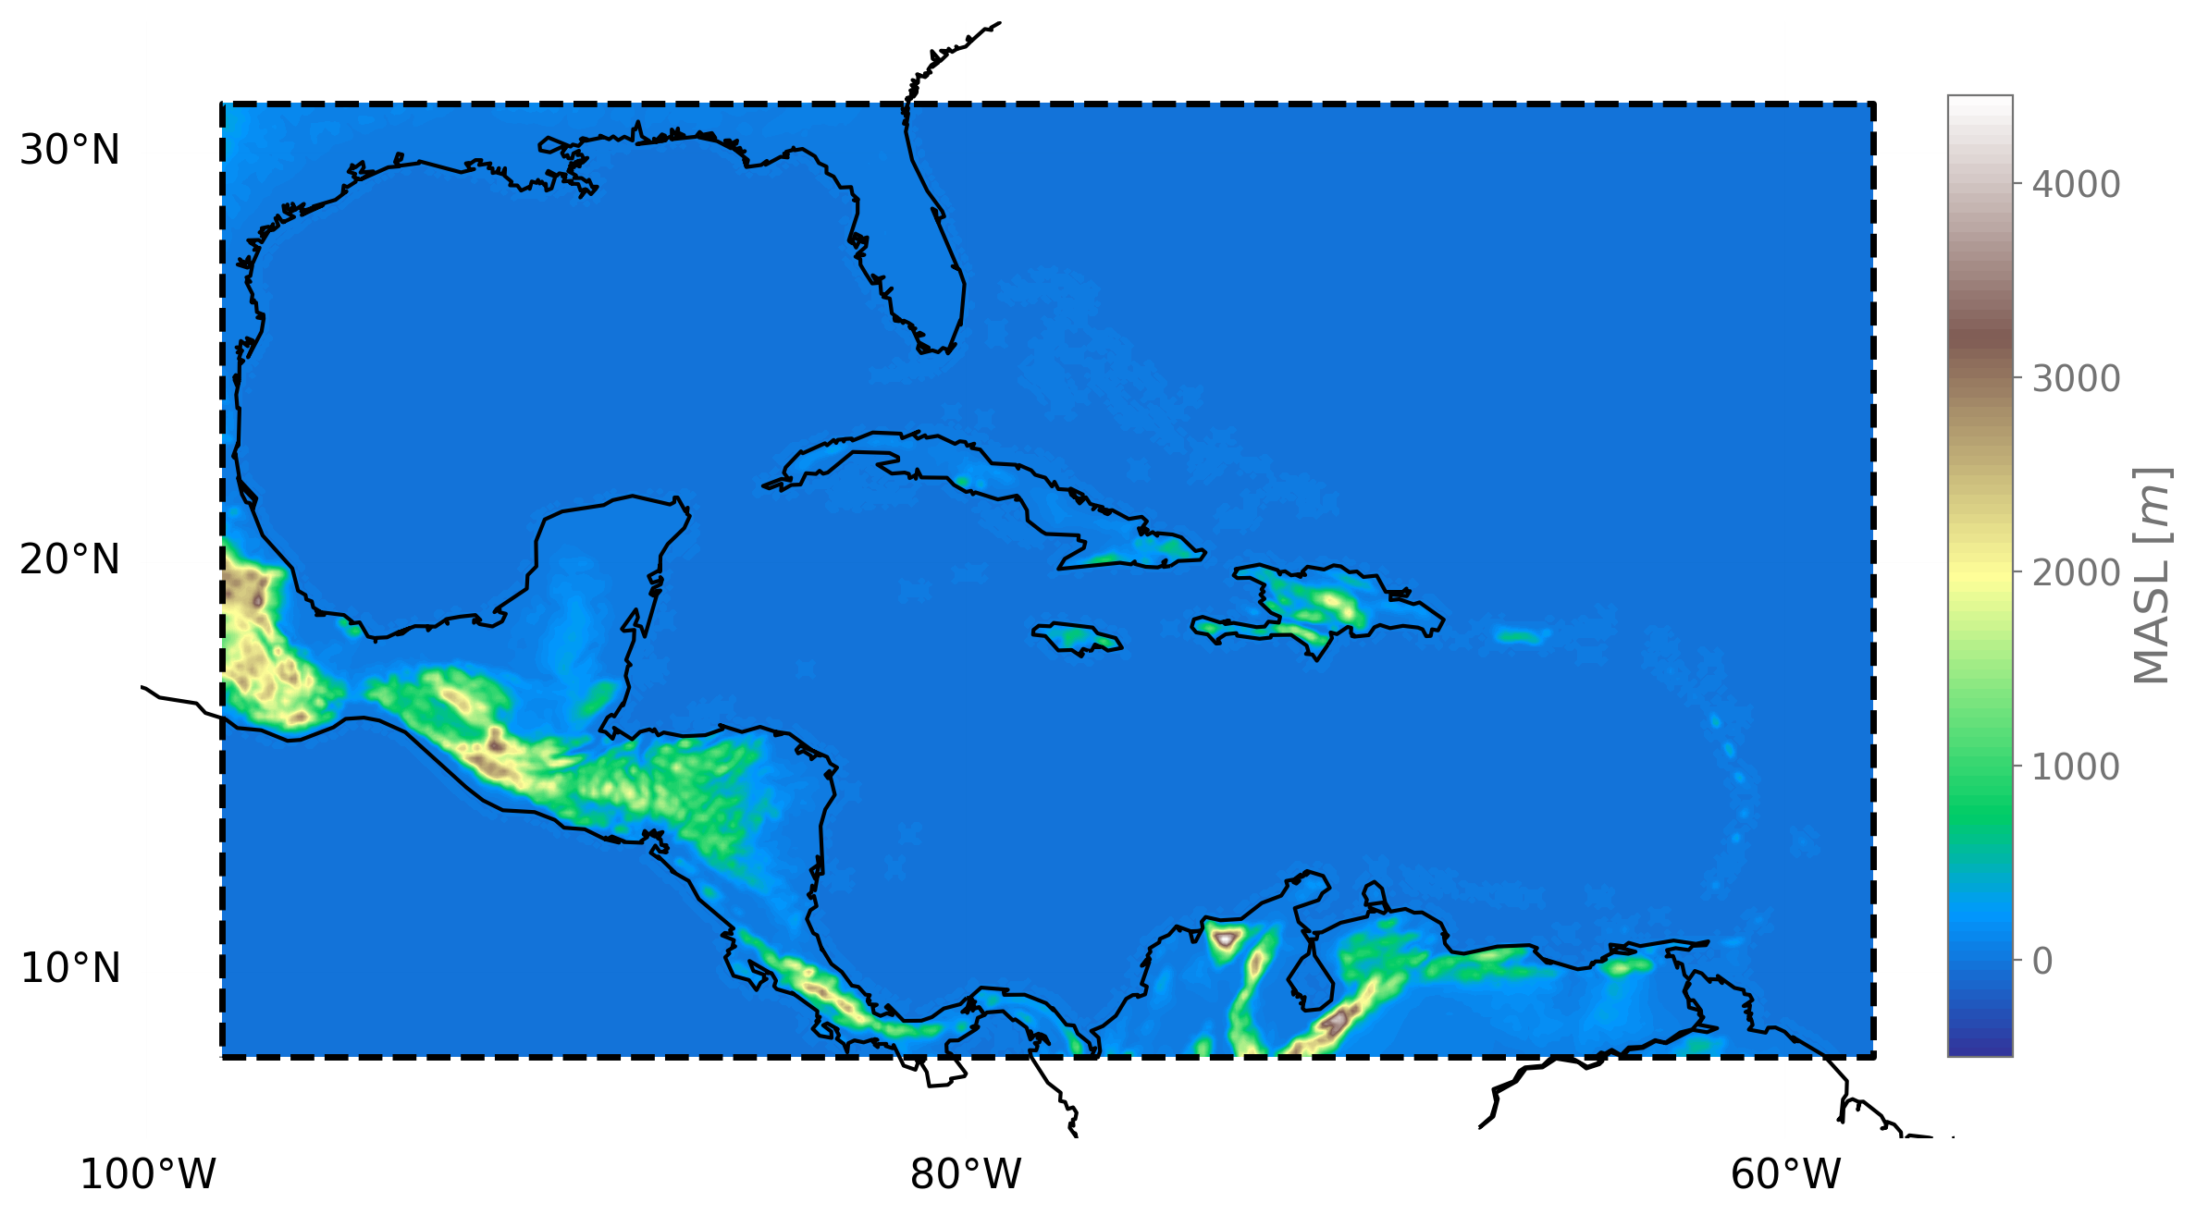
WRF model – Setup
The configuration has 9km x 9 km of spatial resolution, 40 seg of temporal resolution, and 51 vertical levels. We used ERA5 as initial and boundaries conditions every six hours from September 28 to October 8. We used the GFDL parametrizations to shortwave and longwave radiation, Mallor-Yamada-Janjic scheme for the PBL related physical processes. For MP: Kessler, WSM6 and Thompson and for cumulus: Tiedke and Kain-Fritsch.
WRF Spatial domain

Slide 89
WRF Results- Hurricane Matthew
Reflectivity cross section
Simulated and Observed Track
Matthew Intensity change

Slide 98
Muy Viejo

Slide 99
Conclusión: Diferentes parametrizaciones de Cumulus según la época del ano

Slide 102
Todo el mundo evalua modelos con el diagrama de taylor, hay otras formas ?

Slide 103
Recomendaciones
Review de literatura muy importante, según el objetivo de la configuración (la trayectoria del autor es importante).
Realizar análisis de sensibilidad propio para terminar de descartar posibles parametrizaciones

