Slide 1
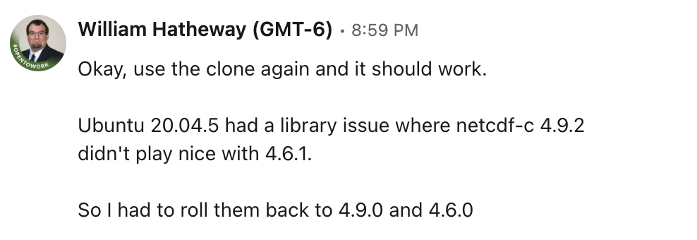
WRF-MOSIT

Slide 2
WRF Pre-Processing System
Best Practices
https://www2.mmm.ucar.edu/wrf/users/namelist_best_prac_wps.html

Slide 3

Flujo de las componentes del modelo WRF
Observaciones In-situ
Radar meteorológico
Radiosondas
Perfiles - radiómetro
WRF-DA
Gridded Terrestrial data:
MODIS
USGS
Geogrid
Metgrid
Real
ARW-Model
Gridded Meteorological data:
Global Forecast System
Final Analysis
ERA5 – ERA interim
Ungrib
WRF Pre-processing System (WPS)
Post Procesamiento
Python
NCL

Slide 4
WRF-Preprocessing System (WPS)
Its functions include:
Defining simulation domains.
      Map projections:
      Polar stereographic
      Lambert-Conformal
      Mercator
      Nesting
Interpolating terrestrial data to the simulation domain.
      User-interfaces to input other static data
Degribbing and interpolating meteorological data.
        GRIB 1/2 meteorological data from various centers around the world
                User-interfaces to input meteorological data.

Slide 5
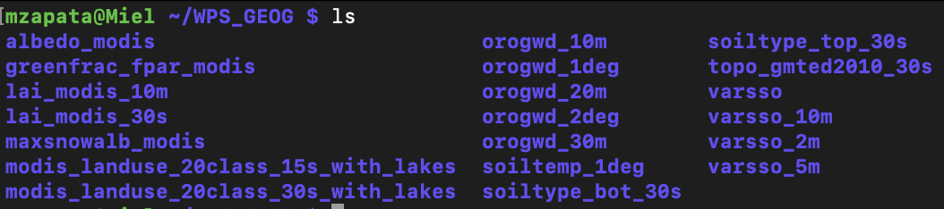
Exploración GEOG
https://www2.mmm.ucar.edu/wrf/users/download/get_sources_wps_geog.html
landuse_30s_with_lakes - USGS

Slide 6
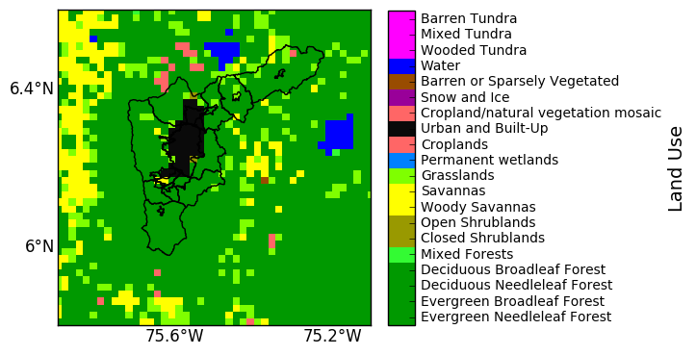
Landuse – WRF
¿Representa la realidad ?

Slide 7
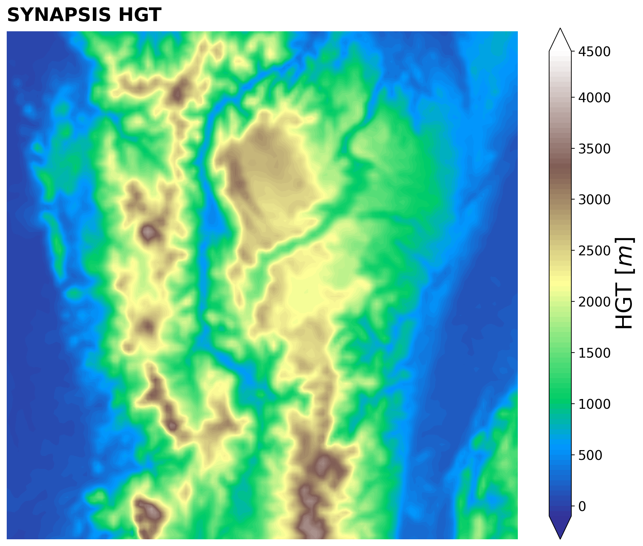
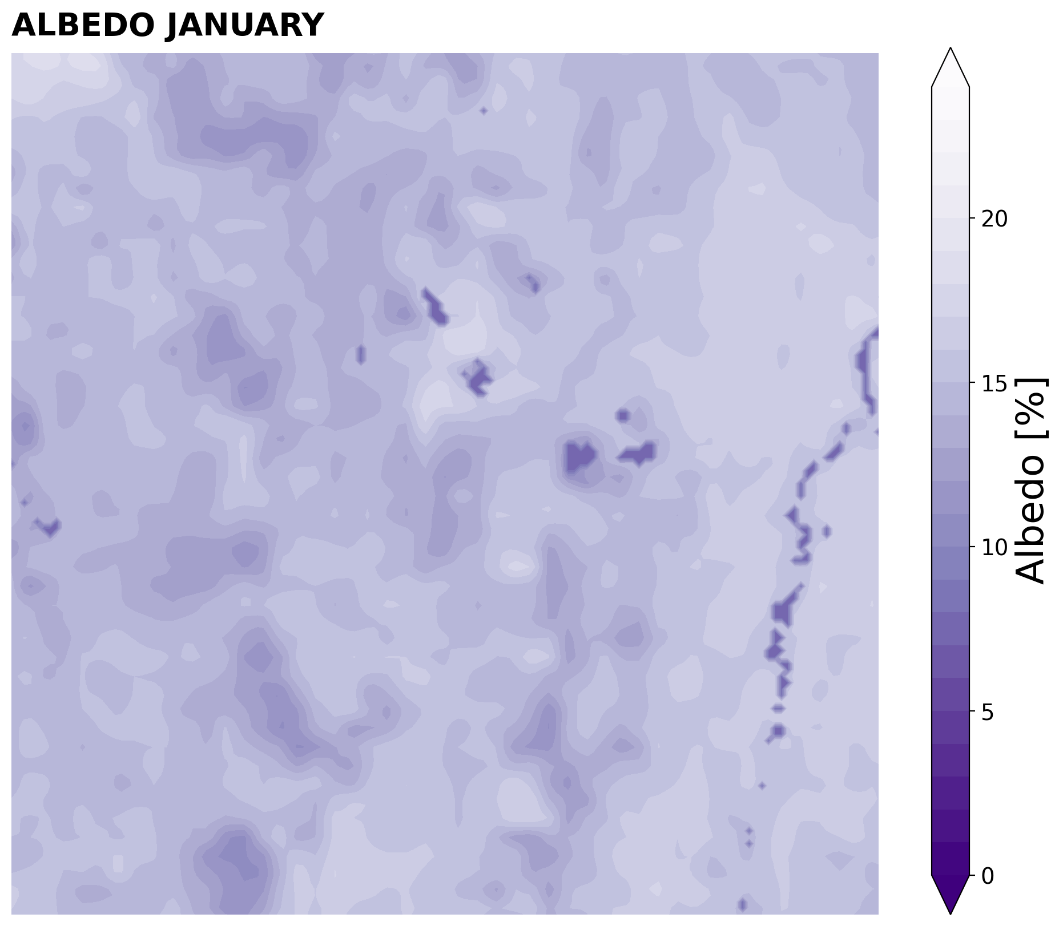
Static Variables – WRF

Slide 8
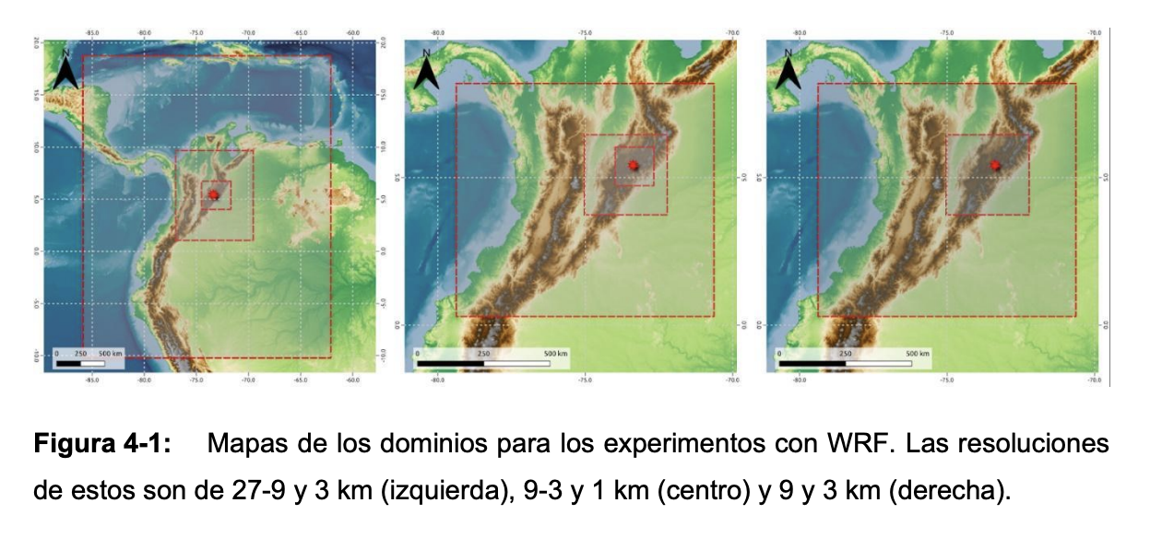
Análisis y Caracterización del Ambiente Atmosférico Durante Heladas Radiativas en Colombia

Slide 9
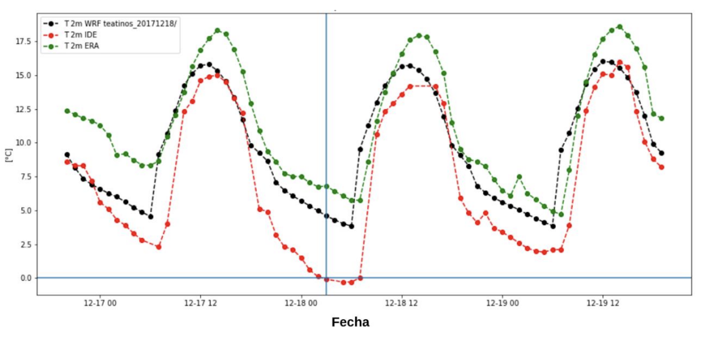
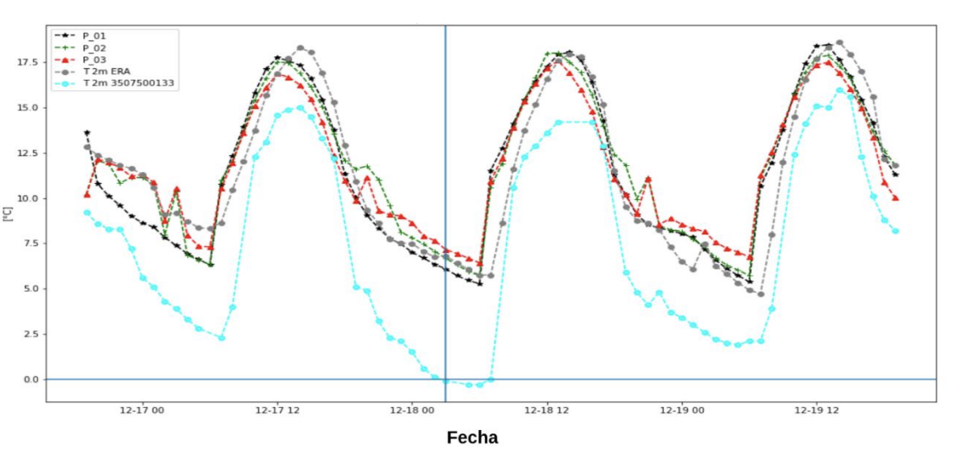
Análisis y Caracterización del Ambiente Atmosférico Durante Heladas Radiativas en Colombia
A través de la helada revisada que pudo ser simulada en WRF, se observa que el modelo tiene dificultades para representar enfriamientos o calentamientos muy abruptos de la temperatura del aire, con lo cual, en orden de mejorar la representación de este tipo de fenómenos meteorológicos, se debe revisar el origen de esta dificultad y entender si esta se debe a factores de resolución, de la física del modelo o de los datos con los cuales este es alimentado.

Slide 10
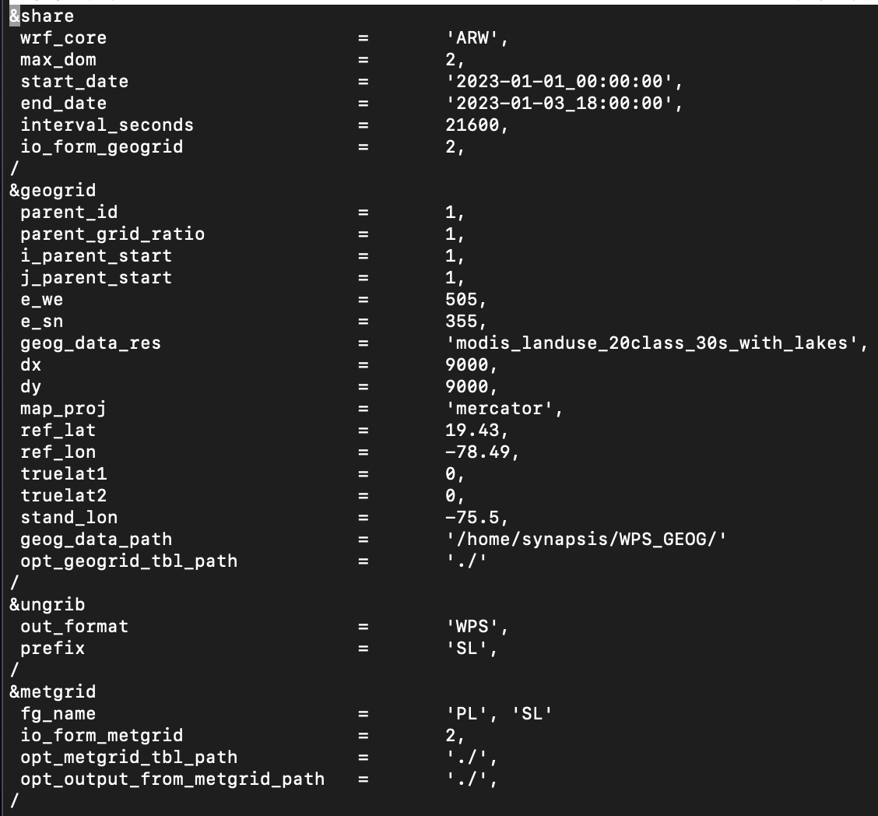
namelist.wps

Slide 11
Share: Opciones de control sobre las operaciones temporales, opción de control sobre el núcleo de cálculo, anidados y datos estáticos.
wrf_core: A character string set to either ‘ARW’ or ‘NMM’ that tells WPS which dynamical core the input data are being prepared for. Default value is ‘ARW’.
max_dom: An integer specifying the total number of domains/nests, including the parent domain, in the simulation.
start_date : A list of MAX_DOM character strings of the form 'YYYY-MMDD_HH:mm:ss' specifying the starting UTC date of the simulation for each nest.
end_date: A list of MAX_DOM character strings of the form 'YYYY-MMDD_HH:mm:ss' specifying the ending UTC date of the simulation for each nest.
interval_seconds: The integer number of seconds between time-varying meteorological input files. No default value.
io_form_geogrid: Files created by the geogrid program will be written in. Possible options are: 1 for binary; 2 for NetCDF; 3 for GRIB1. Default value is 2 (NetCDF).
opt_output_from_geogrid_path: Location where output files from geogrid should be written to and read from. Default value is ‘./’.

Slide 12
Geogrid: Definición del dominio, anidados, proyecciones y datos estáticos.
geog_data_res: A list of MAX_DOM character strings specifying, for each nest, a corresponding resolution of source data to be used when interpolating static terrestrial data to the nest’s grid.
map_proj: Projection of the simulation domain. For ARW, accepted projections are ‘Lambert’, ‘polar’, and ‘Mercator’.
geog_data_path: The path, to the directory where the geographical data directories may be found.
opt_geogrid_tbl_path: The path to the GEOGRID.TBL file

Slide 13
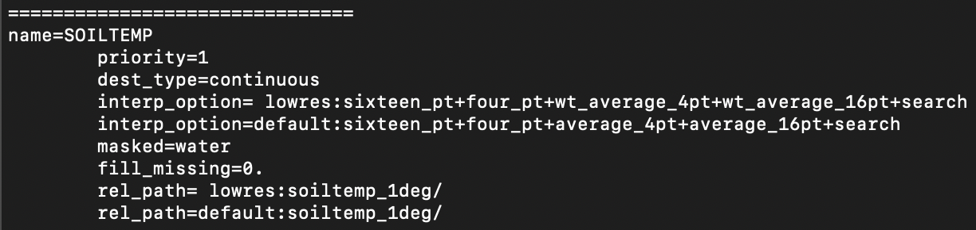
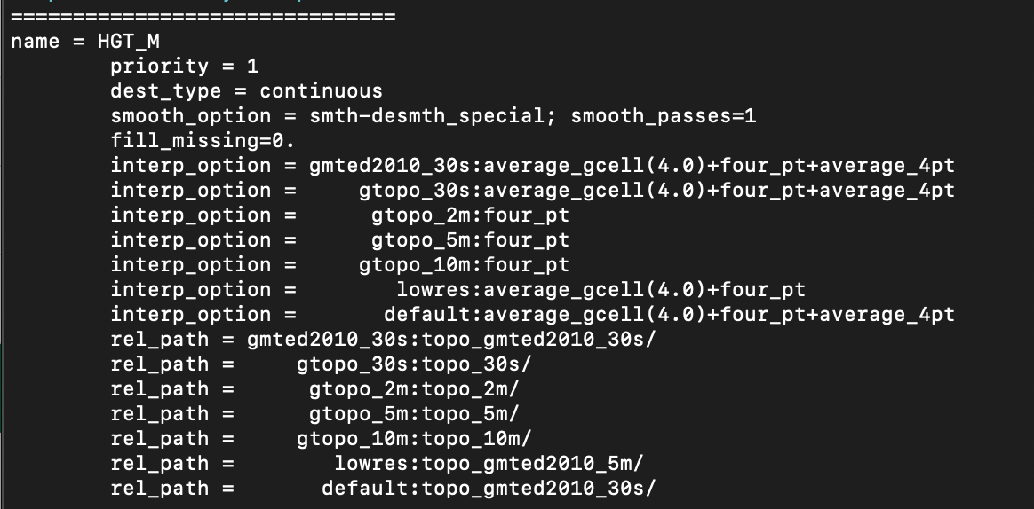
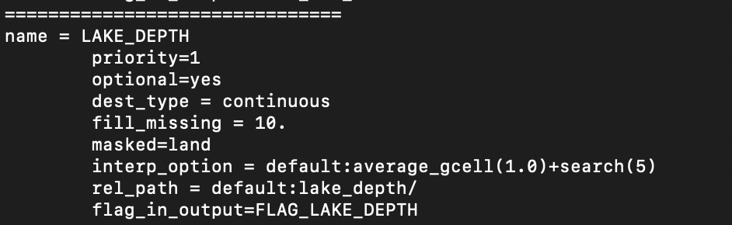
Archivos necesarios – GEOGRID.TBL
The GEOGRID.TBL file is a text file that defines parameters of each of the data sets to be interpolated by geogrid (Ver Archivo)

Slide 14
Archivos necesarios – GEOGRID.TBL
The GEOGRID.TBL file is a text file that defines parameters of each of the data sets to be interpolated by geogrid (Ver Archivo)
NAME : Name that will be assigned to the interpolated field upon output.
PRIORITY : An integer specifying the priority that the data source identified in the table section takes with respect to other sources of data for the same field. If a field has n sources of data, then there must be n separate table entries for the field, each of which must be given a unique value for priority in the range [1,n]. No default value.
REL_PATH : Path relative to the path given in the namelist variable geog_data_path.
MASKED : Either land or water, indicating that the field is not valid at land or water points, respectively.
FILL_MISSING : A real value used to fill in any missing or masked grid points in the interpolated field.
INTERP_OPTION : The names of interpolation methods to be used when horizontally interpolating the field.
    average_4pt,
    average_16pt,
    wt_average_4pt,
    wt_average_16pt,
    nearest_neighbor,
    four_pt, sixteen_pt,

Slide 15
How to create a WRF Domain
parent_id: A list of MAX_DOM integers specifying, for each nest, the domain number of the nest’s parent.
parent_grid_ratio: A list of MAX_DOM integers specifying, for each nest, the nesting ratio relative to the domain’s parent.
e_we : A list of MAX_DOM integers specifying, for each nest, the nest’s full westeast dimension. For nested domains, e_we must be one greater than an integer multiple of the nest's parent_grid_ratio.
e_sn: A list of MAX_DOM integers specifying, for each nest, the nest’s full southnorth dimension. For nested domains, e_sn must be one greater than an integer multiple of the nest's parent_grid_ratio.
ref_lat, ref_lon: Latitude and Longitude of the domain center.
dx, dy: Spatial resolution.
i_parent_start : A list of MAX_DOM integers specifying, for each nest, the xcoordinate of the lower-left corner.
j_parent_start: A list of MAX_DOM integers specifying, for each nest, the ycoordinate of the lower-left corner

Slide 16

How to create a WRF Domain ?
dx
dy
e_sn = 8
ref_lon, ref_lat
e_we = 12

Slide 17
How to create a WRF Domain Nested ?
dx
dy
e_sn
j_parent_start
e_we
i_parent_start

Slide 18
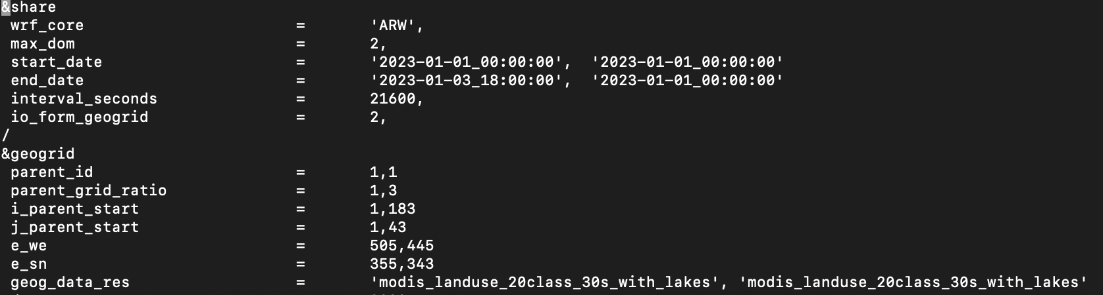
Opciones del namelist.wps para anidar
max_dom
start_date
snd_date
parent_id
parent_grid_ratio
i_parent_start
j_parent_start
e_we
s_sn
geog_data_res

Slide 19
Nest options: Telescope, Same level
Grid id = 1
Grid id = 1
Grid id = 2
Grid id = 3
Grid id = 2
Grid id = 3
Telescoping
Same level respect parent

Slide 20
Not allowed Nesting
Grid id = 1
Grid id = 1
Grid id = 3
Grid id = 2
Grid id = 3
Grid id = 3
Grid id = 4
Overlapping Grids
More than one parent grid

Slide 21
Best Practices
Domains should not be smaller than 100x100 grid spaces. If domains are too small, the solution will be determined by forcing data, which defeats the purpose of running a simulation.
It is recommended that dx and dy have the same value for Mercator, Polar, and Lambert projections.
Mercator: well-suited for low-latitudes. Lambert: well-suited for mid-latitudes. Polar: good for high-latitude domains.
Recommended ratios are 3 or 5. If you are unfamiliar with the model, it is best to leave this set to 3. It is not recommended to use an even number.
e_ew = n*parent_grid_ratio+1 for some integer n. Example, for parent grid ratio = 3, e_ew could be 121 (120/parent_grid_ratio is an integer).
Avoid placing any boundaries over complex terrain

Slide 22
Best Practices
Grid id = 1
Grid id = 1
1
2
3
4
Grid id = 2
Grid id = 2
1/3
1/3
It is good practice to keep nest boundaries away from coarse domain boundaries. As a rough approximation, keep about 1/3 of the coarse-grid domain surrounding each side of the nest.
Minimum distance between nest boundary and parent boundary: - 4 grid cells

Slide 23
Jupyter Notebook
WRF-Preprocessing System
- Caribe
- Indico
- RDFS
- SYNAPSIS

Slide 24
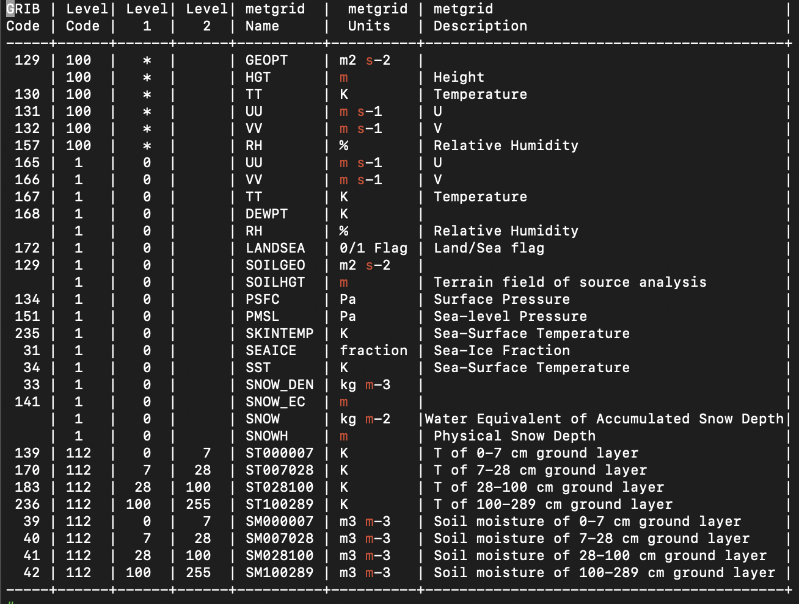
Archivos necesarios – Vtable
GRIB files typically contain more fields than are needed to initialize WRF. Both versions of the GRIB format use various codes to identify the variables and levels in the GRIB file. Ungrib uses tables of these codes – called Vtables, for variable tables – to define which fields to extract from the GRIB file and write to the intermediate format.

Slide 25
Archivos necesarios – Vtable
100 – Upper Air
1 – Surface
112 – Field Given as layer ..
Determines the variable name that will be assigned to a meteorological field when it is written to the intermediate files by ungrib.
GRIB code for the meteorological field, which is a number unique to that field within the data set
Metgrid Names (WPS)
Temperature at upper-air levels has GRIB code 11 in GFS data, but GRIB code 130 in ECMWF data
Meteorological Database

Slide 26

Ungrib: Lee archivos GRIB, degribs los datos y escribe los datos en un formato simple, llamado formato intermedio.
out_format: A character string set either to ‘WPS’, ‘SI’, or ‘MM5’.
      If set to ‘MM5’, ungrib will write output in the format of the MM5 pregrid program;
      if set to ‘SI’, ungrib will write output in the format of grib_prep.exe;
      if set to ‘WPS’, ungrib will write data in the WPS intermediate format. Default value is ‘WPS’.
prefix: A character string that will be used as the prefix for intermediate-format files created by ungrib; here, prefix refers to the string PREFIX in the filename PREFIX:YYYY-MM-DD_HH. The prefix may contain path information.

Slide 27
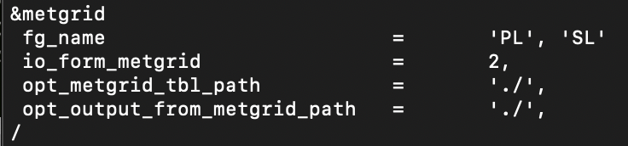
Metgrid: Interpola horizontalmente los datos meteorológicos de formato intermedio extraídos por el programa ungrib en los dominios de simulación definidos por el programa geogrid.
out_format: A list of character strings specifying the path and prefix of ungribbed data files
io_form_metgrid: Files created by the geogrid program will be written in. Possible options are: 1 for binary; 2 for NetCDF; 3 for GRIB1. Default value is 2 (NetCDF).
opt_metgrid_tbl_path: The path to the METGRID.TBL file.
opt_output_from_metgrid_path: Location where output files from metgrid should be written to and read from. Default value is ‘./’.

Slide 28
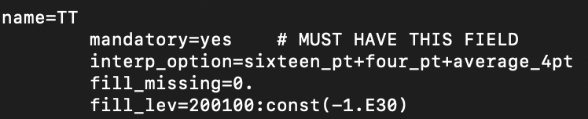
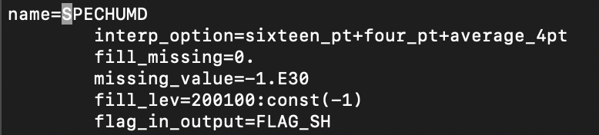
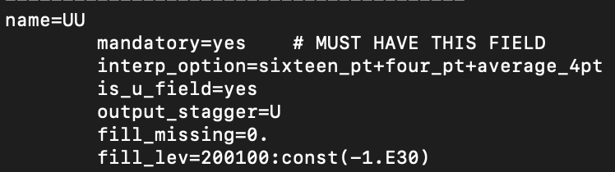
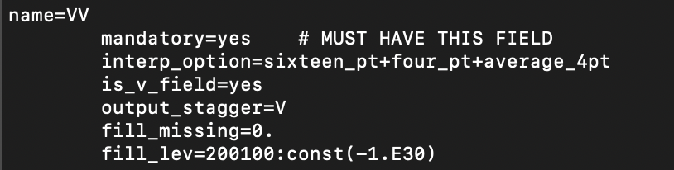
Archivos necesarios – METGRID.TBL
The METGRID.TBL is a text file that defines parameters of each of the meteorological fields to be interpolated by metgrid (Ver Archivo)

Slide 29
Archivos necesarios – METGRID.TBL
The METGRID.TBL is a text file that defines parameters of each of the meteorological fields to be interpolated by metgrid (Ver Archivo)
NAME : A character string giving the name of the meteorological field to which the containing section of the table pertains. The name should exactly match that of the field as given in the intermediate files (Vtable names).
MANDATORY : Either yes or no, indicating whether the field is required for successful completion of metgrid.
OUTPUT_STAGGER: The model grid staggering to which the field should be interpolated. For ARW, this must be one of U, V, and M.
INTERP_MASK : The name of the field to be used as an interpolation mask, along with the value within that field which signals masked points.
FILL_MISSING : A real value used to fill in any missing or masked grid points in the interpolated field.
INTERP_OPTION : The names of interpolation methods to be used when horizontally interpolating the field.
    average_4pt,
    average_16pt,
    wt_average_4pt,
    wt_average_16pt,
    nearest_neighbor,
    four_pt, sixteen_pt,

