Slide 1


ABL
Processes / Variability
Regional Meteorology
Valley Flow
Local Turbulence
Complex Terrain
Urban Surface
?
Urban Canopy
Thermal Properties
?
Synoptic Forcing
Valley Flow variability
Valley Wind Days
Morning Transition Efficiency
“Obeys” MOST ?
Local Scaling
Energy Balance
“Spatio-temporal” Flux behavior
COmplex terrain Measurement Project of Land-atmosphere Energy eXchanges

Slide 2
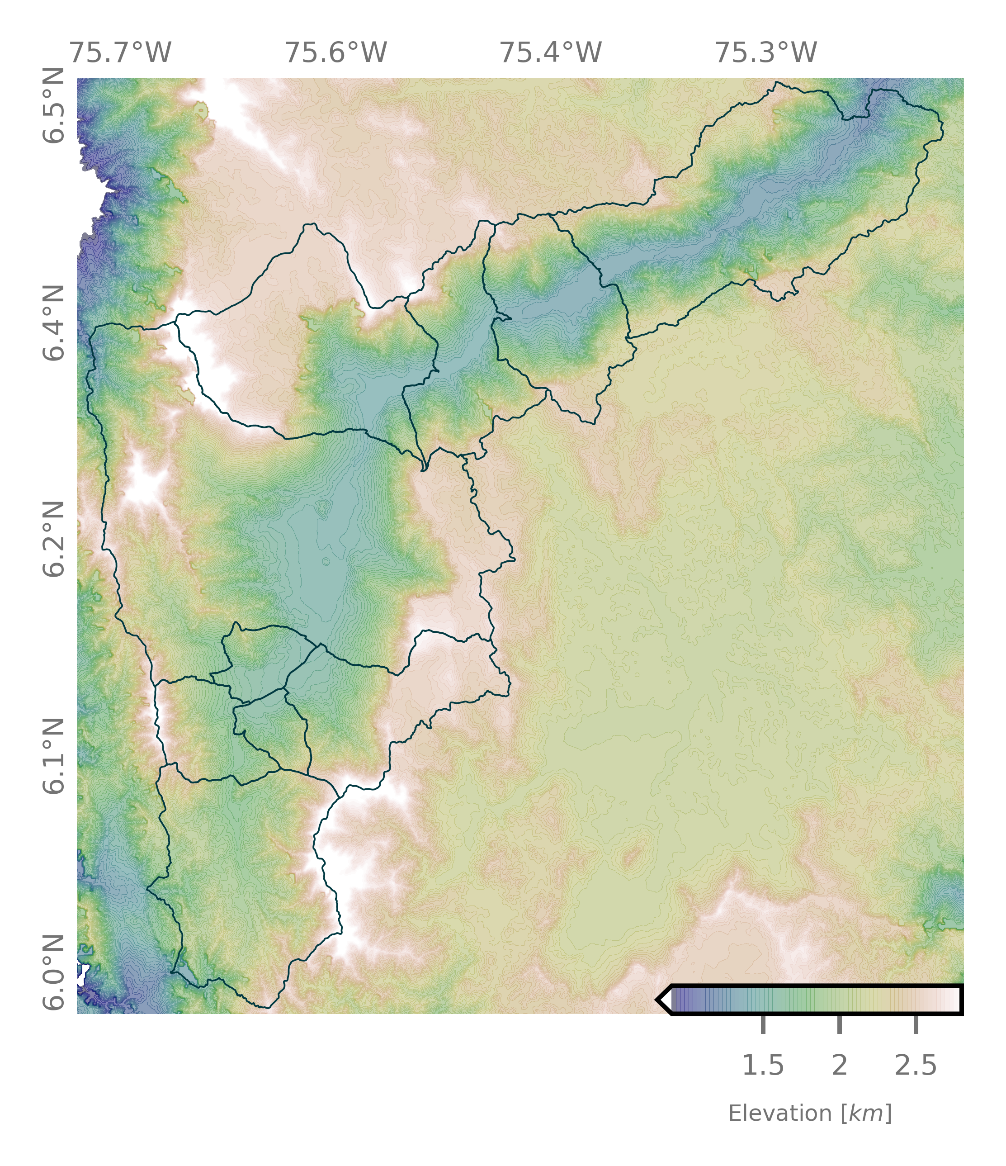
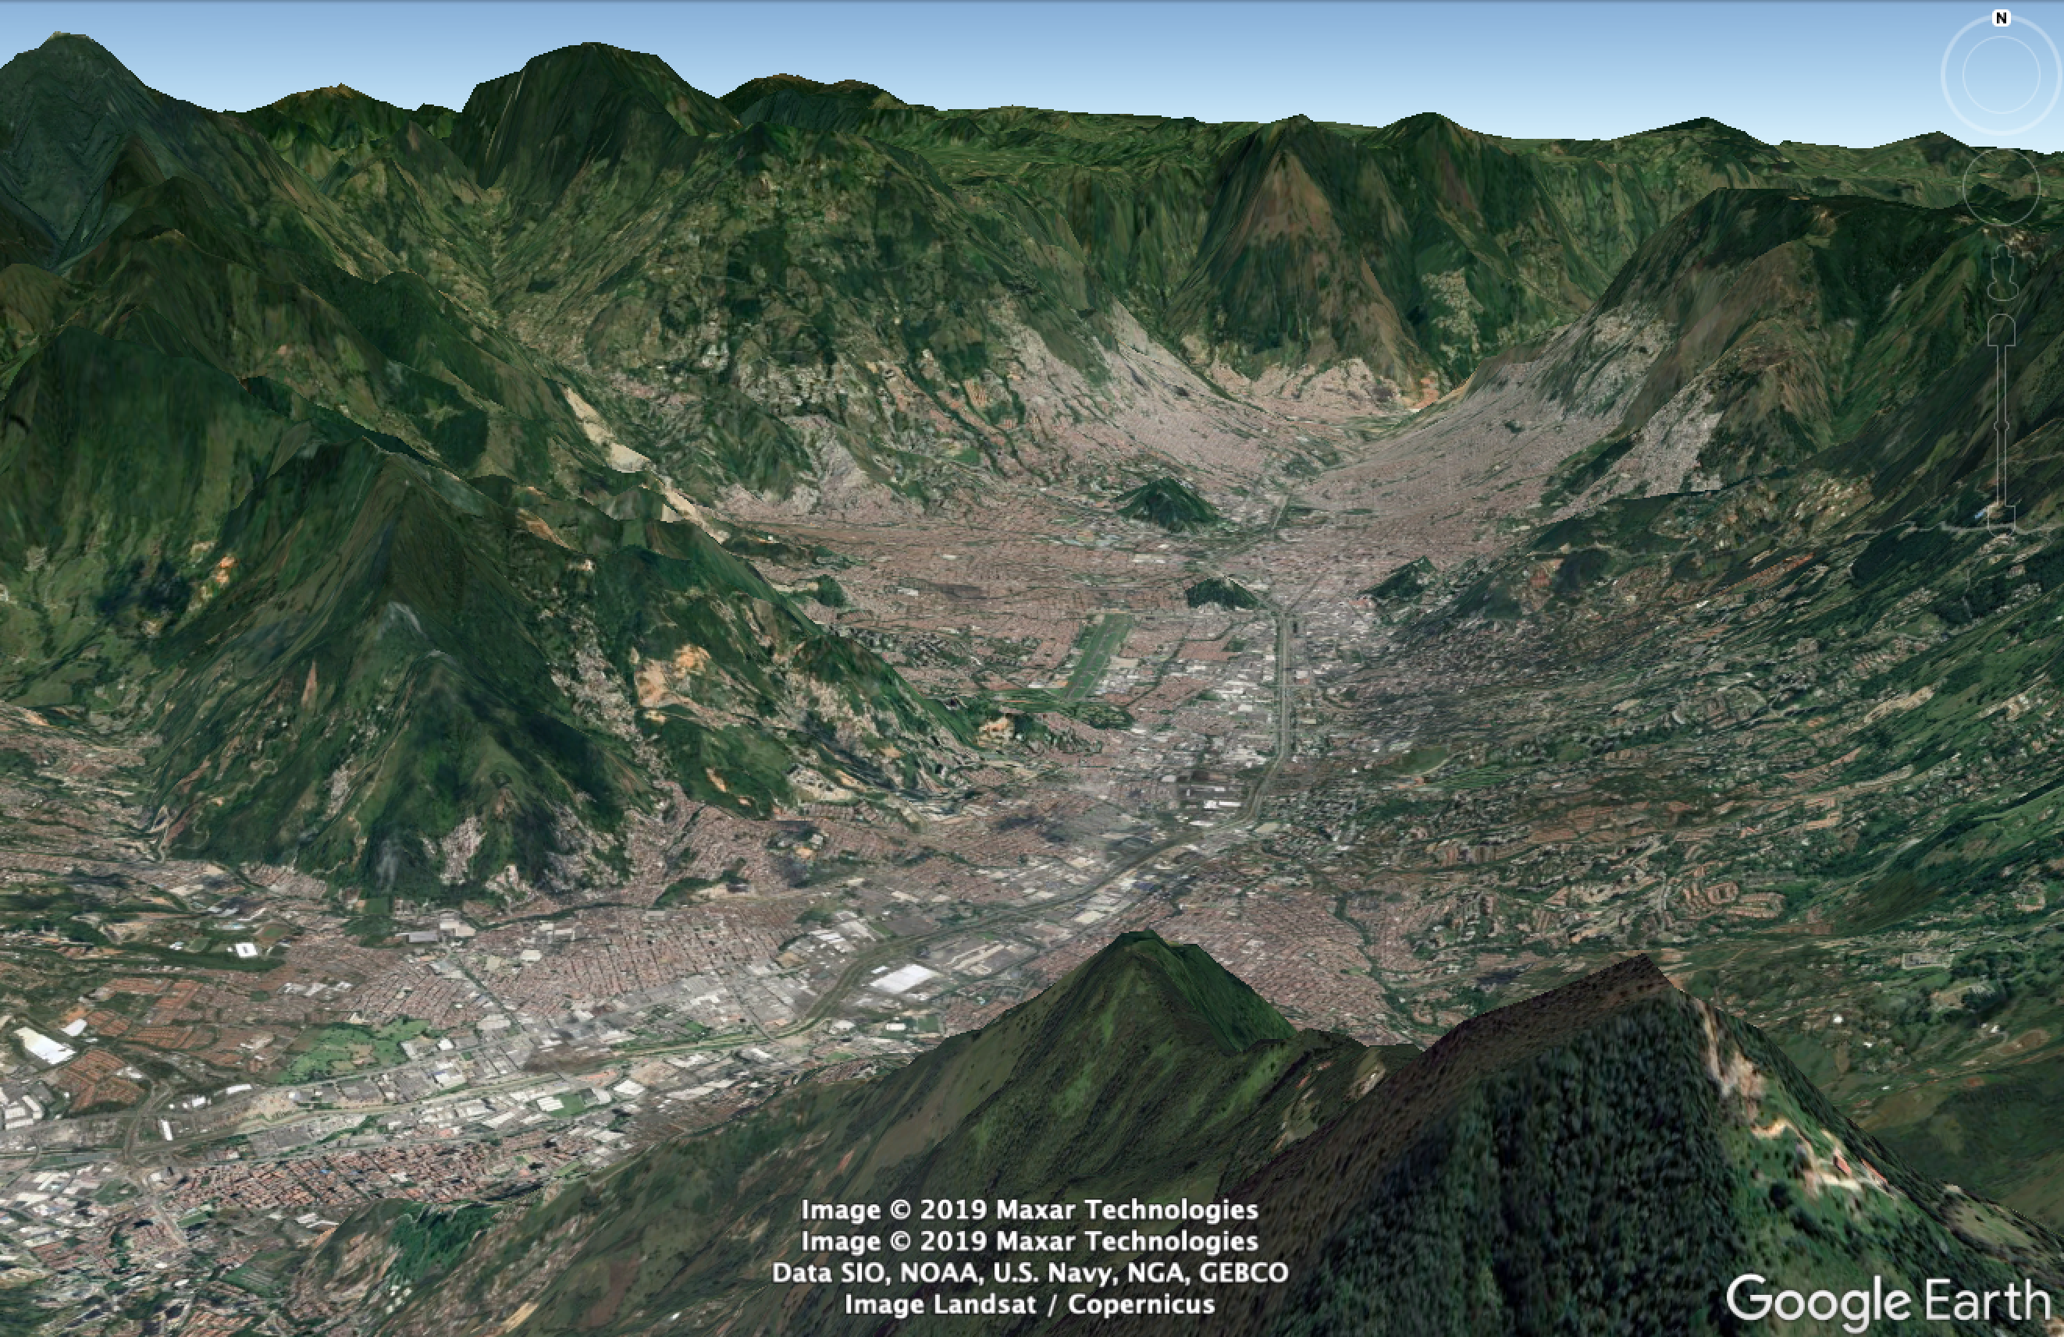
Aburrá Valley

Slide 3
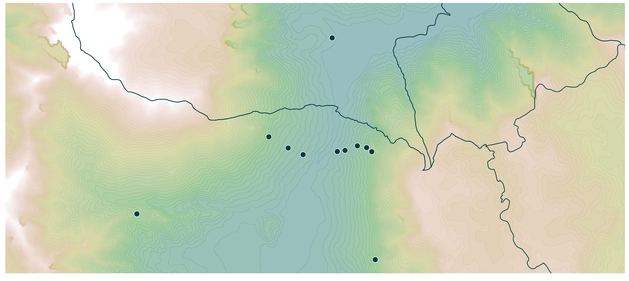
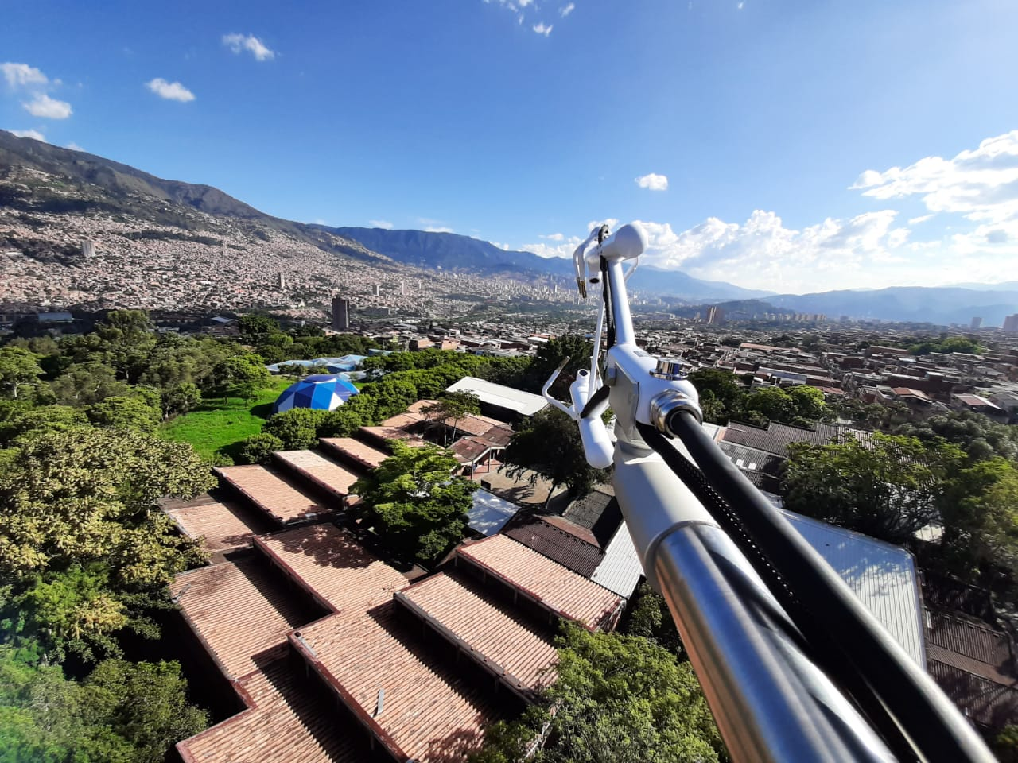
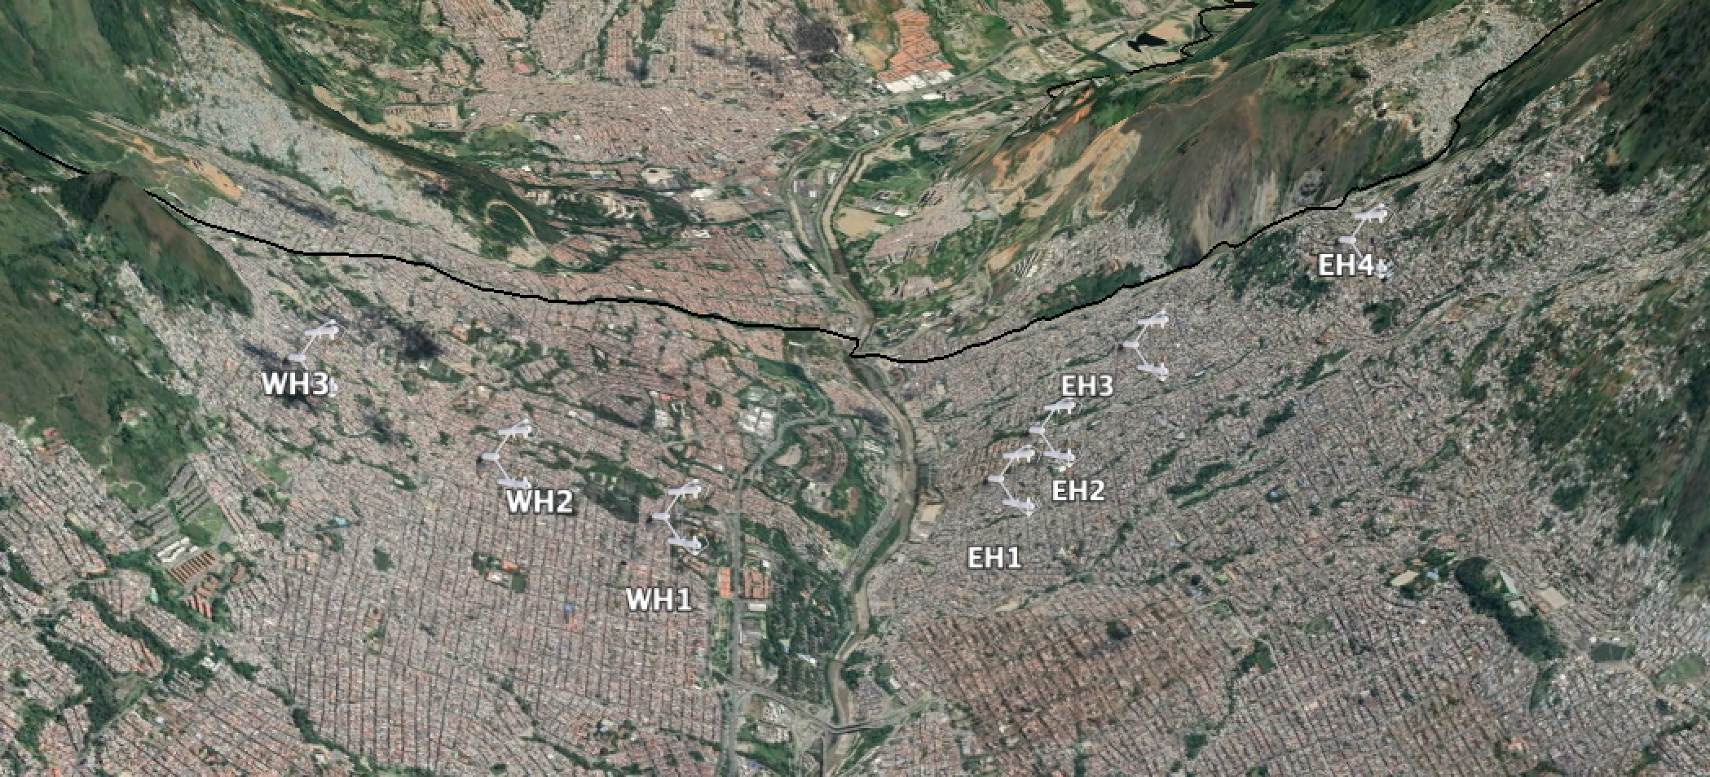
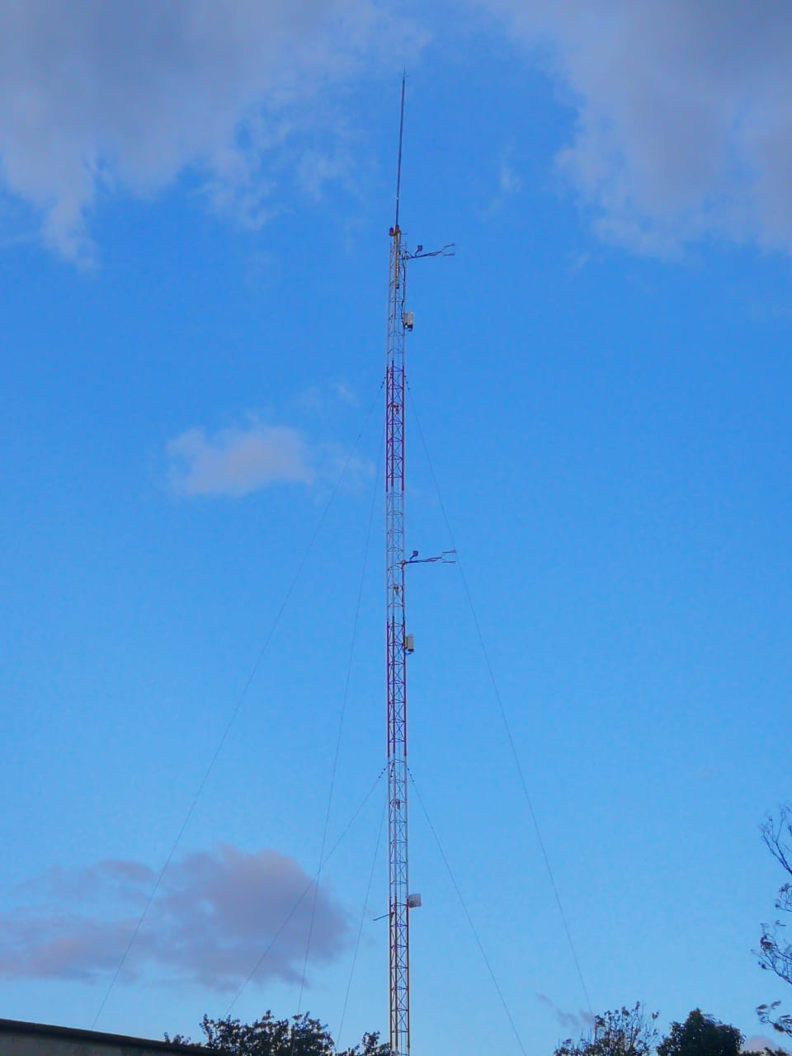

Slide 4
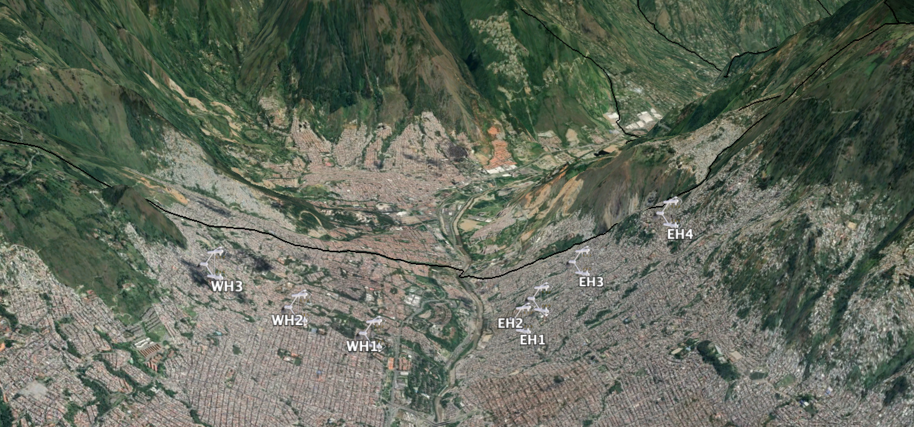
Daily Cycle
East Hillslope 4
Wind Speed
(ms⁻¹)
0 - 1
1 - 2
2 - 3
3 - 4
4 - 5
5 - 6
6 - 7
>7
0:00
12:00
2:00
14:00
4:00
16:00
6:00
18:00
8:00
20:00
10:00
22:00
6 m
11 m

Slide 5
Daily Cycle
East Hillslope 3
Wind Speed
(ms⁻¹)
0 - 1
1 - 2
2 - 3
3 - 4
4 - 5
5 - 6
6 - 7
>7
0:00
12:00
2:00
14:00
4:00
16:00
6:00
18:00
8:00
20:00
10:00
22:00
9 m
16 m

Slide 6
East Hillslope 2
Wind Speed
(ms⁻¹)
0 - 1
1 - 2
2 - 3
3 - 4
4 - 5
5 - 6
6 - 7
>7
0:00
12:00
2:00
14:00
4:00
16:00
6:00
18:00
8:00
20:00
10:00
22:00
6 m
10 m

Slide 7
East Hillslope 1
Wind Speed
(ms⁻¹)
0 - 1
1 - 2
2 - 3
3 - 4
4 - 5
5 - 6
6 - 7
>7
0:00
12:00
2:00
14:00
4:00
16:00
6:00
18:00
8:00
20:00
10:00
22:00
9 m
12 m

Slide 8
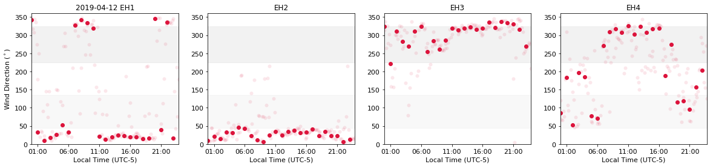
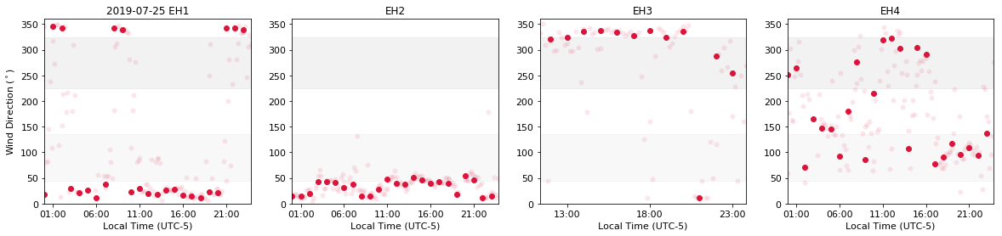
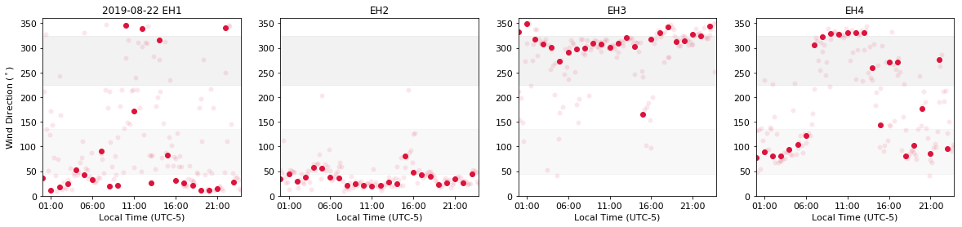
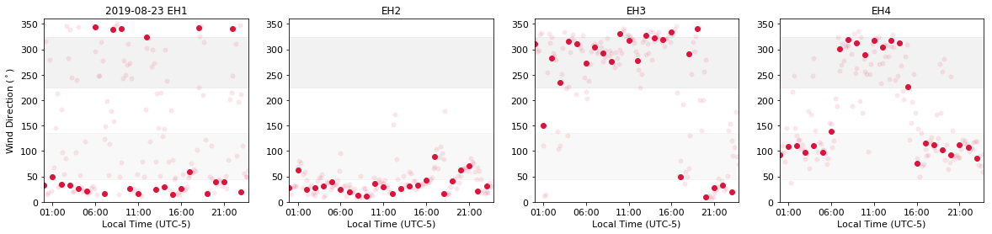

Slide 9
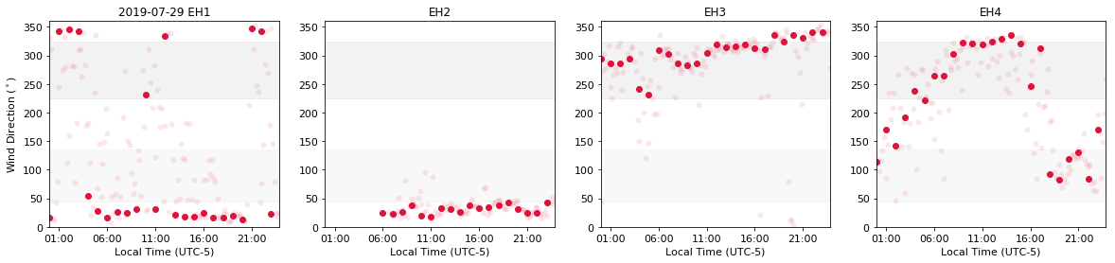
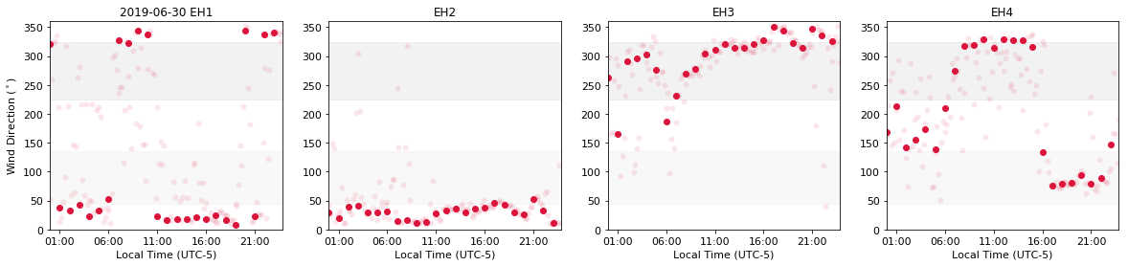
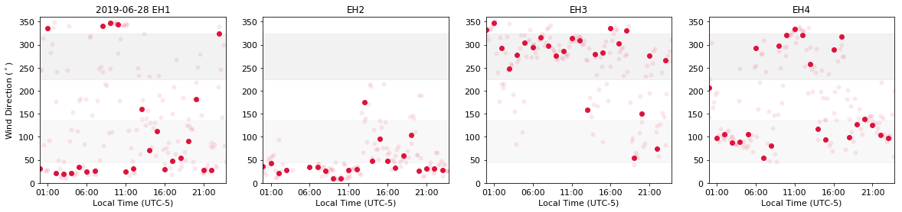
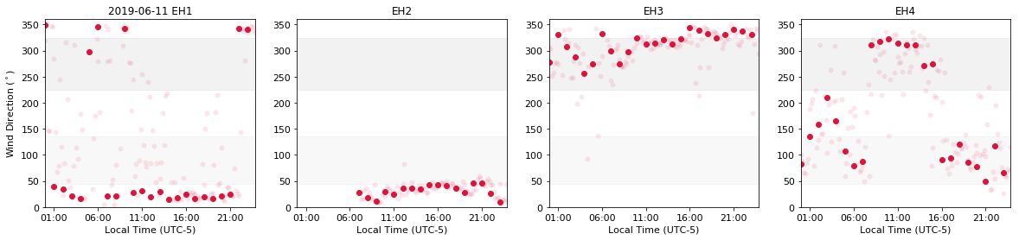

Slide 10

Valley Flow
1.
2.
Meteo
Stations
Valley Wind Days
35 Stations
Since 2014 03 01

Slide 11
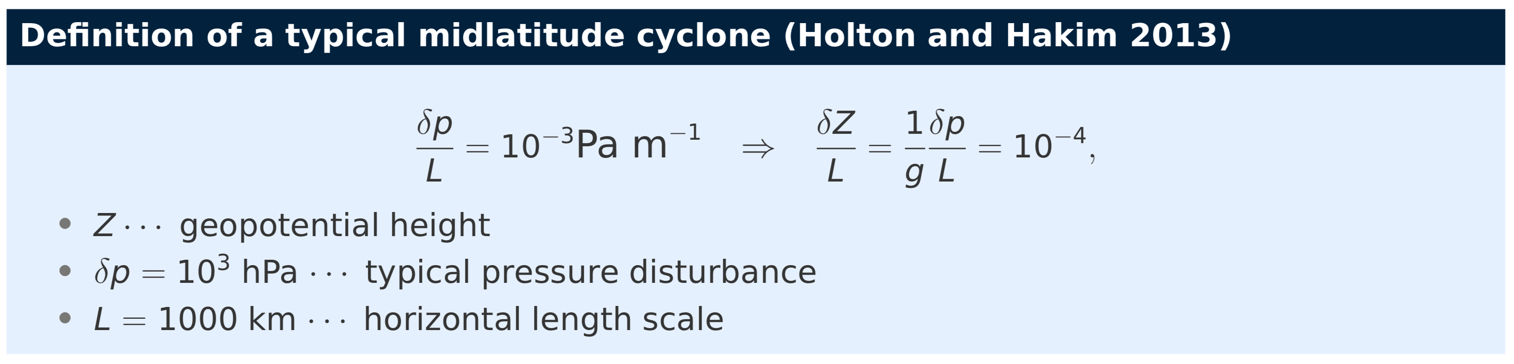
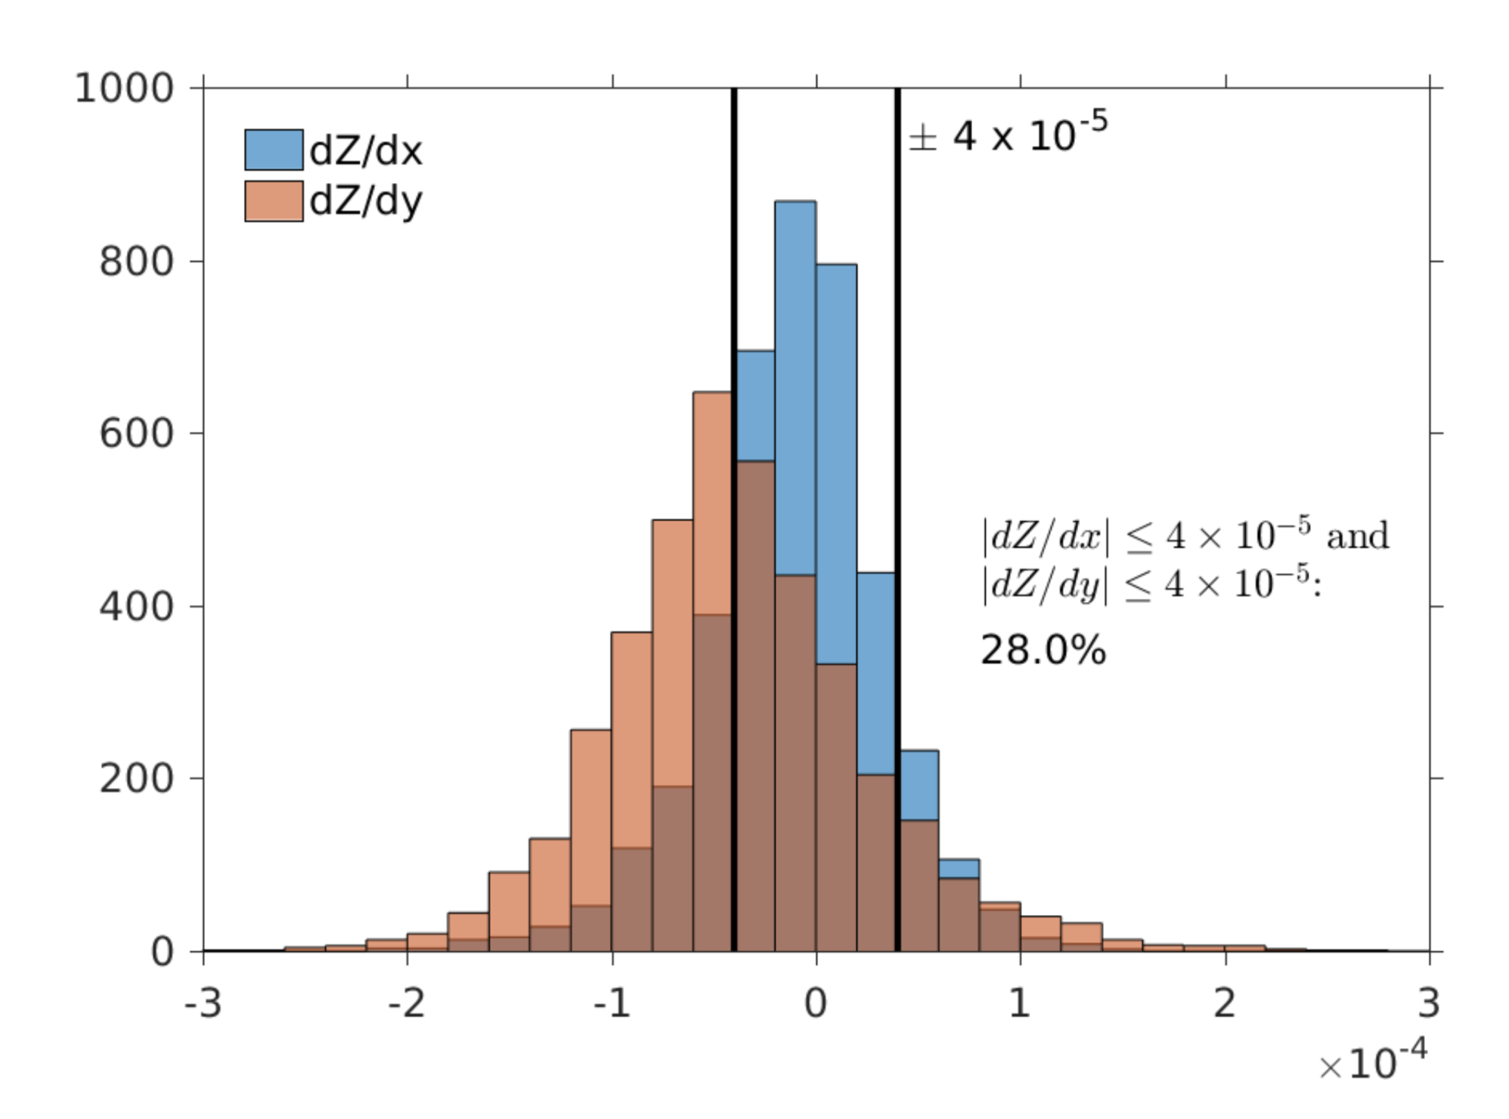

Valley Wind Days
In general, pressure gradients in the tropics are weak (Except in tropical cyclones)

Slide 12
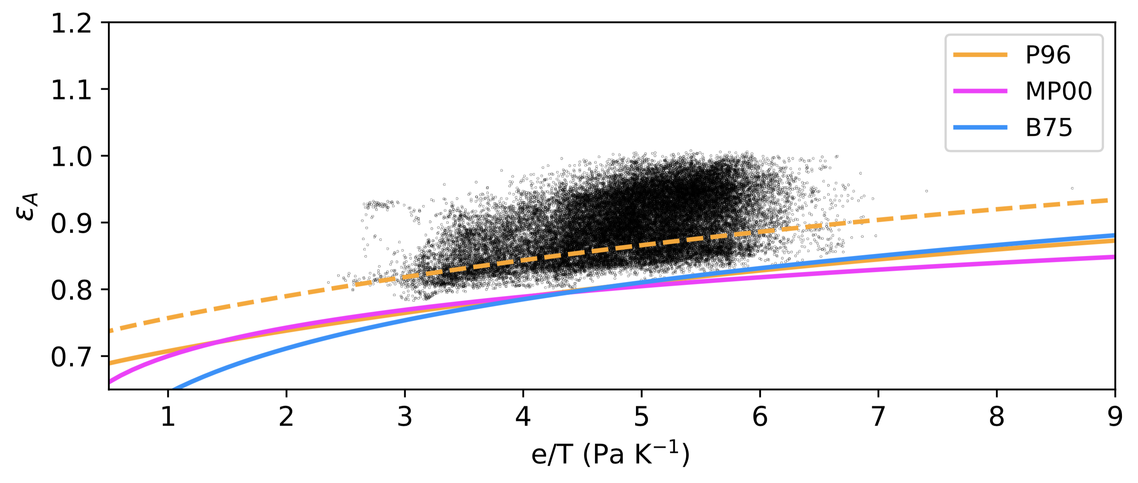
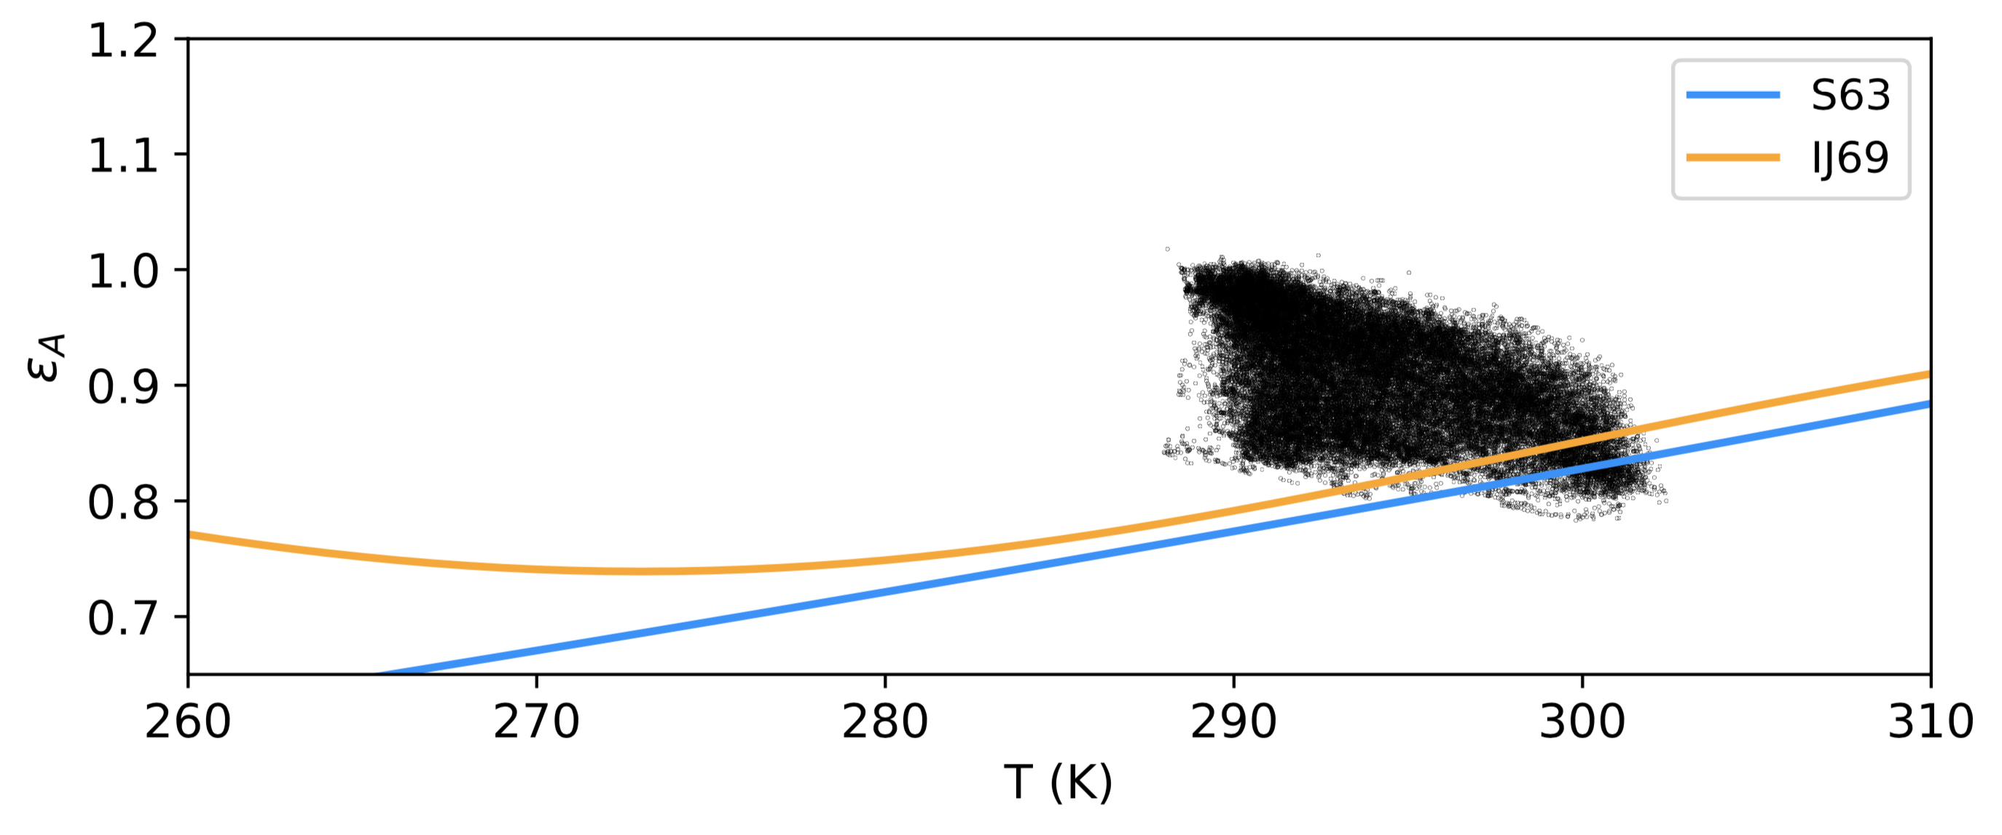
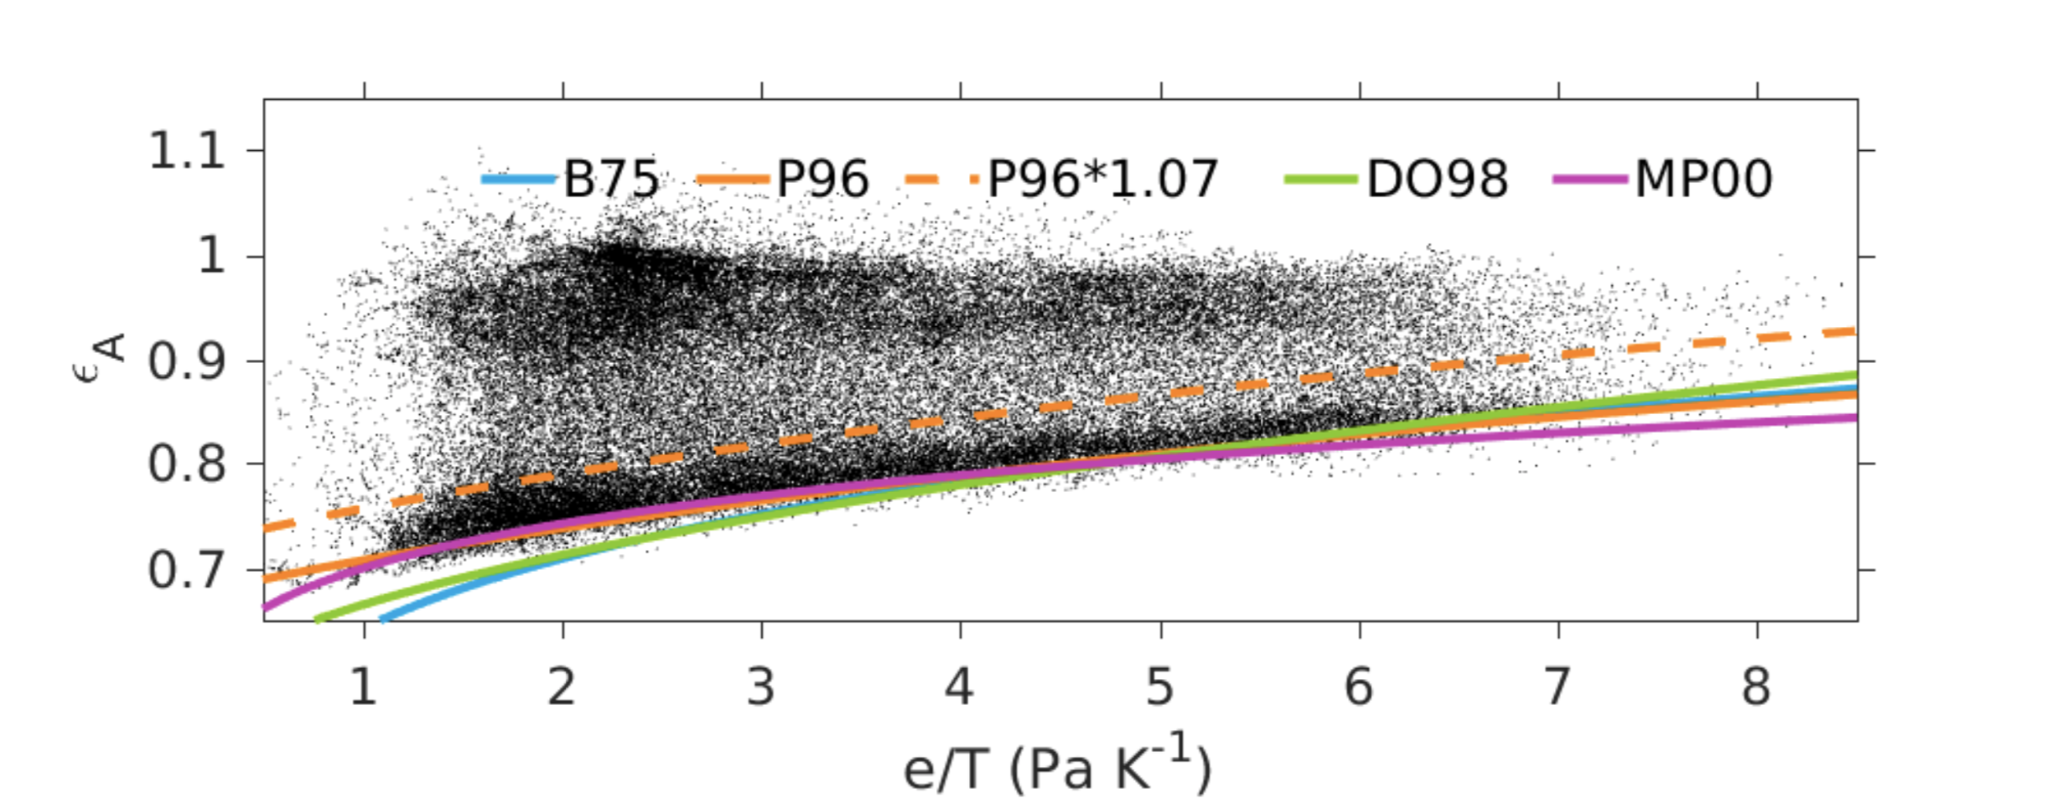
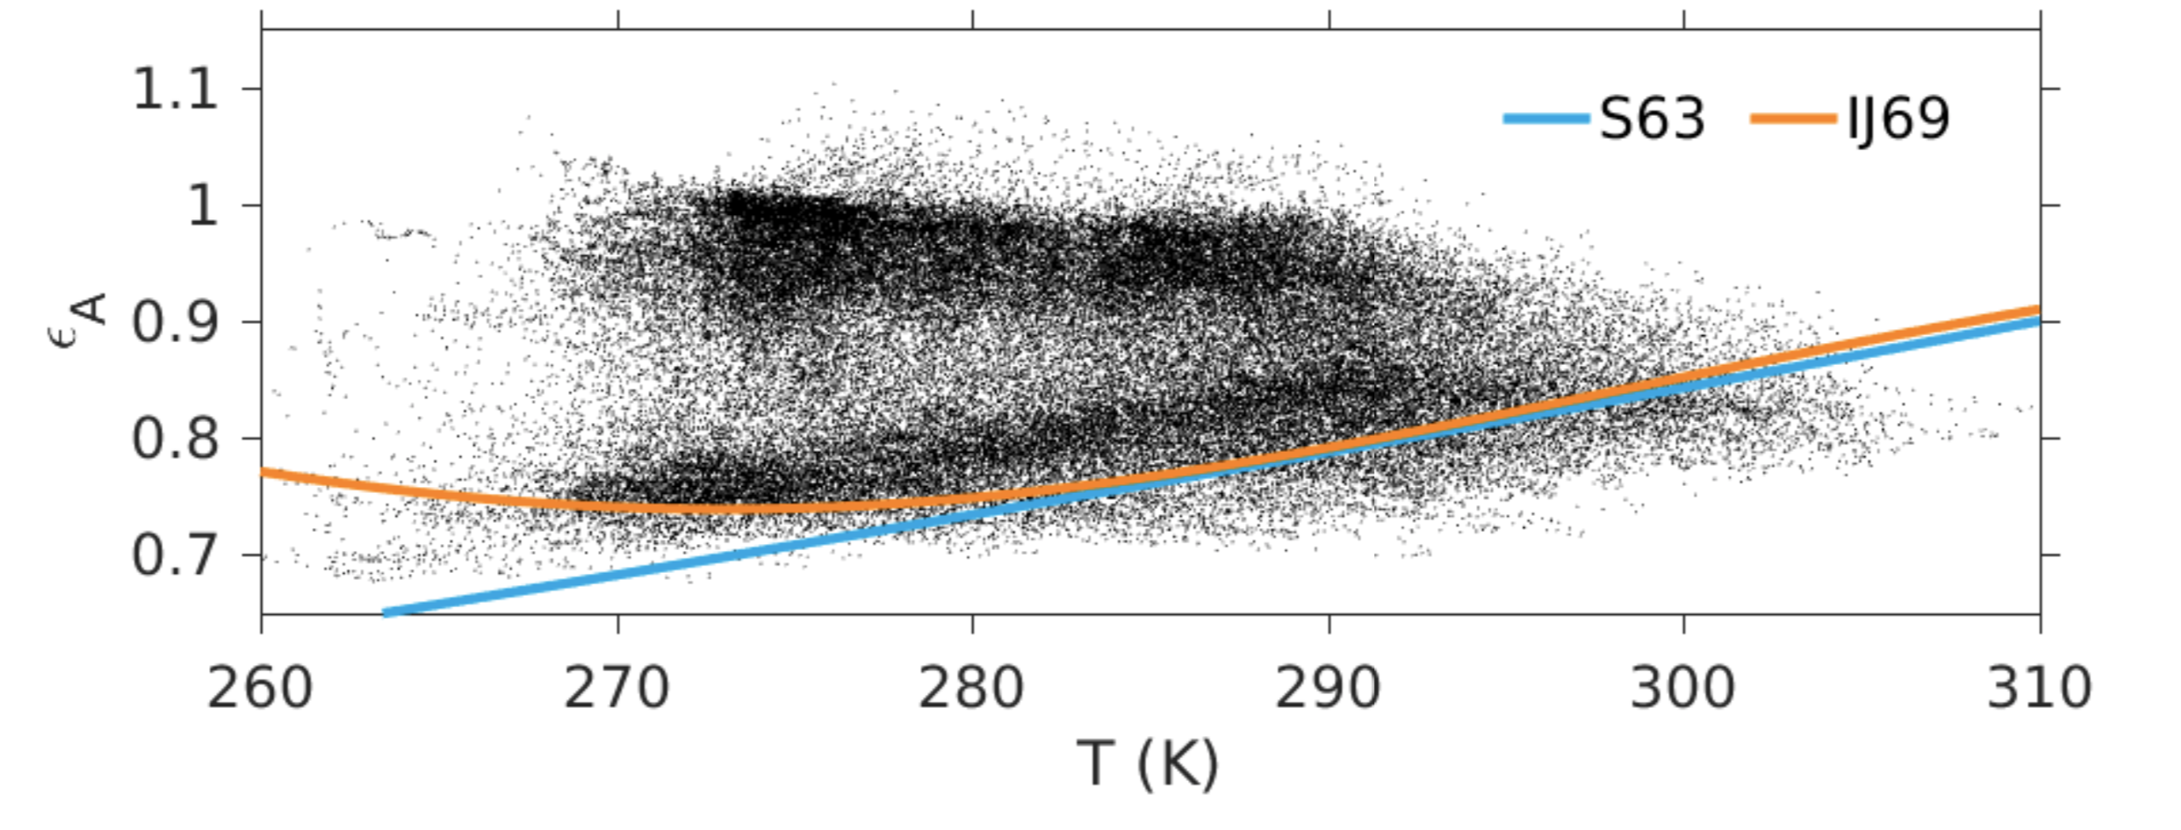
Aburrá Valley (10 months )
Inn Valley

Slide 13
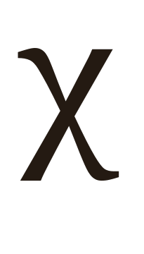
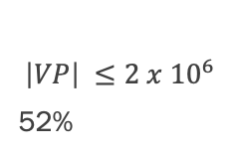
Alternative? Velocity Potential + Stream Function
The idea is to separate the wind field in two components
V = V_{ROT} + V_{DIV}
V_{DIV} = 𝛻
Velocity Potential
$$\left|VP\right| ≤2 x {10}^{6}$$
52%

Slide 14
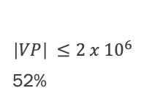
Valley Wind Days
2016-03-10 / 2019-10-01
Synoptic Forcing
“Local” Dynamics
Velocity Potential
No Trade Winds
No Rain
No Clouds
+
$$\left|VP\right| ≤2 x {10}^{6}$$
52%
Total Days = 0

Slide 15
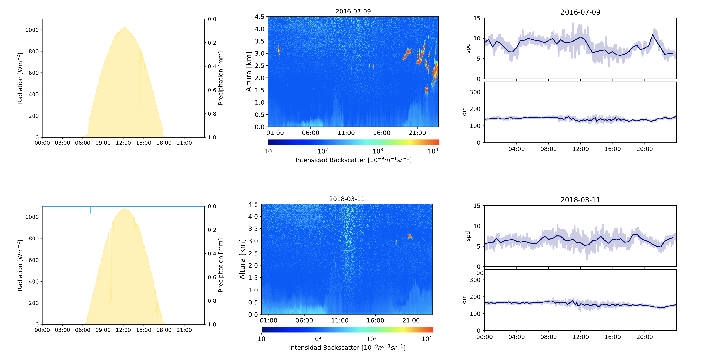
Valley Wind Days

Slide 16
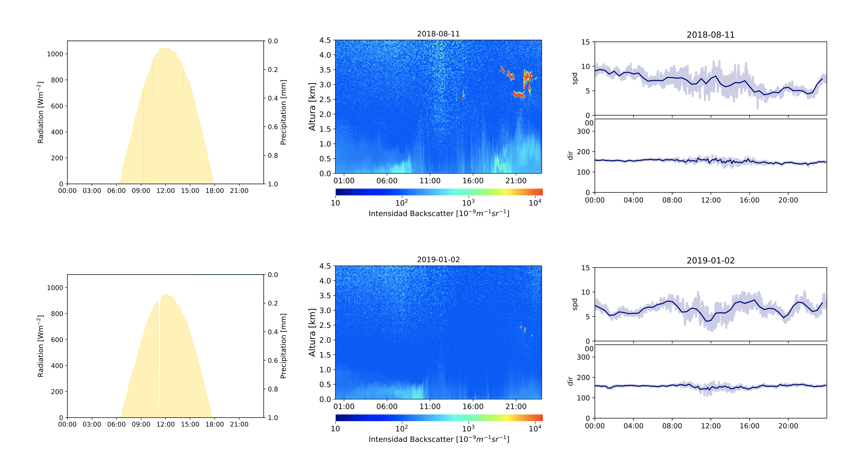

Slide 17
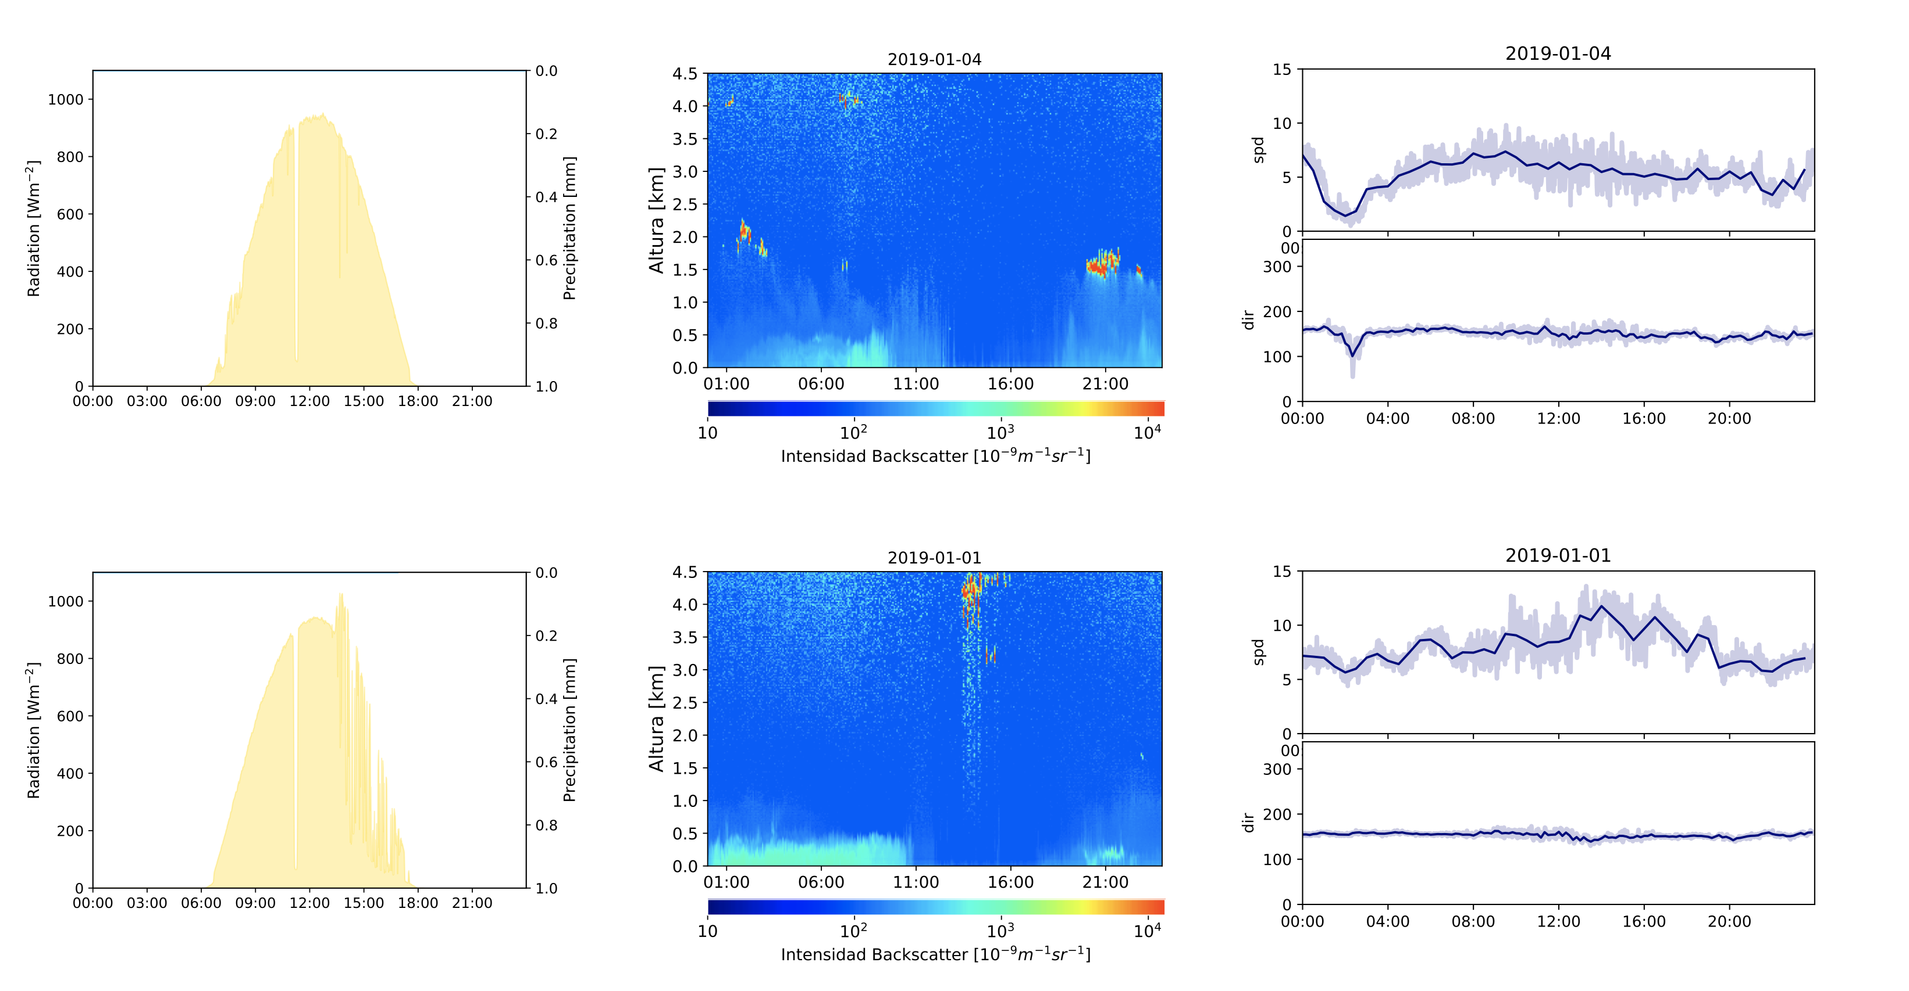

Slide 18
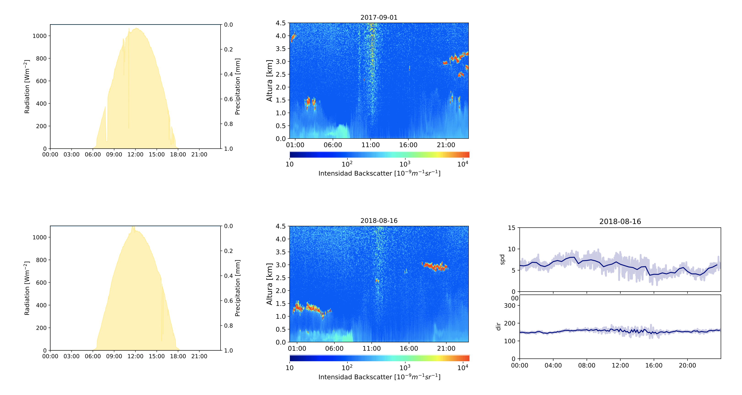

Slide 19
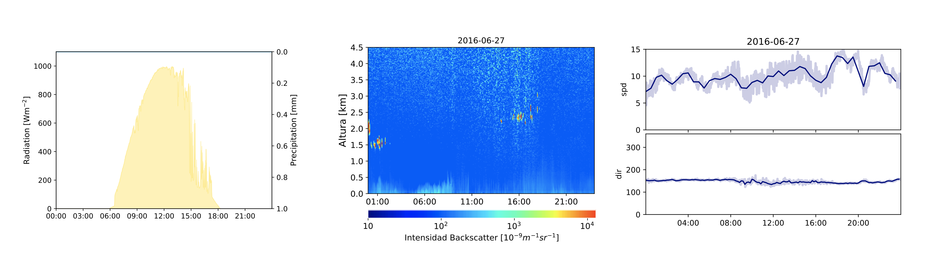

Slide 20
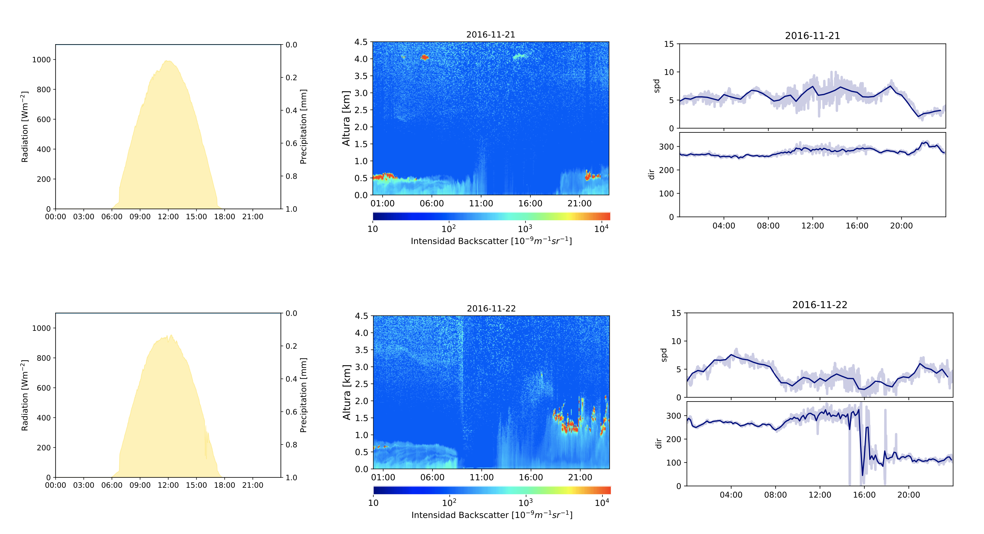

Slide 21
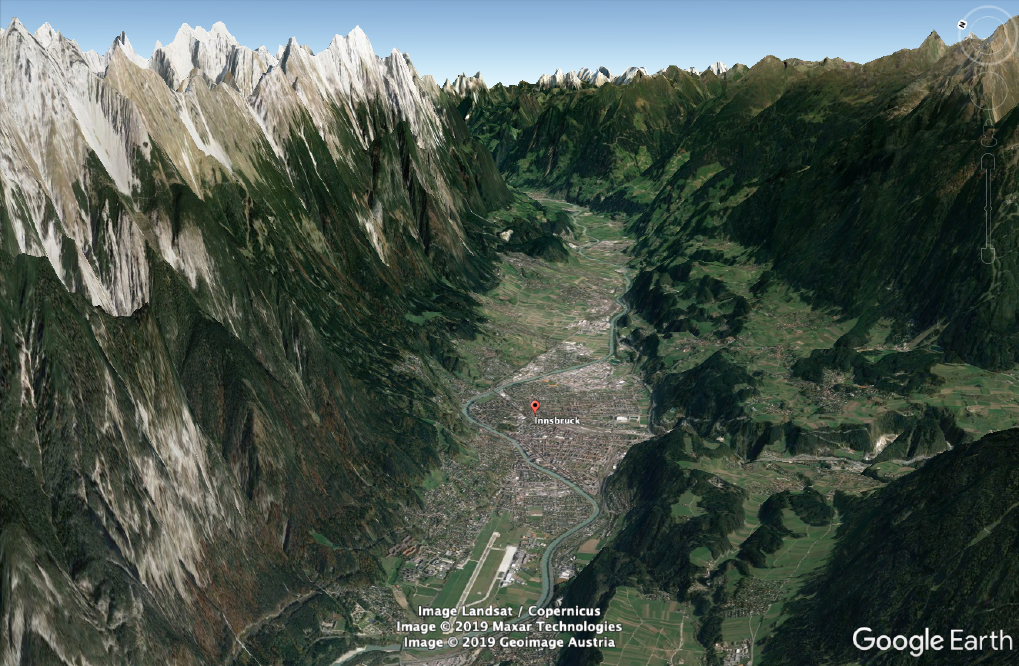
Aburrá Valley
Inn Valley

Slide 22
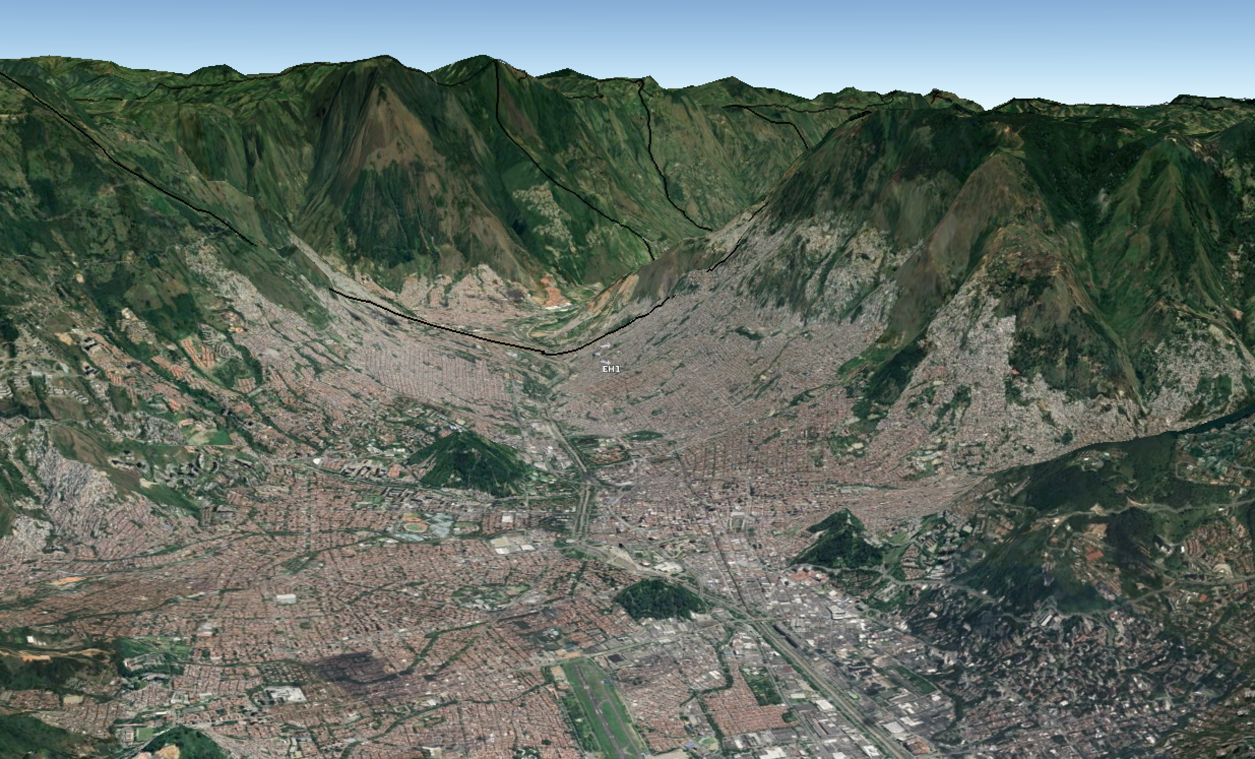

Slide 24
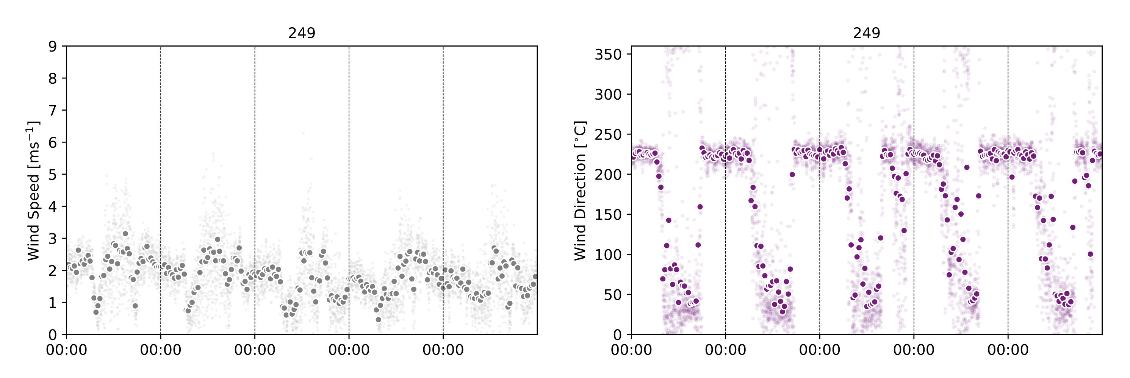

Slide 25
0:00
12:00
2:00
14:00
4:00
16:00
6:00
18:00
8:00
20:00
10:00
22:00

Slide 26
0:00
12:00
2:00
14:00
4:00
16:00
6:00
18:00
8:00
20:00
10:00
22:00

Slide 27
0:00
12:00
2:00
14:00
4:00
16:00
6:00
18:00
8:00
20:00
10:00
22:00

Slide 28
0:00
12:00
2:00
14:00
4:00
16:00
6:00
18:00
8:00
20:00
10:00
22:00

Slide 29
0:00
12:00
2:00
14:00
4:00
16:00
6:00
18:00
8:00
20:00
10:00
22:00

Slide 30
0:00
12:00
2:00
14:00
4:00
16:00
6:00
18:00
8:00
20:00
10:00
22:00

Slide 31
0:00
12:00
2:00
14:00
4:00
16:00
6:00
18:00
8:00
20:00
10:00
22:00

Slide 32
0:00
12:00
2:00
14:00
4:00
16:00
6:00
18:00
8:00
20:00
10:00
22:00

Slide 33
0:00
12:00
2:00
14:00
4:00
16:00
6:00
18:00
8:00
20:00
10:00
22:00

Slide 34
0:00
12:00
2:00
14:00
4:00
16:00
6:00
18:00
8:00
20:00
10:00
22:00

Slide 35
0:00
12:00
2:00
14:00
4:00
16:00
6:00
18:00
8:00
20:00
10:00
22:00

Slide 36
0:00
12:00
2:00
14:00
4:00
16:00
6:00
18:00
8:00
20:00
10:00
22:00

Slide 37
0:00
12:00
2:00
14:00
4:00
16:00
6:00
18:00
8:00
20:00
10:00
22:00

Slide 38
0:00
12:00
2:00
14:00
4:00
16:00
6:00
18:00
8:00
20:00
10:00
22:00

Slide 39
0:00
12:00
2:00
14:00
4:00
16:00
6:00
18:00
8:00
20:00
10:00
22:00

Slide 40
0:00
12:00
2:00
14:00
4:00
16:00
6:00
18:00
8:00
20:00
10:00
22:00

Slide 41
0:00
12:00
2:00
14:00
4:00
16:00
6:00
18:00
8:00
20:00
10:00
22:00

Slide 42
0:00
12:00
2:00
14:00
4:00
16:00
6:00
18:00
8:00
20:00
10:00
22:00

Slide 43
0:00
12:00
2:00
14:00
4:00
16:00
6:00
18:00
8:00
20:00
10:00
22:00

Slide 44
0:00
12:00
2:00
14:00
4:00
16:00
6:00
18:00
8:00
20:00
10:00
22:00

Slide 45
0:00
12:00
2:00
14:00
4:00
16:00
6:00
18:00
8:00
20:00
10:00
22:00

Slide 46
0:00
12:00
2:00
14:00
4:00
16:00
6:00
18:00
8:00
20:00
10:00
22:00

Slide 47
22 Stations
≈ 1 year
Empirical Orthogonal Functions
(EOF)

Slide 48
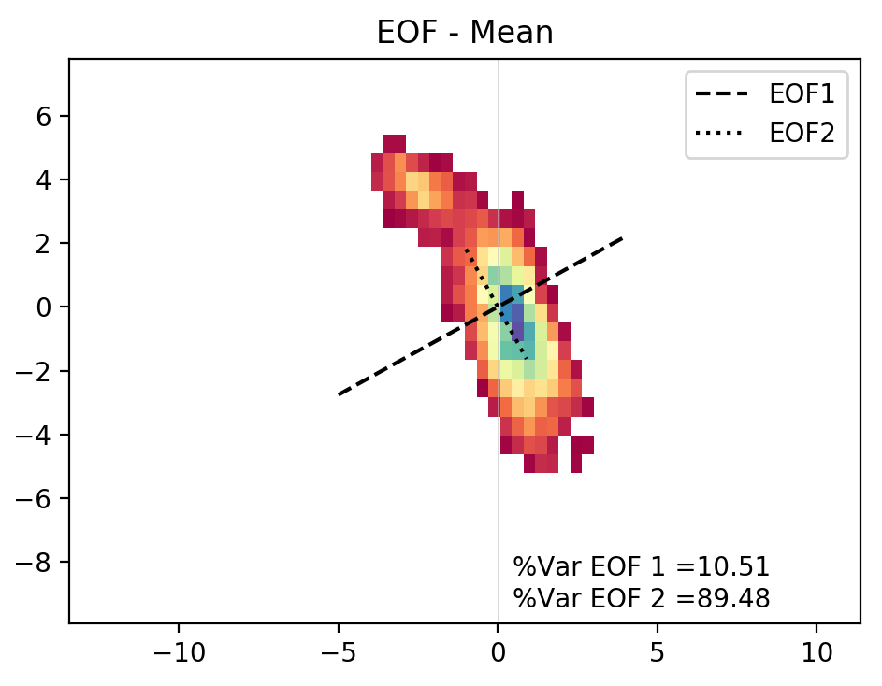
Trade Wind Station

Slide 49
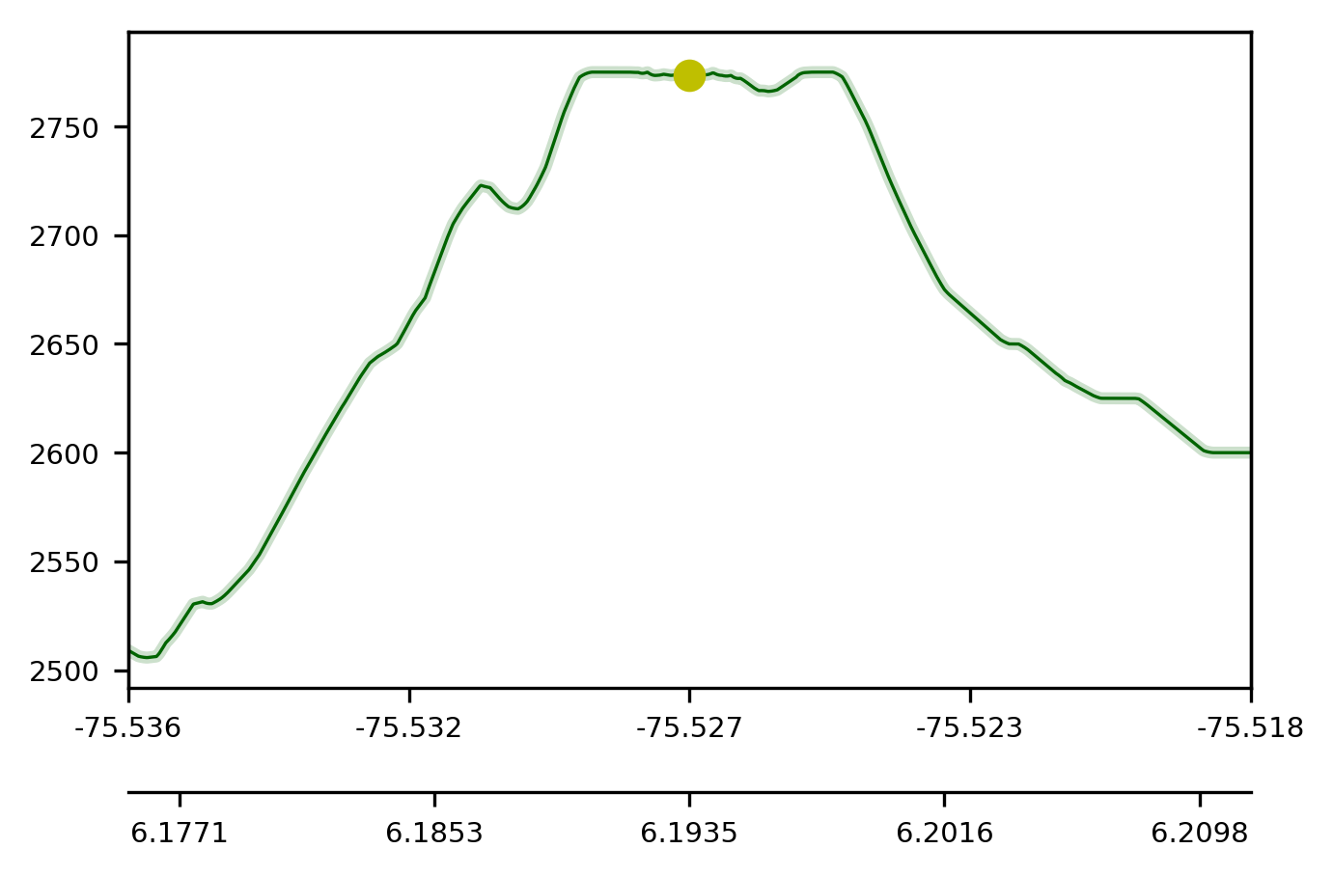
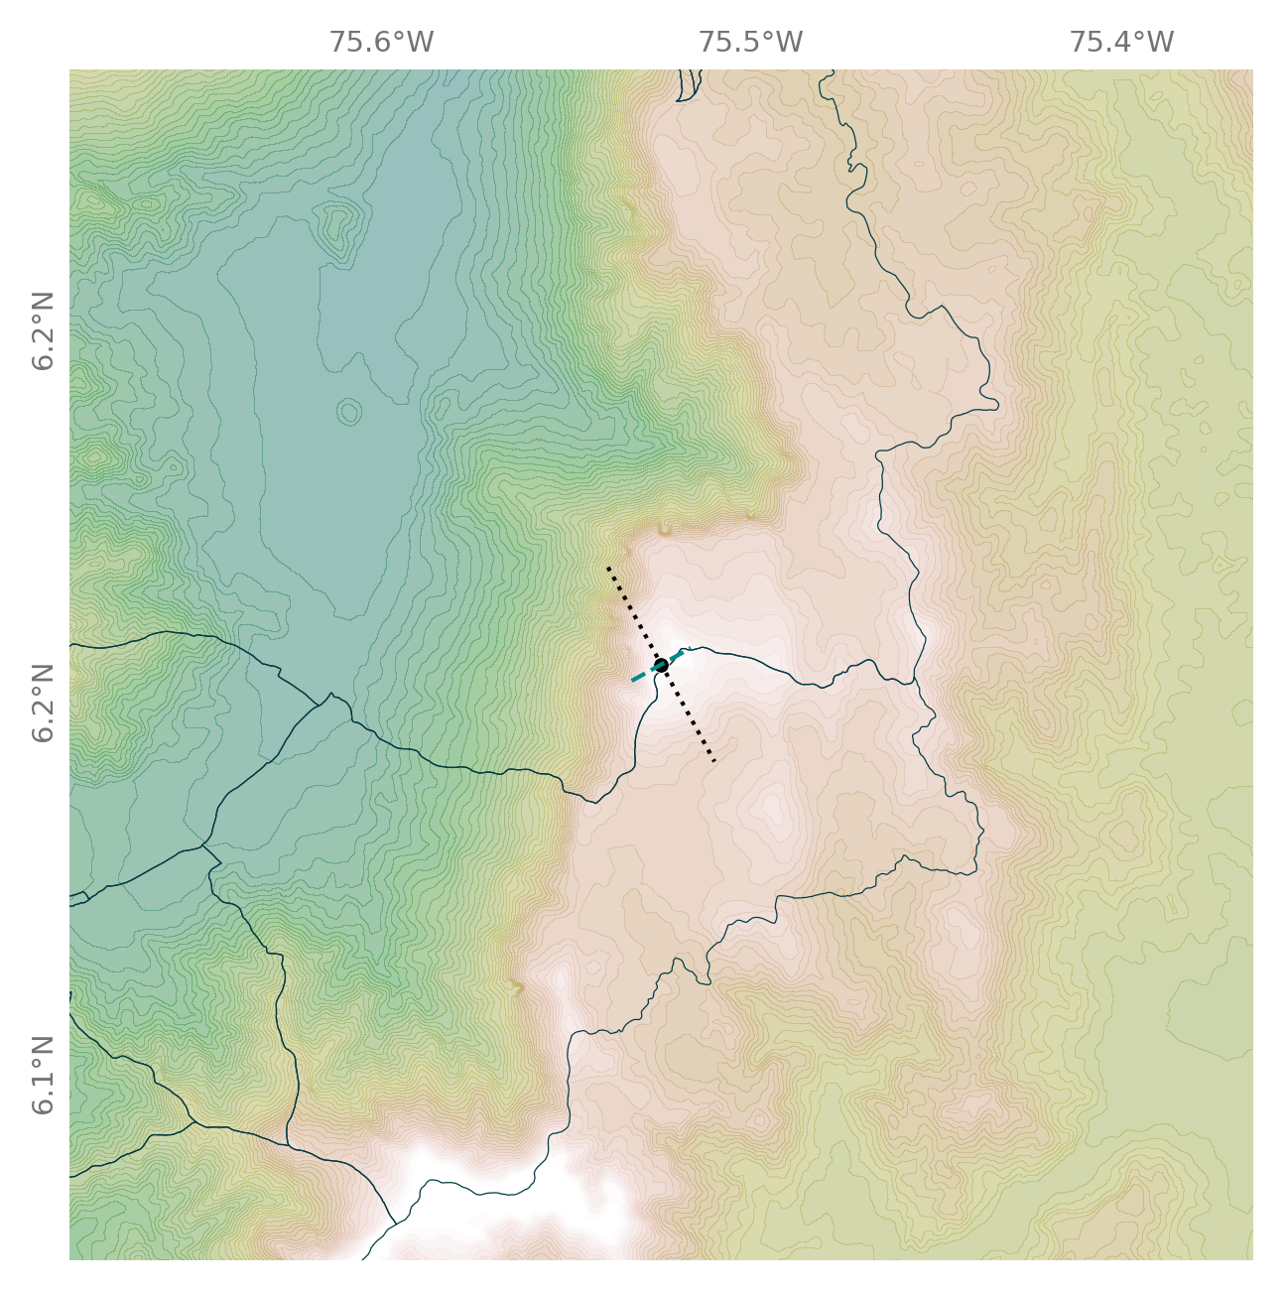
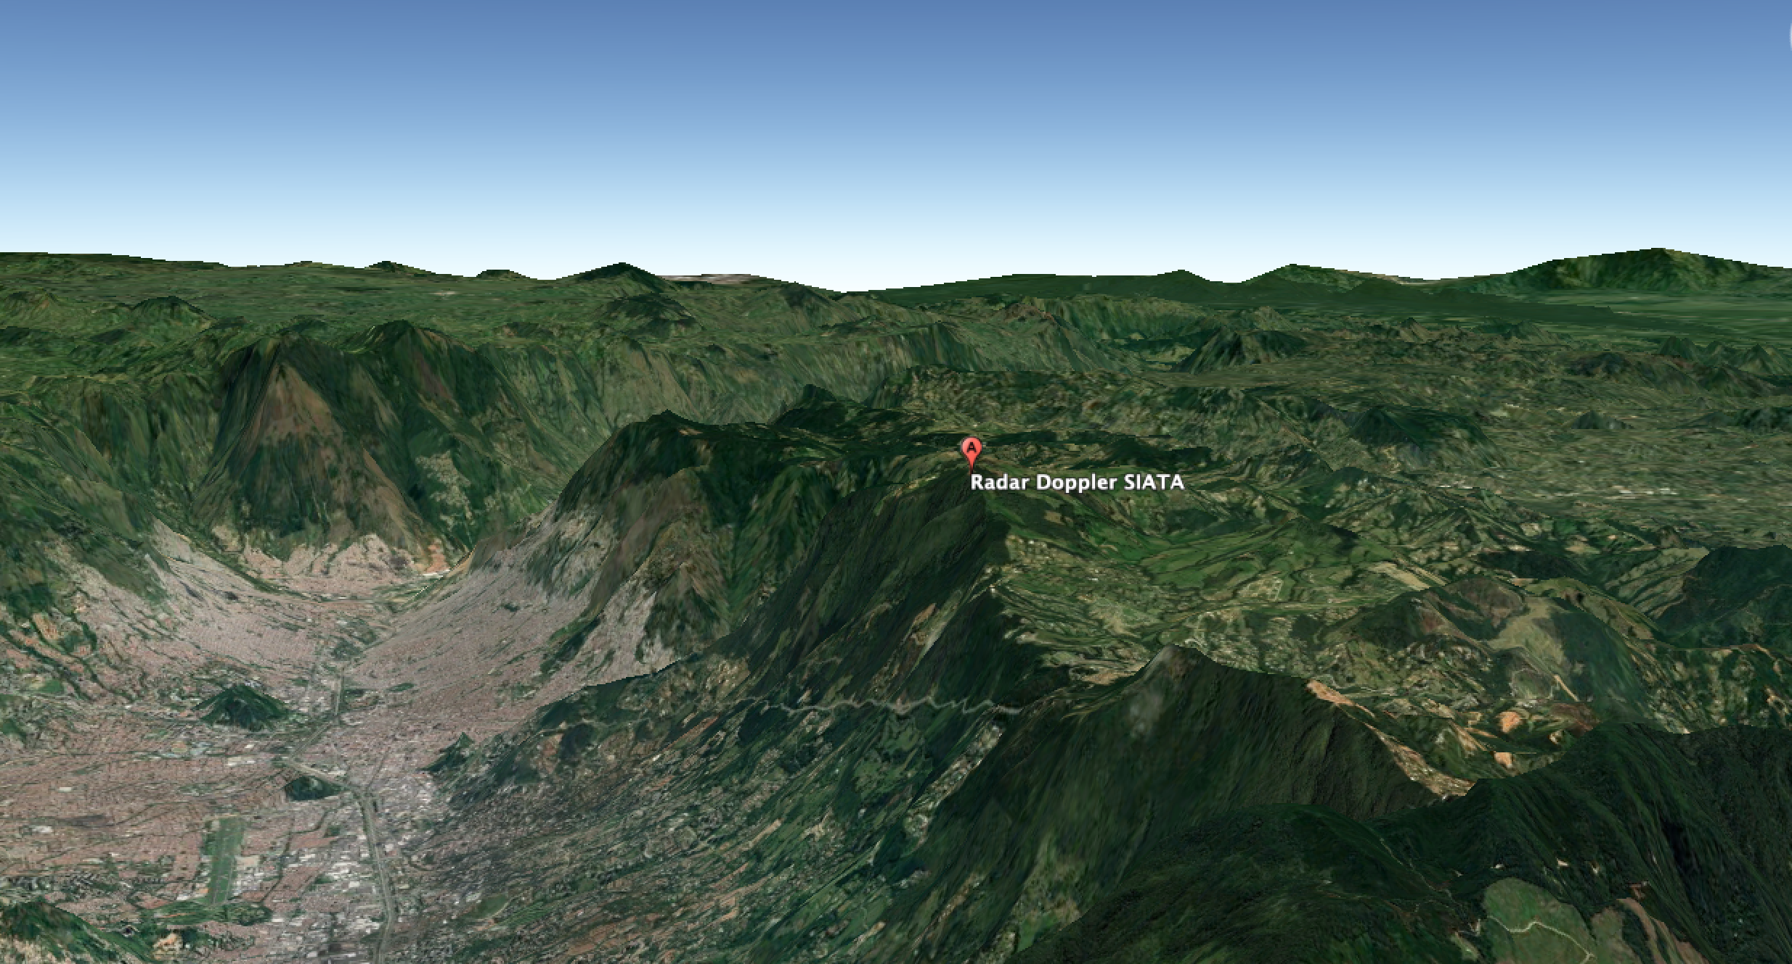
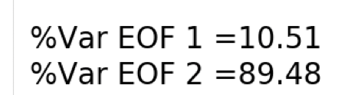
Trade Wind Station

Slide 50
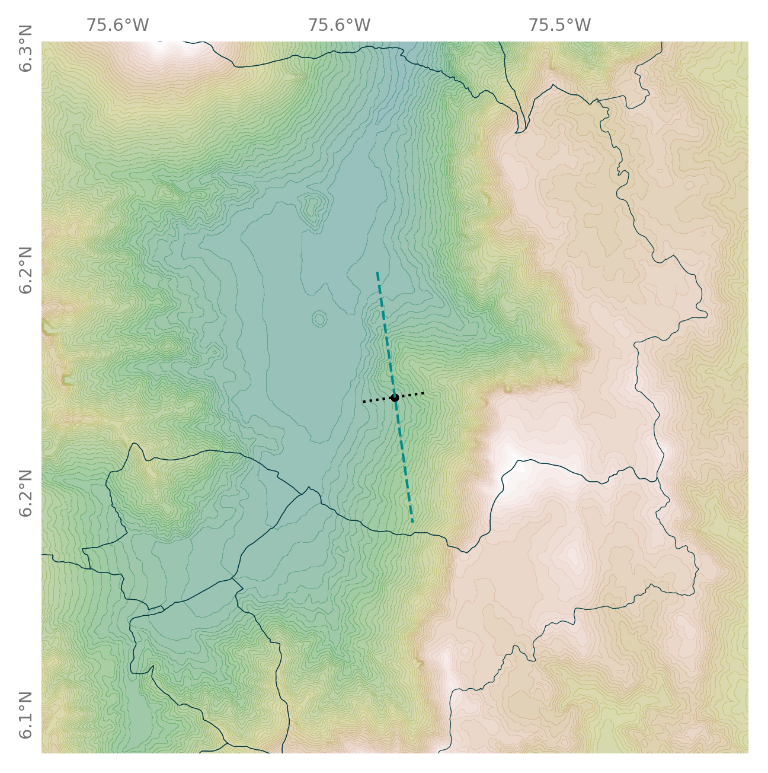
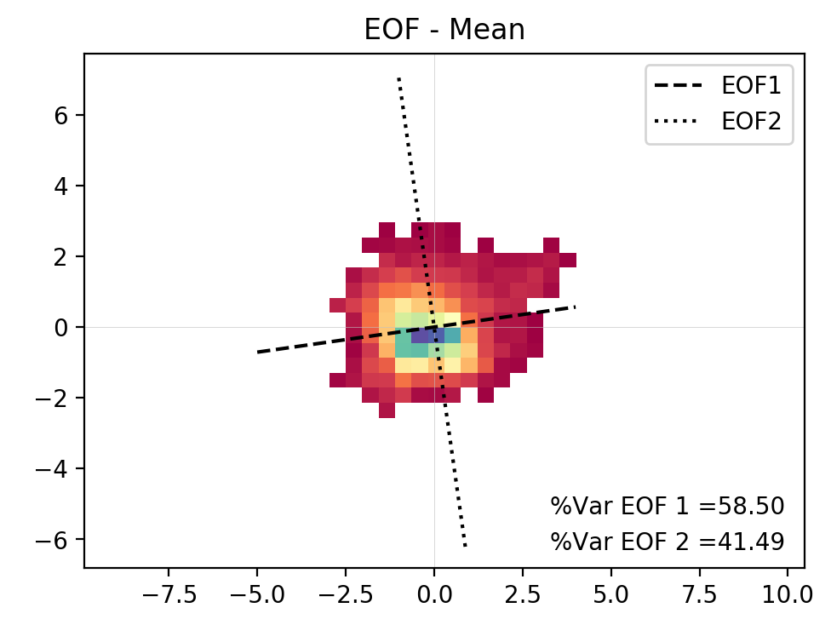
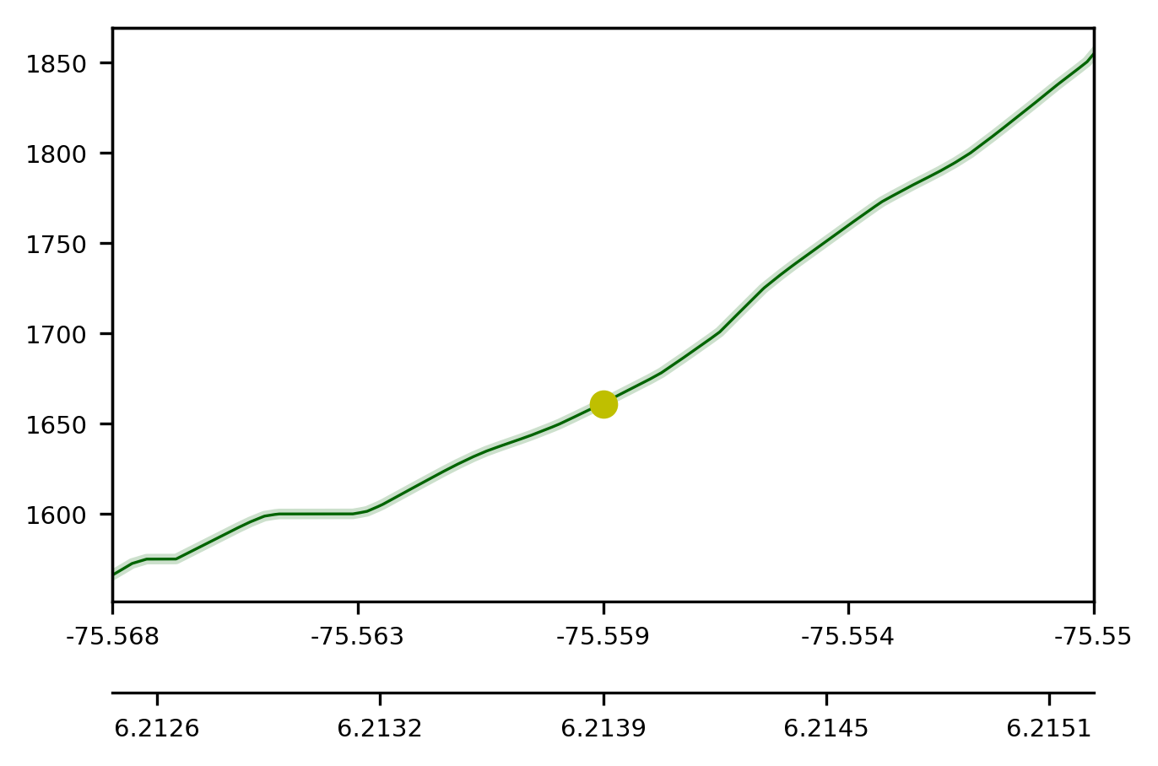

Slide 51
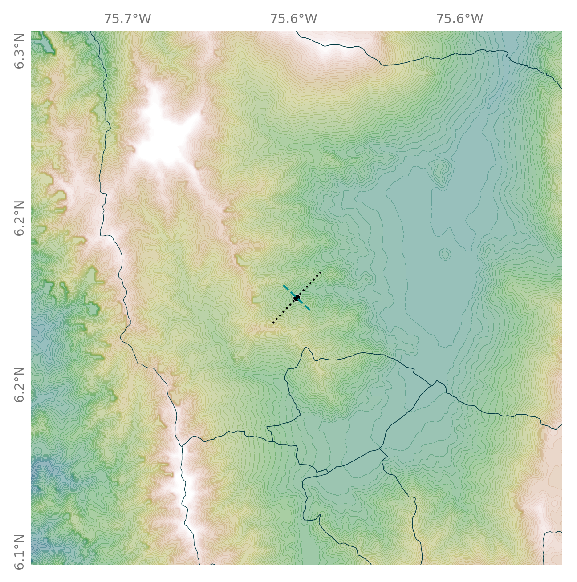
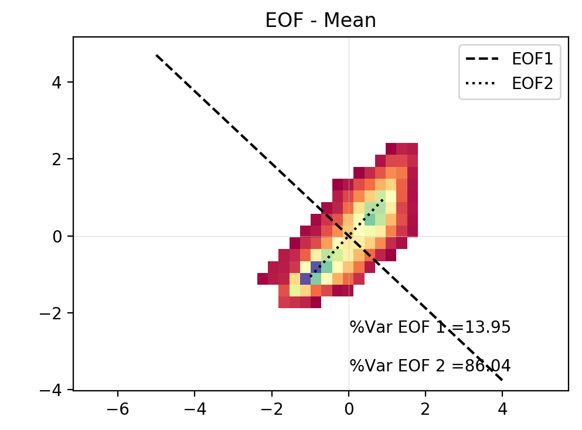

Slide 52
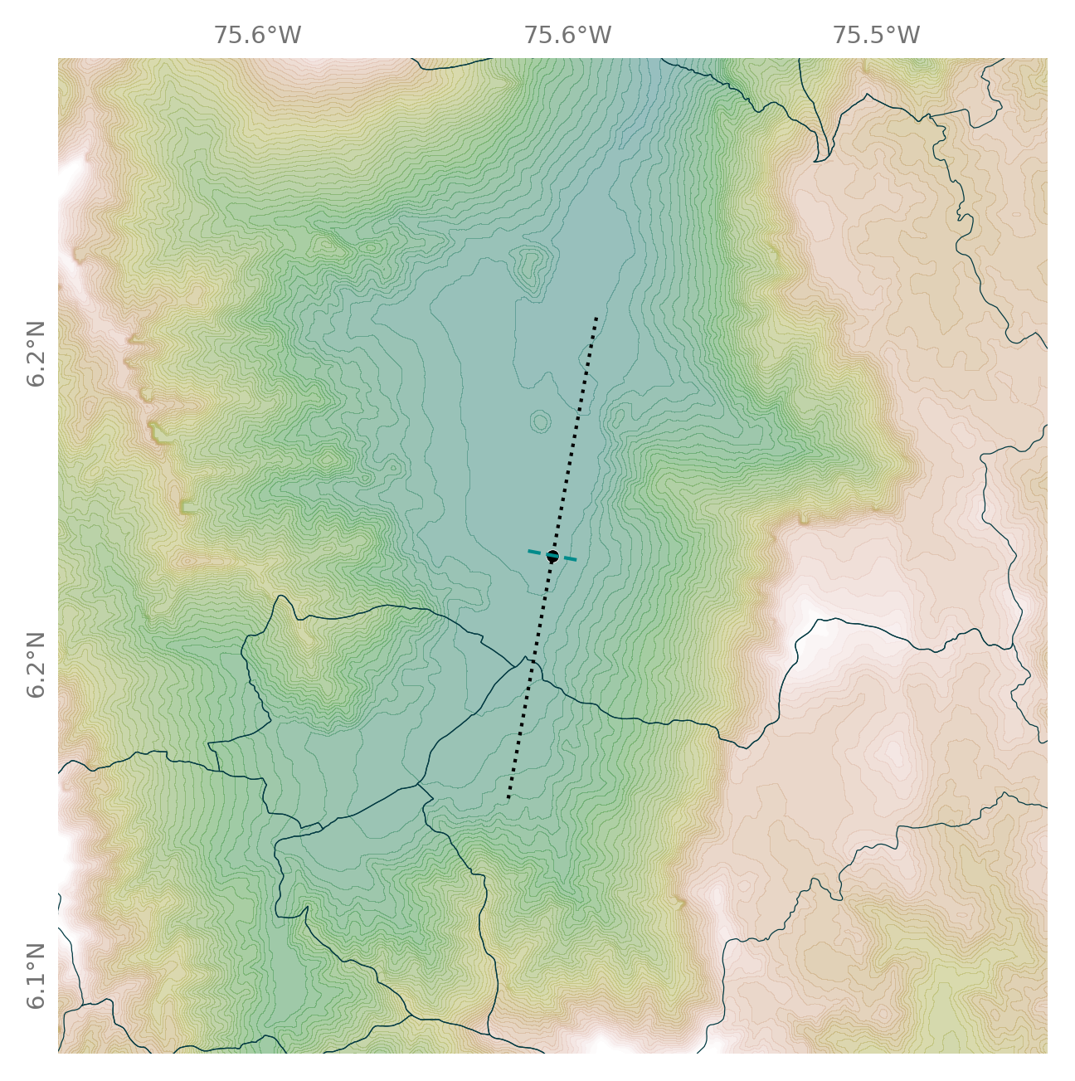
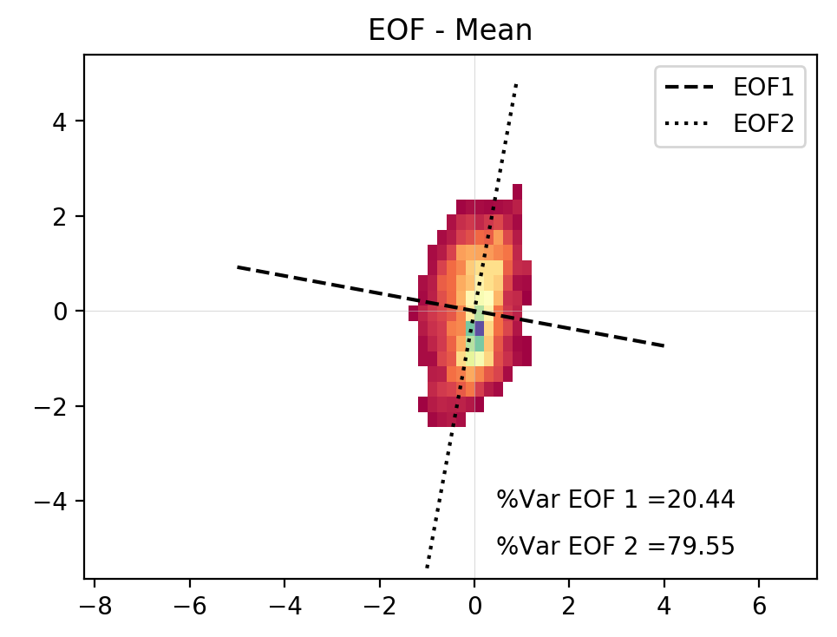

Slide 53
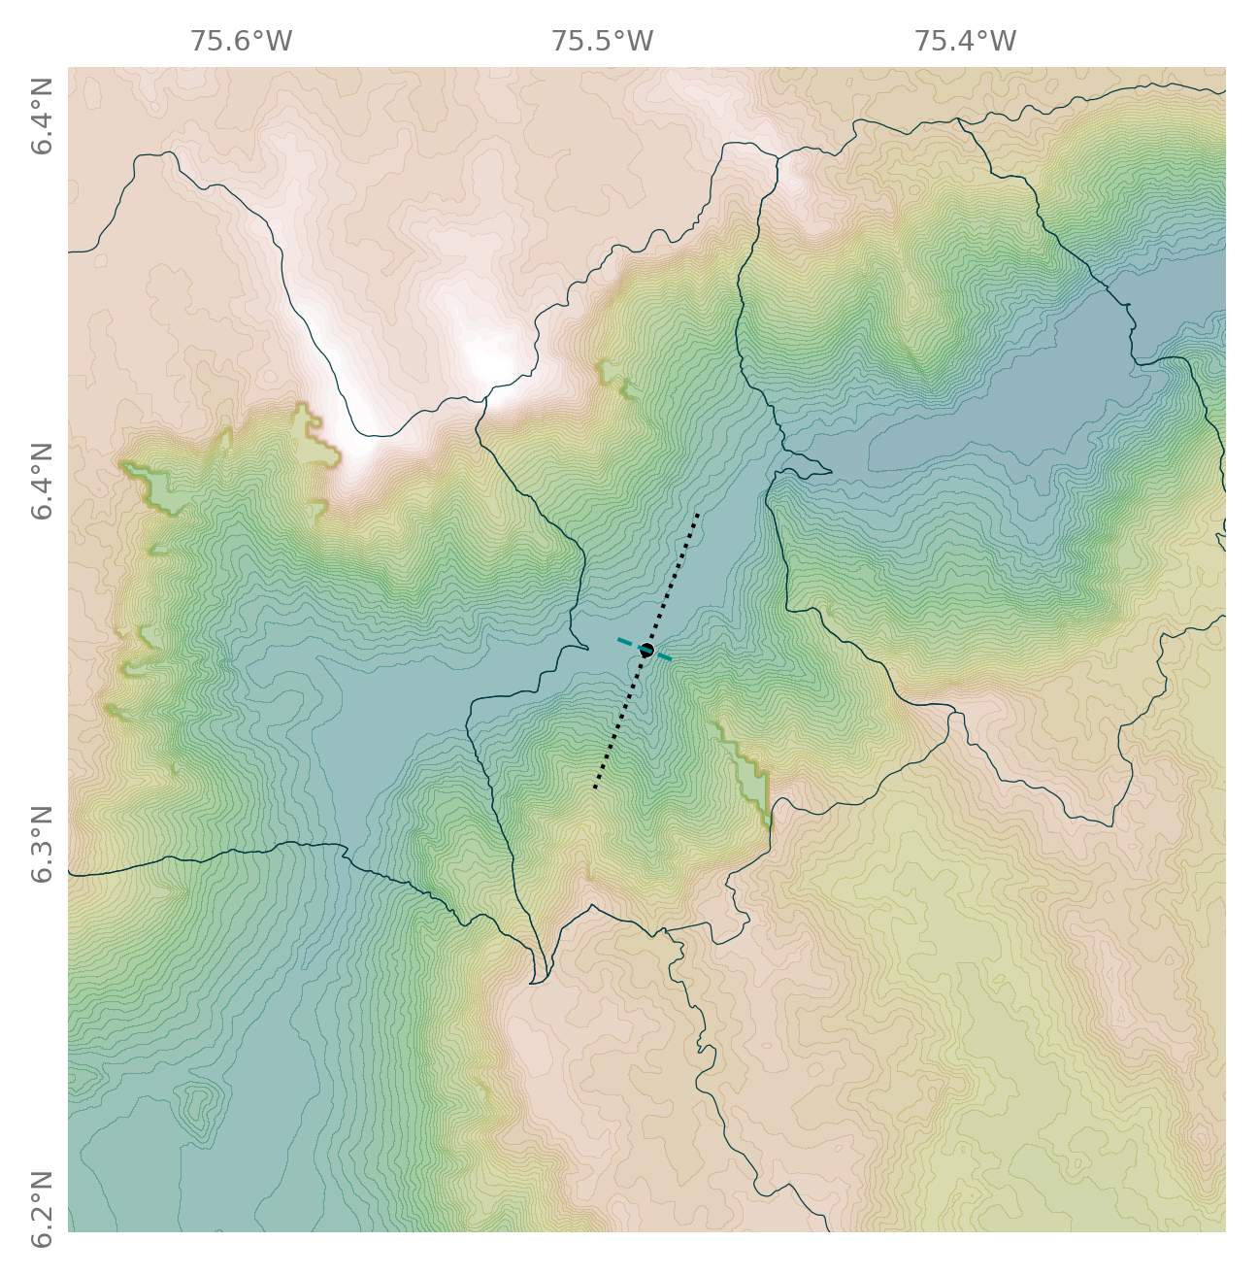
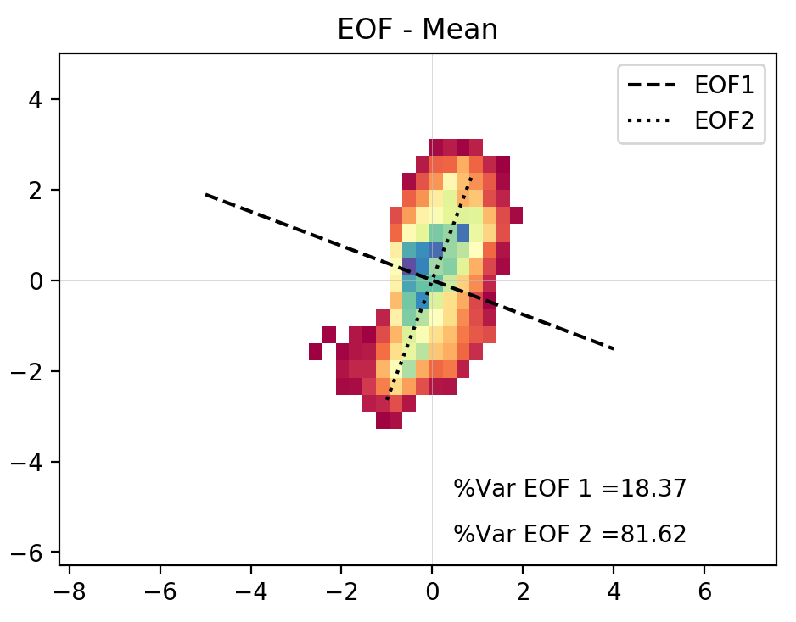
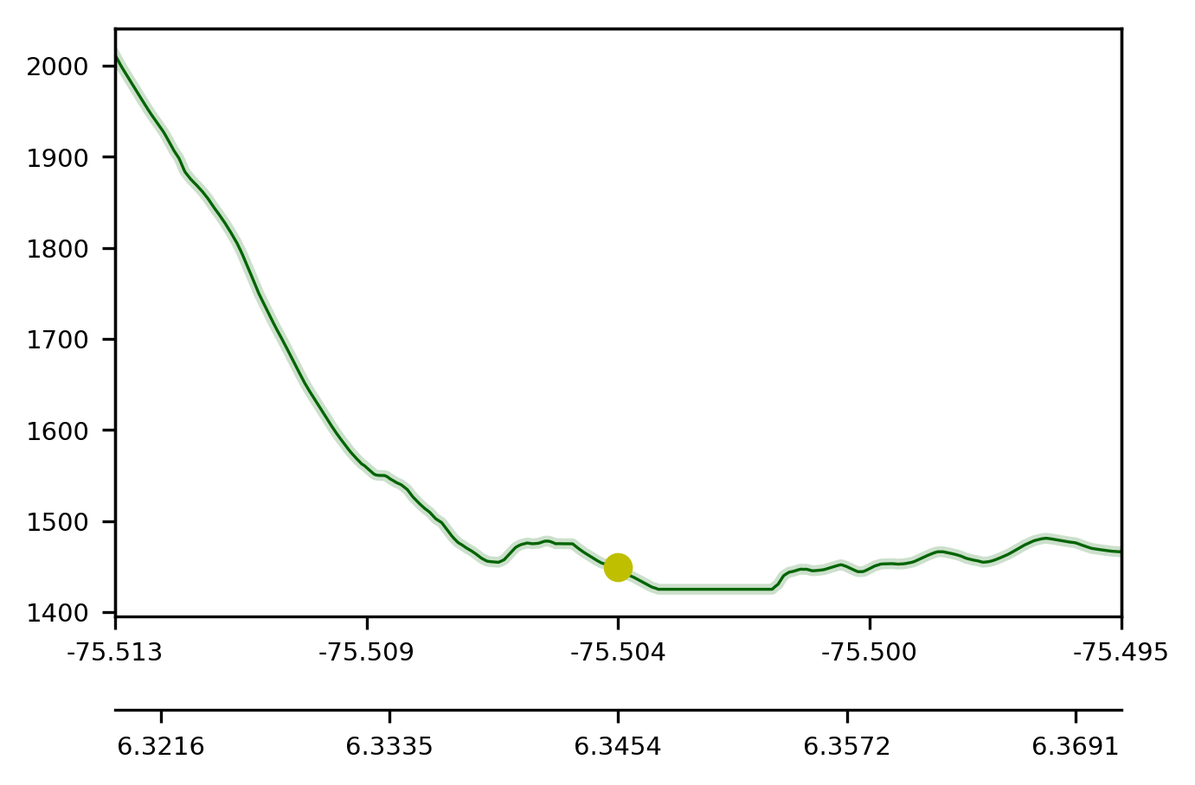

Slide 54
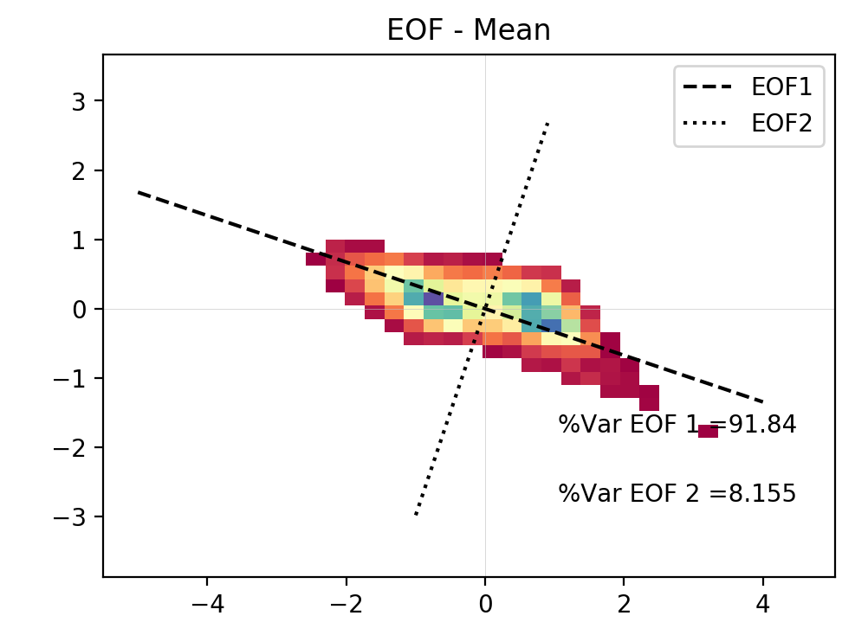
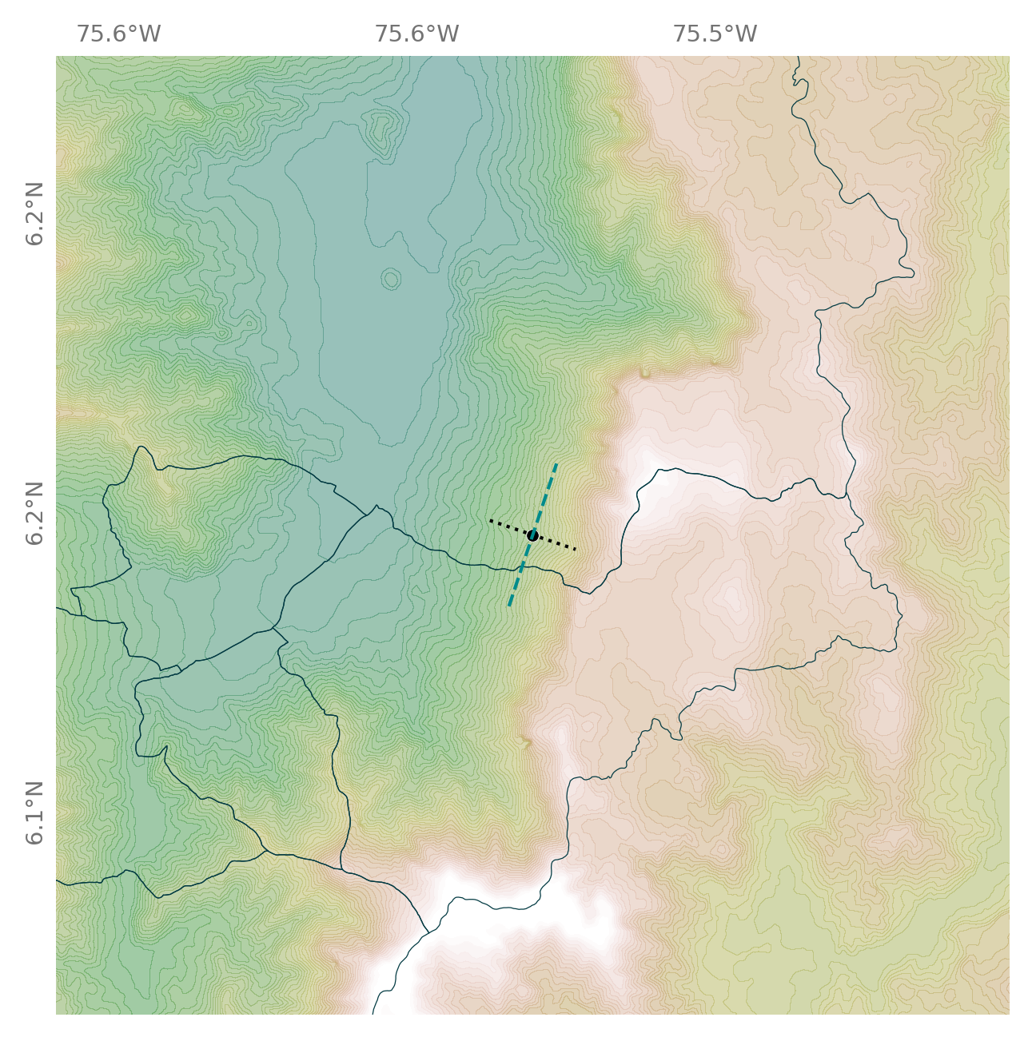

Slide 55




Slide 56




Slide 57




Slide 58




Slide 59



Slide 60



Slide 61



Slide 62



Slide 63



Slide 64



Slide 65



Slide 66



Slide 67



Slide 68



Slide 70
Valley Floor Stations

Slide 71
West Hillslope Stations

Slide 72
East Hillslope Stations

