Slide 1
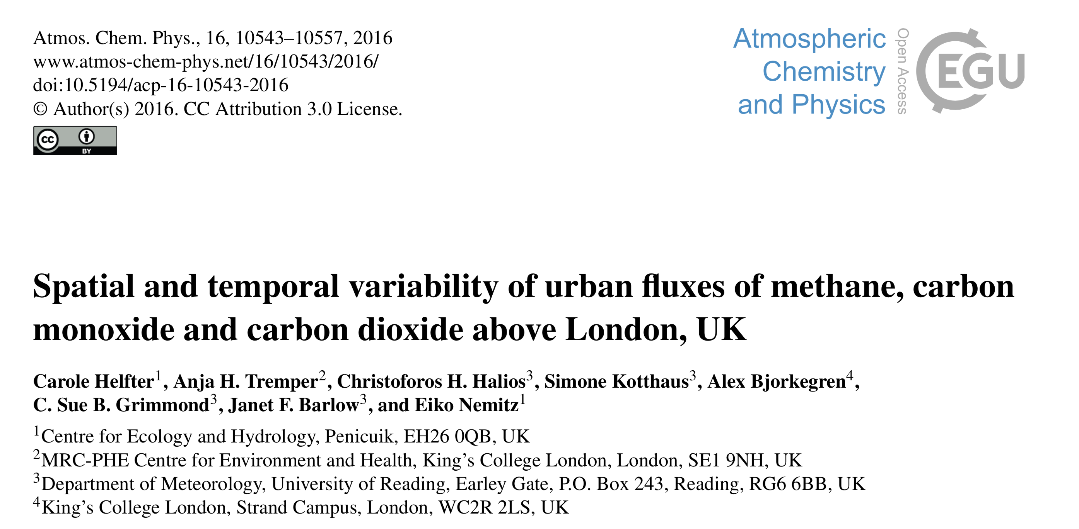

Slide 2
Why Methane?
CH₄ originates from a large range of sources with complex controls (not well understood yet) ﻿with theories attributing these changes to:
Biogenic,
Thermogenic,
Pyrogenic emissions or
a decline in the atmospheric CH₄ sink
(Nisbet et al., 2016, 2019; Saunois et al., 2016; Hmiel et al., 2020).
Methane (CH₄) is a potent GHG with a global warming potential 28-34 times larger than that of CO₂ at the 100-year horizon (﻿Myhre et al., 2013)
Urban Areas
High percentage of CH₄ emissions are attributable to the fugitive emissions of Natural Gas distribution system.
High Uncertainties
(McKain et al., 2015; Hendrick et al., 2016; Wunch et al., 2009; Jeong et al., 2016, 2017)

Slide 3
Estimates of Methane emissions Urban Areas
﻿In general, the inventory methods arrived at lower estimates of emissions compared to the top-down approaches.
(Balashov, 2020)
﻿A variety of techniques have recently been applied to provide independent top-down estimates of urban CH₄ emissions. These include:
ground-based mass balance approaches (McKain et al., 2015),
airborne observations (O’Shea et al., 2014; Cambaliza et al., 2015),
Fourier Transform Spectrometry (FTS) (Wunch et al., 2009),
isotopic source apportionment studies (e.g. Lowry et al., 2001; Zazzeri et al., 2015)
and Eddy- covariance

Slide 4
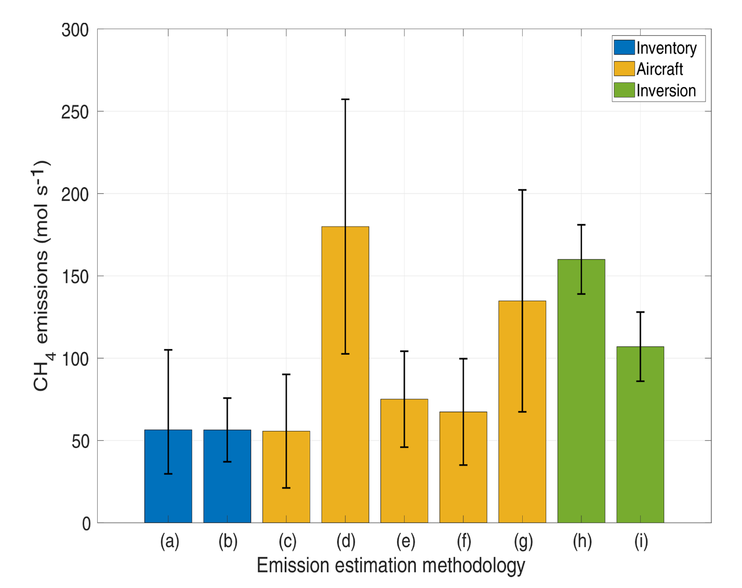
Estimates of Methane emissions Urban Areas
Underestimation of natural gas production and agricultural sources are possible reasons for this disagreement
(Miller et al., 2013; Brandt et al., 2014; Jeong et al., 2014).
Balashov et al. 2020 - Indianapolis
Notes:
﻿(a, b) Bottom-up estimates of CH4 emissions conducted by Lamb et al. (2016) in 2013 and Maasakkers et al. (2016) based on the EPA 2012 inventory, respectively. Error bars show 95% confidence inter- vals (for more details see abovementioned articles). (c–g) Top-down evaluations of CH4 emissions with aircraft from various flight cam- paigns where (c) contains five flights over March–April of 2008, (d) contains three flights over November–January of 2008–2009, (e) contains five flights over April–July of 2011, (f) contains nine flights from November–December, 2014, and (g) contains the same five flights over April–July of 2011 as in (e) but uses different methodology. Methodologies for (c–f) are described in Lamb et al. (2016) and the methodology for (g) is described in Cambaliza et al. (2015). Error bars show 95% confidence intervals (for more details see abovementioned articles). (h, i) Top-down evaluations of CH4 emissions for 2012–2013 using tower inversion modeling methodology with two different domains, where (h) uses the full domain of Fig. 2 and (i) uses only the Marion County domain of Fig. 2. The inversion methodology and 95% confidence intervals are described in detail in Lamb et al. (2016).

Slide 5
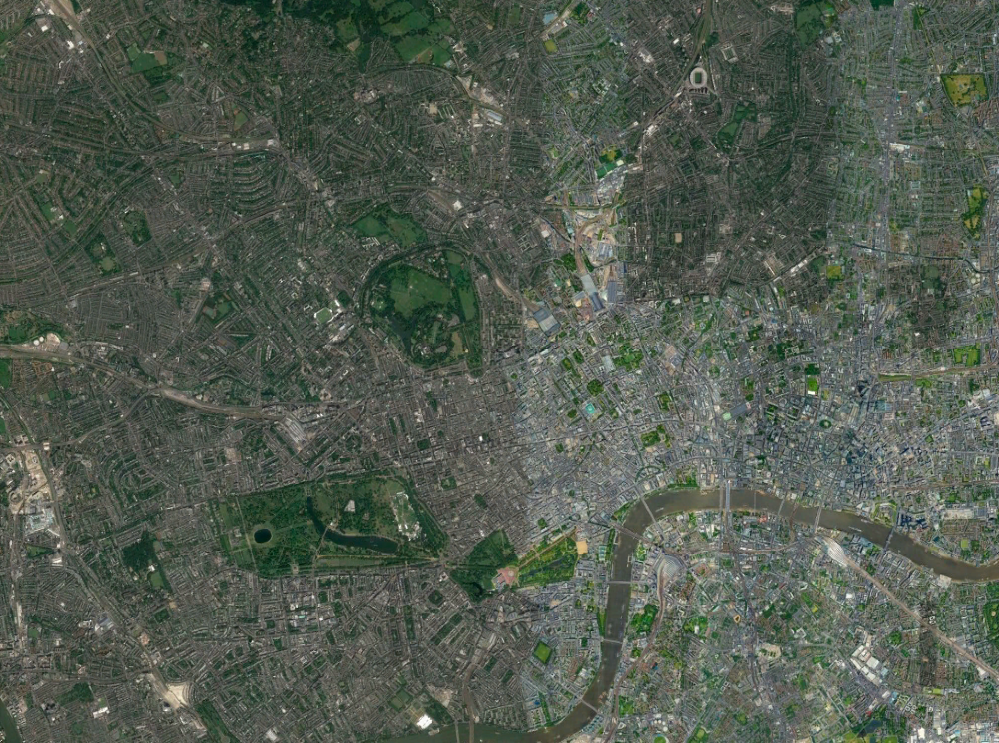
London Experiment
Dataset = 3 years CO₂ CH₄ CO (2012-2014)
3D Sonic Anemometer
R3-50 Gill Inst. (20Hz)
CO₂ H₂O
﻿IRGA model Li7500
LICOR (20Hz)
CO₂ CH₄ H₂O
Picarro cavity ring down spectrometer (CARDS) 1301- f (1Hz)
Open Path
BT Tower
CO﻿
Aerolaser fast AL5002 (10Hz)
190 m
Closed Path
BT Tower

Slide 6
London Experiment
3D Sonic Anemometer
CSAT3 Campbell (20Hz)
CO₂ H₂O
﻿IRGA Li7500 (20Hz)
BT Tower
2km
King’s College
August–September 2015 ﻿
CH4 sensor (Aerodyne Quantum Cascade Laser (QCL))
50 m
King’s College

Slide 7
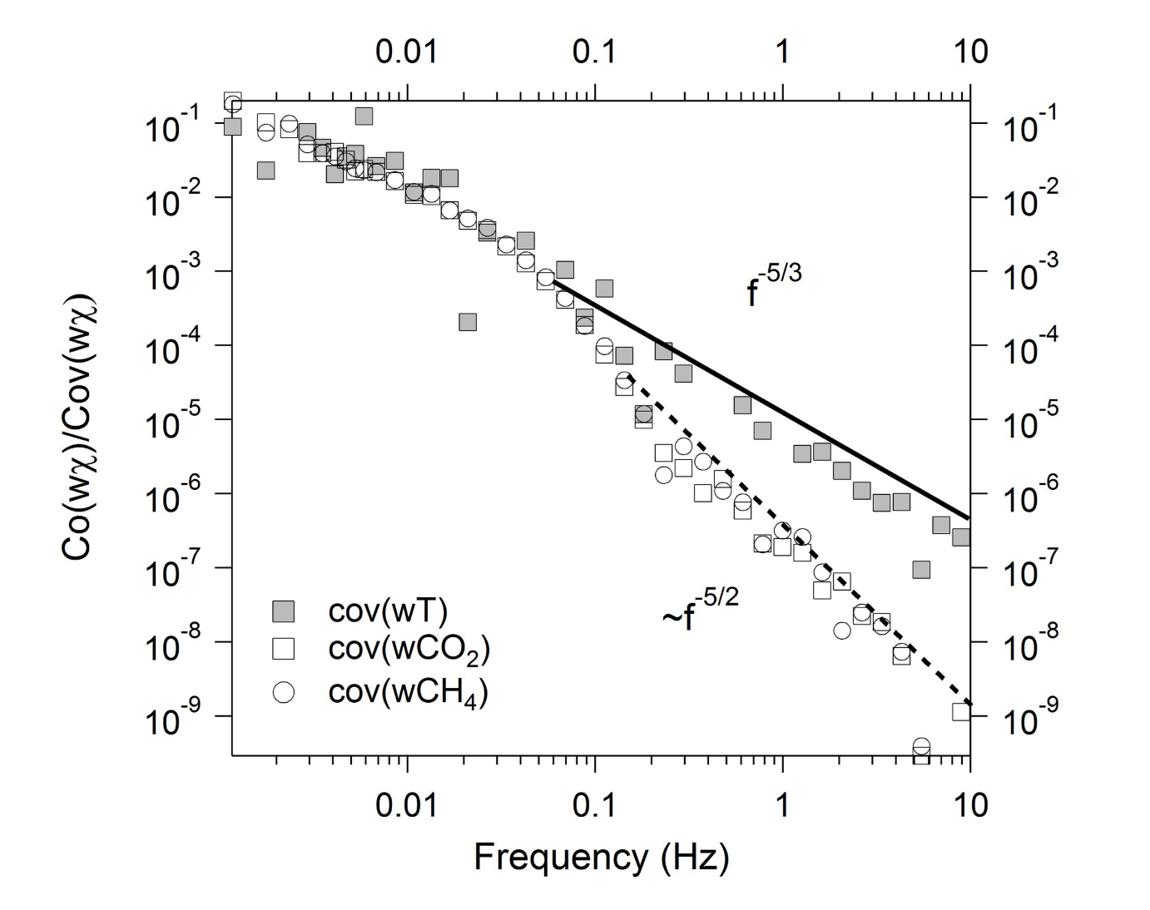
EC Data Corrections and pre-processing
﻿High-frequency attenuation
Difference in sampling
Number of raw data per period < 35000
The flow rate in the sampling line < 15 Lmin⁻¹
Spikes in u, v, w or any of the trace gas mole fractions was > 1%
Latent and sensible heat fluxes fell outside the -250Wm⁻² to 800Wm⁻² range.
The level of turbulence was deemed insufficient for flux measurement (u∗, < 0.2ms⁻¹).
The stationarity test < 30% (Foken and Wichura, 1996; Foken et al., 2004).

Slide 8
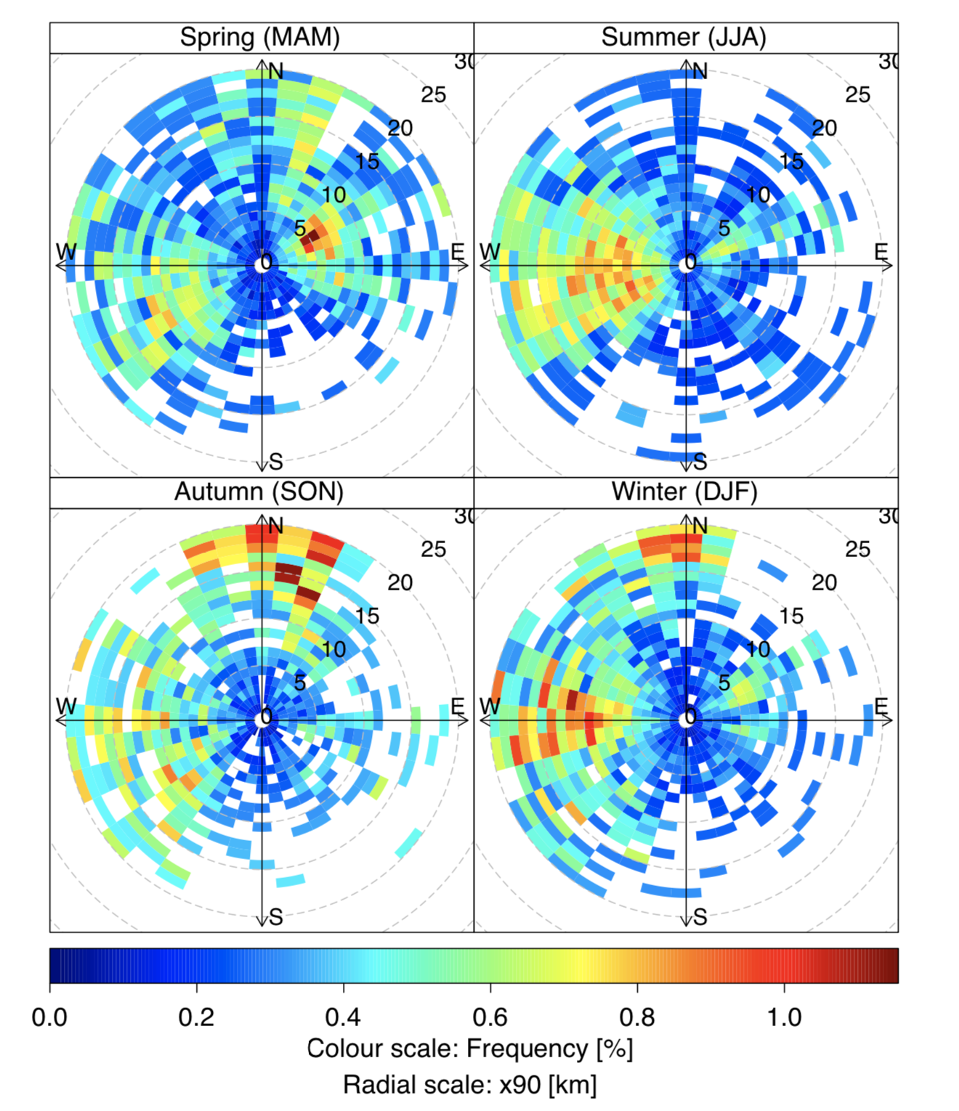
﻿Analytical model of Kormann and Meixner (2001) for non-neutral atmospheric stratification
BT Tower Footprints
Typically, 90 % of the flux measured at the BT tower site originated from distances of the order of a few km in spring and summer compared to several tens of km in winter.

Slide 9
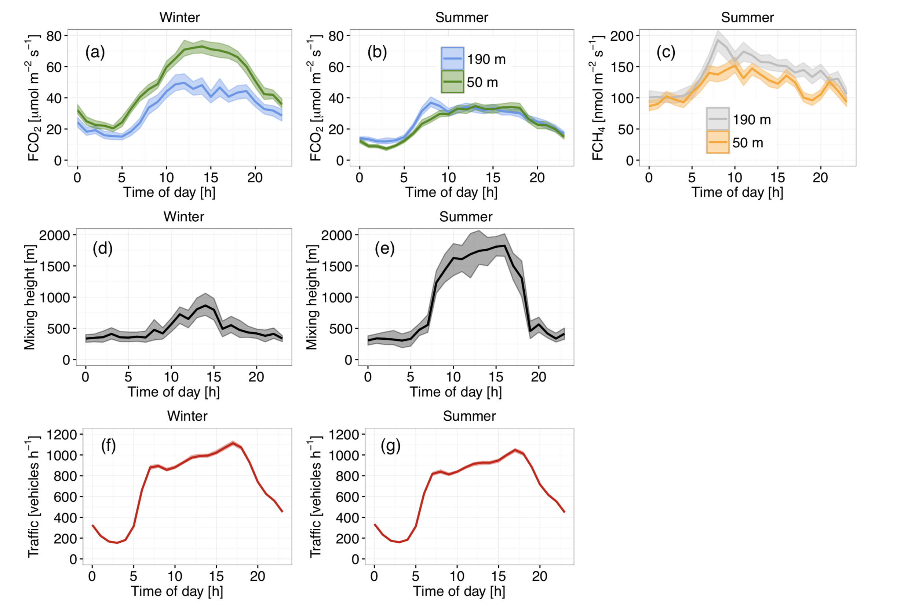
﻿Comparison with flux measurements at a lower height

Slide 10
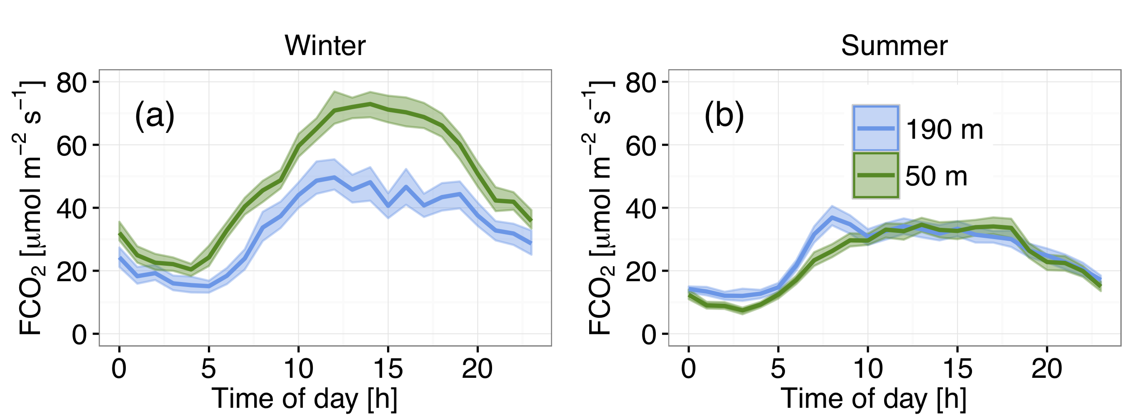
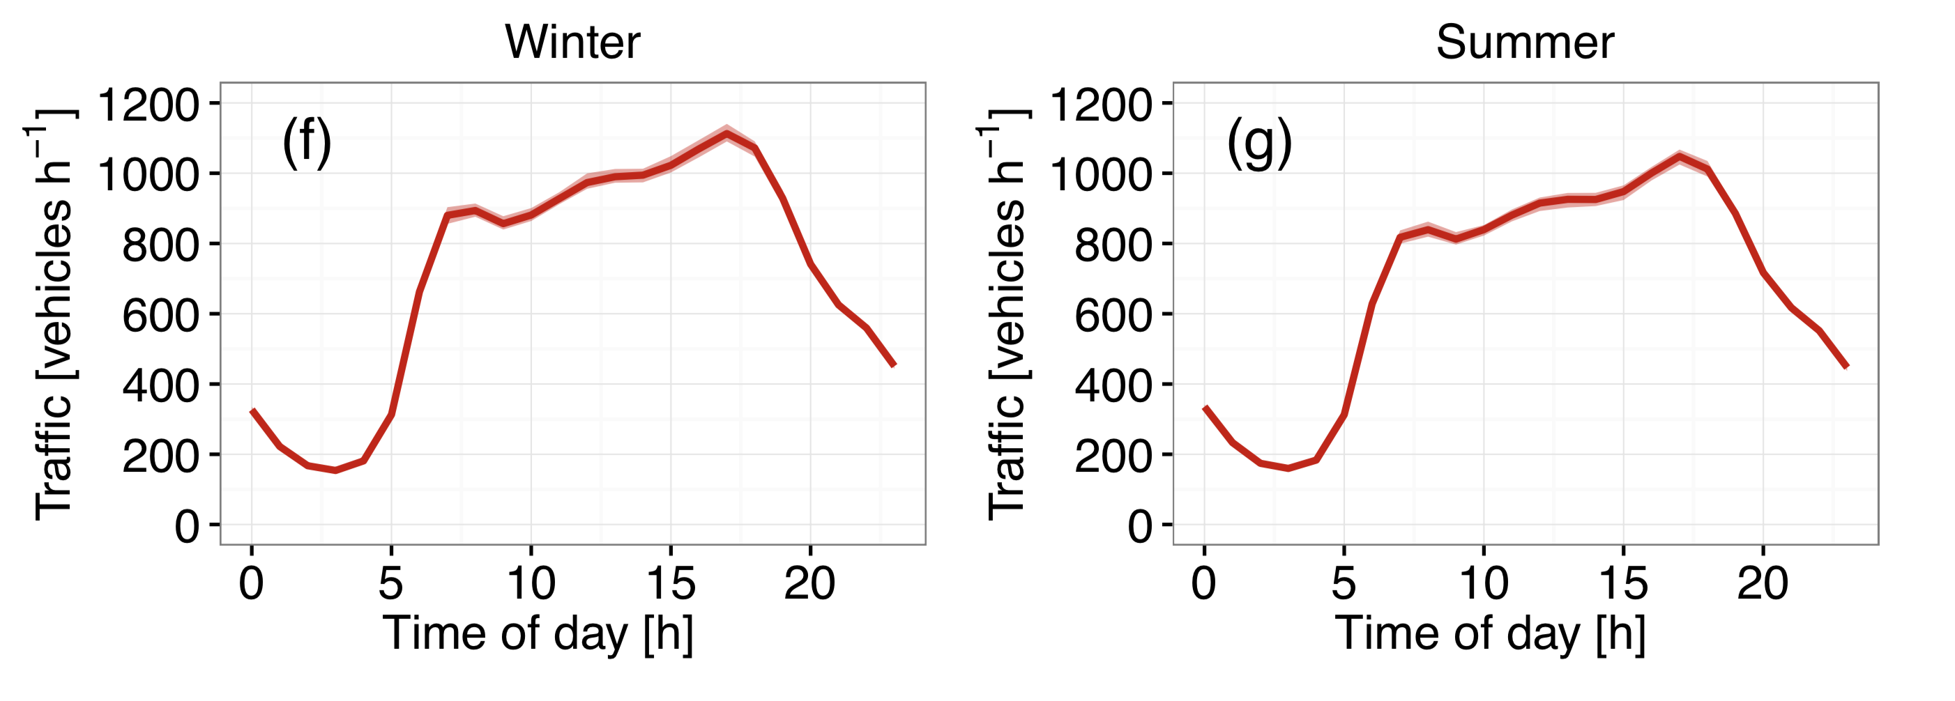
﻿CO₂
﻿DJF
﻿JJA
Daily Cycle consistent with minimum traffic loads
Vehicle emissions apparently represent a significant control not only for the local-scale observations but also for fluxes at the elevated BT tower measurement point.

Slide 11
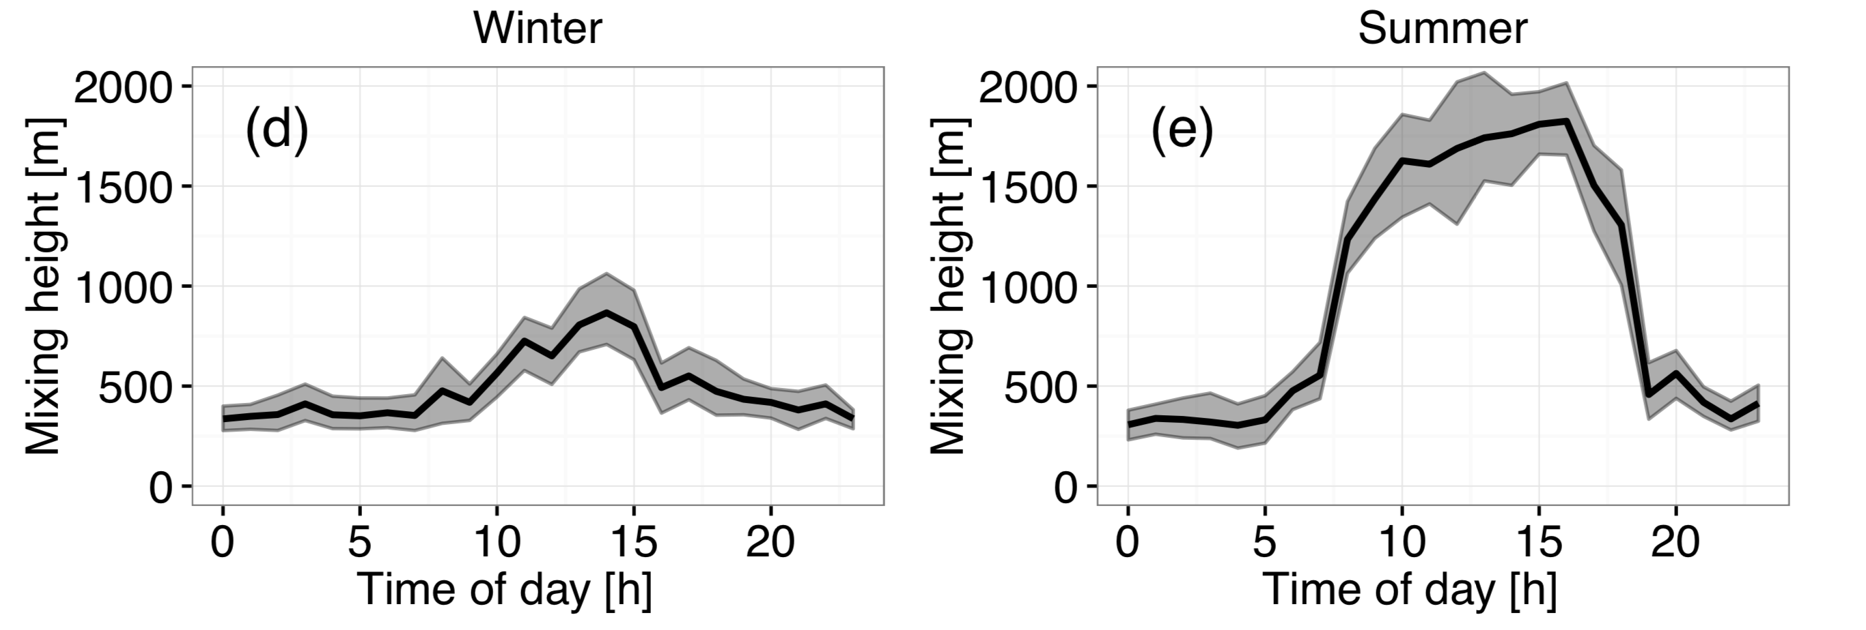
﻿CO₂
﻿DJF
﻿JJA
Doppler LIDAR turbulence measurements
Summer: 23 July–17 Aug 2012
Winter: 6 Jan–11 Feb 2012
These short-term climatology estimates might not be representative for the full period analyzed for the turbulent flux

Slide 12
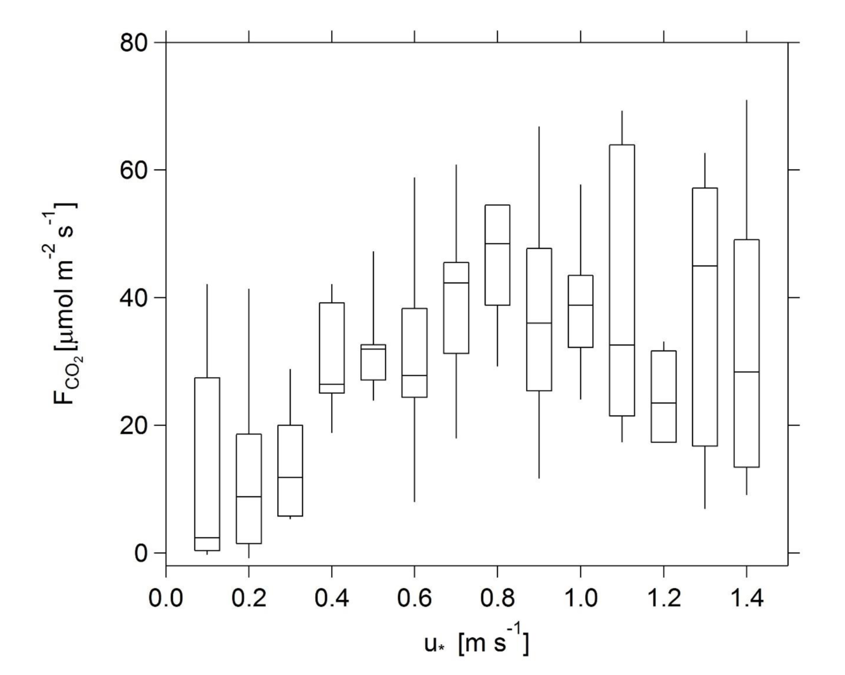
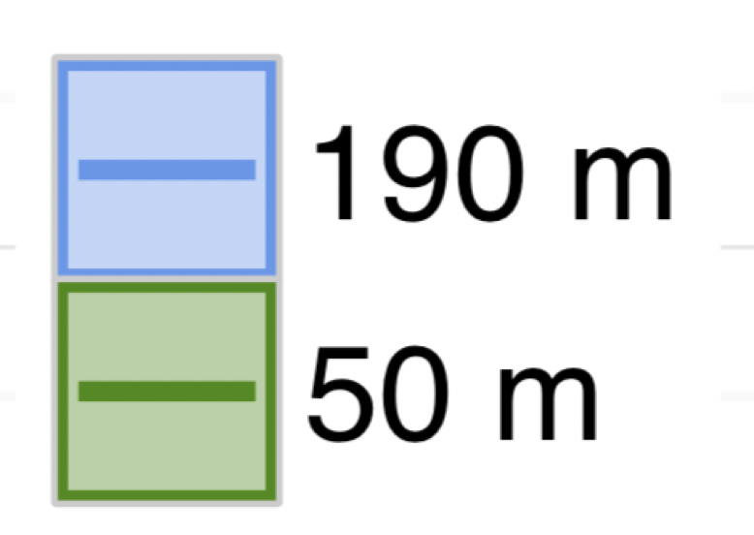
This type of behavior is usually attributed to a reduction in the transport to the measurement height, resulting in storage of CO₂ below that height which may be subject to advection.
It is likely that a loss of coupling with street level sources as a result of limited vertical transport occurred in situations of low turbulence.
﻿The slight morning delay in wintertime FCO2 observed at BT tower might be explained by the efficacy of vertical turbulent transport between street level and the top of the BT tower which has been shown to depend on atmospheric stability.

Slide 13
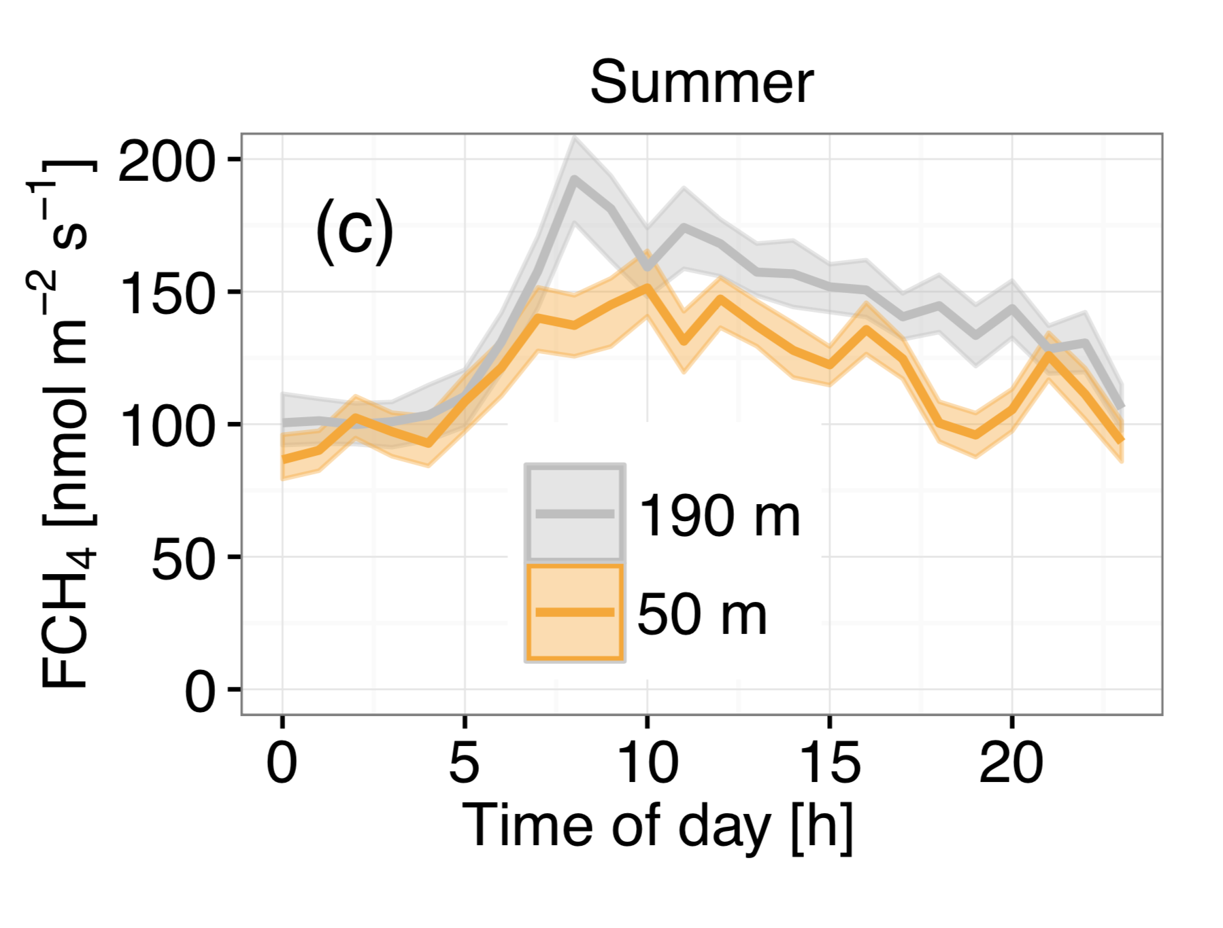
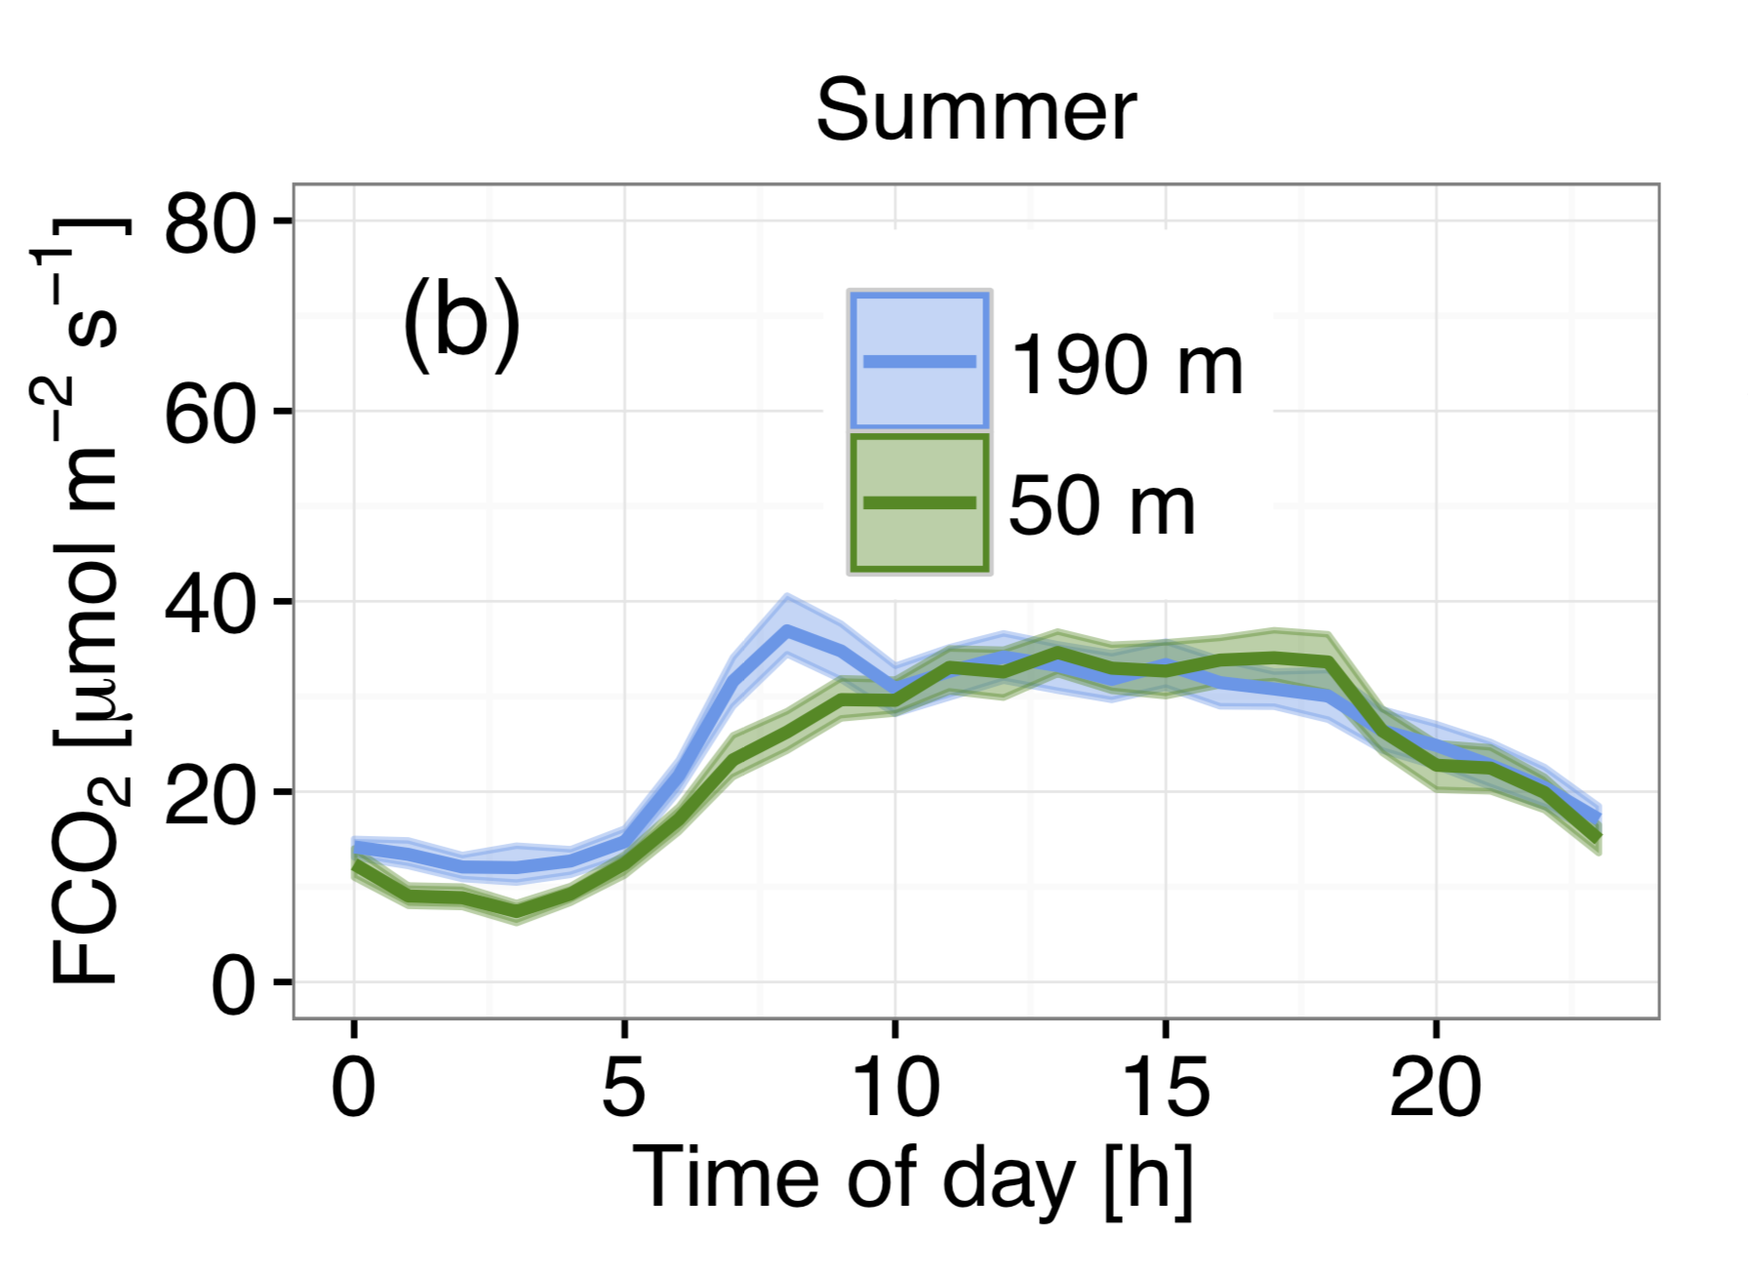
﻿CH₄
Onset of turbulent mixing
The diurnal profiles were obtained for a much shorter time period (Aug-Sep 2015)

Slide 14
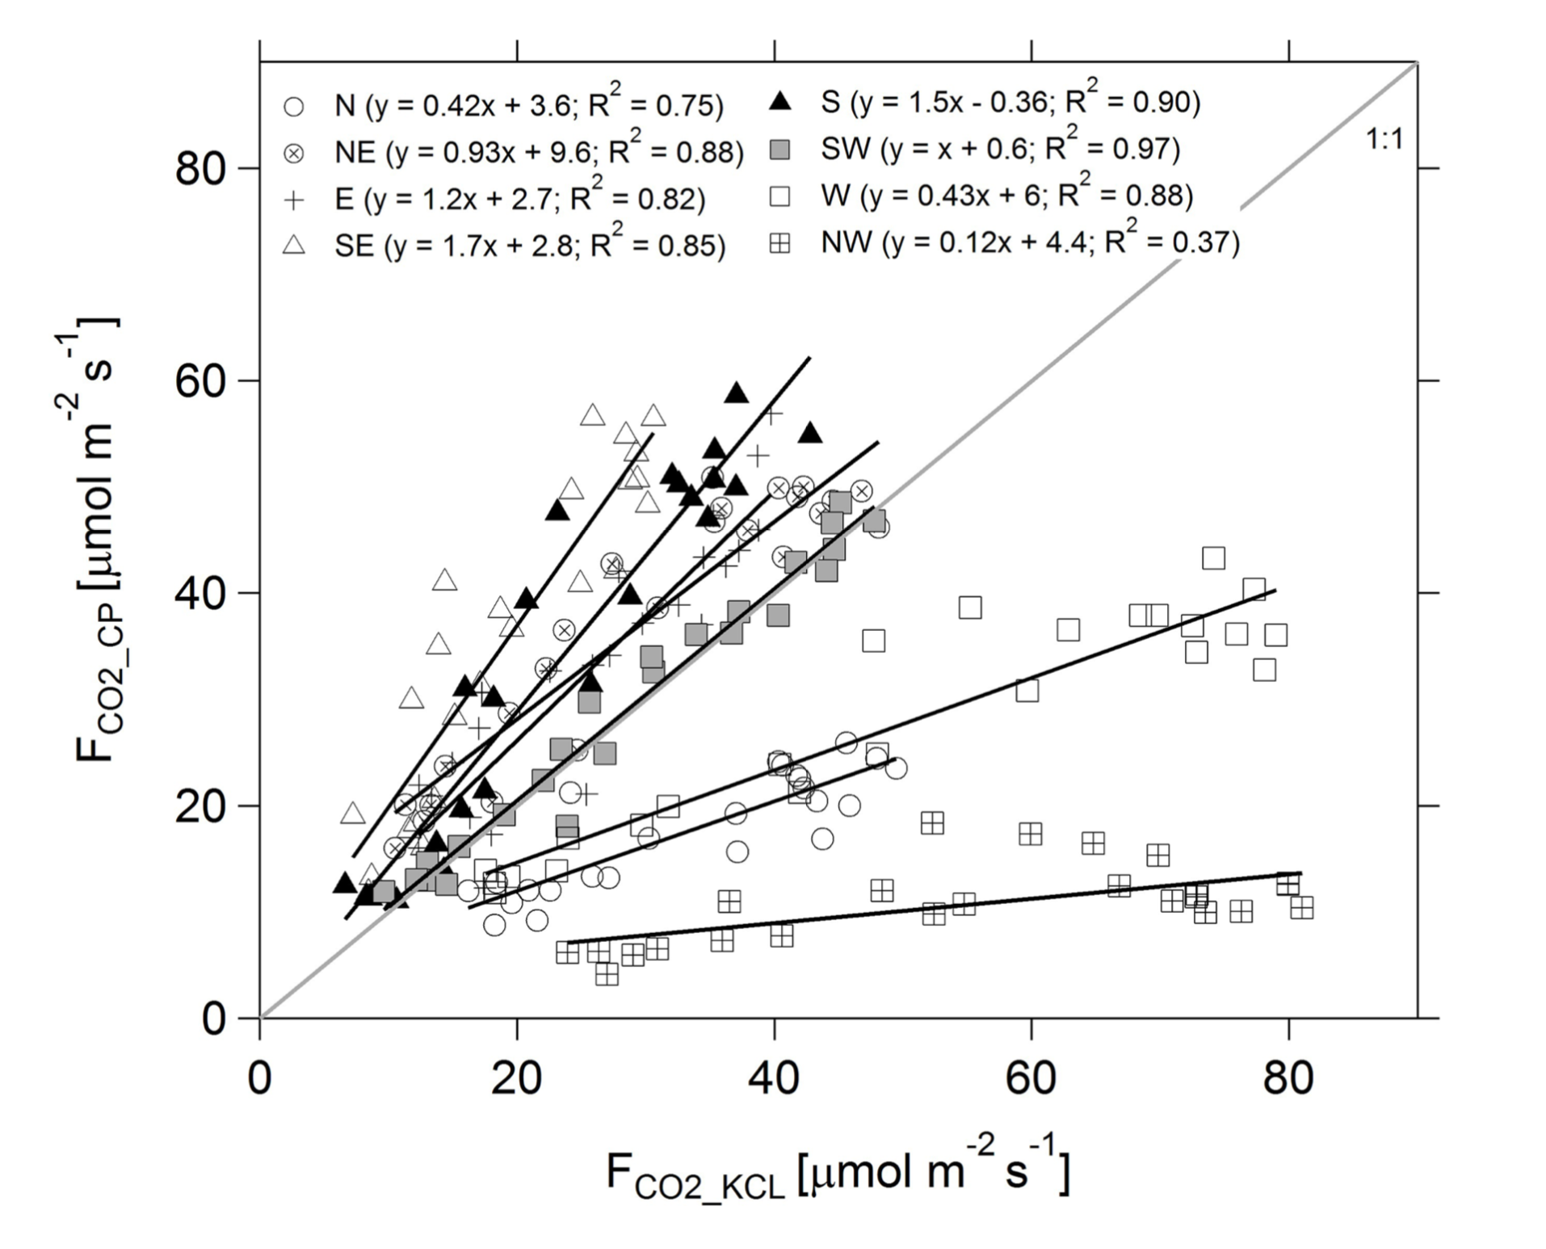
﻿Comparison of flux spatial variability
N
NW
NE
W
E
SW
SE
S

Slide 15
﻿Comparison of flux spatial variability
N
NW
NE
W
E
SW
SE
S
﻿These differences can be attributed to differences in flux footprints at the two measurement sites, including the extent ﻿as well as emission source density (a function of surface types)

Slide 16
Diurnal variability of the measured fluxes
Maximum-to-minimum ratio
1.9
3.5
3.7
The fluxes of all three gases exhibited well-defined diurnal cycles

Slide 17
Dependence of flux magnitude and diurnal patterns on wind sector
The difference in emissions between wind sectors was however only statistically significant for the N and NW wind sectors .
N
NW
NE
This perhaps suggests more complex, spatially discrete, source distribution and composition for CH4 compared with CO2 and CO.
W
E
SW
SE
S

Slide 18
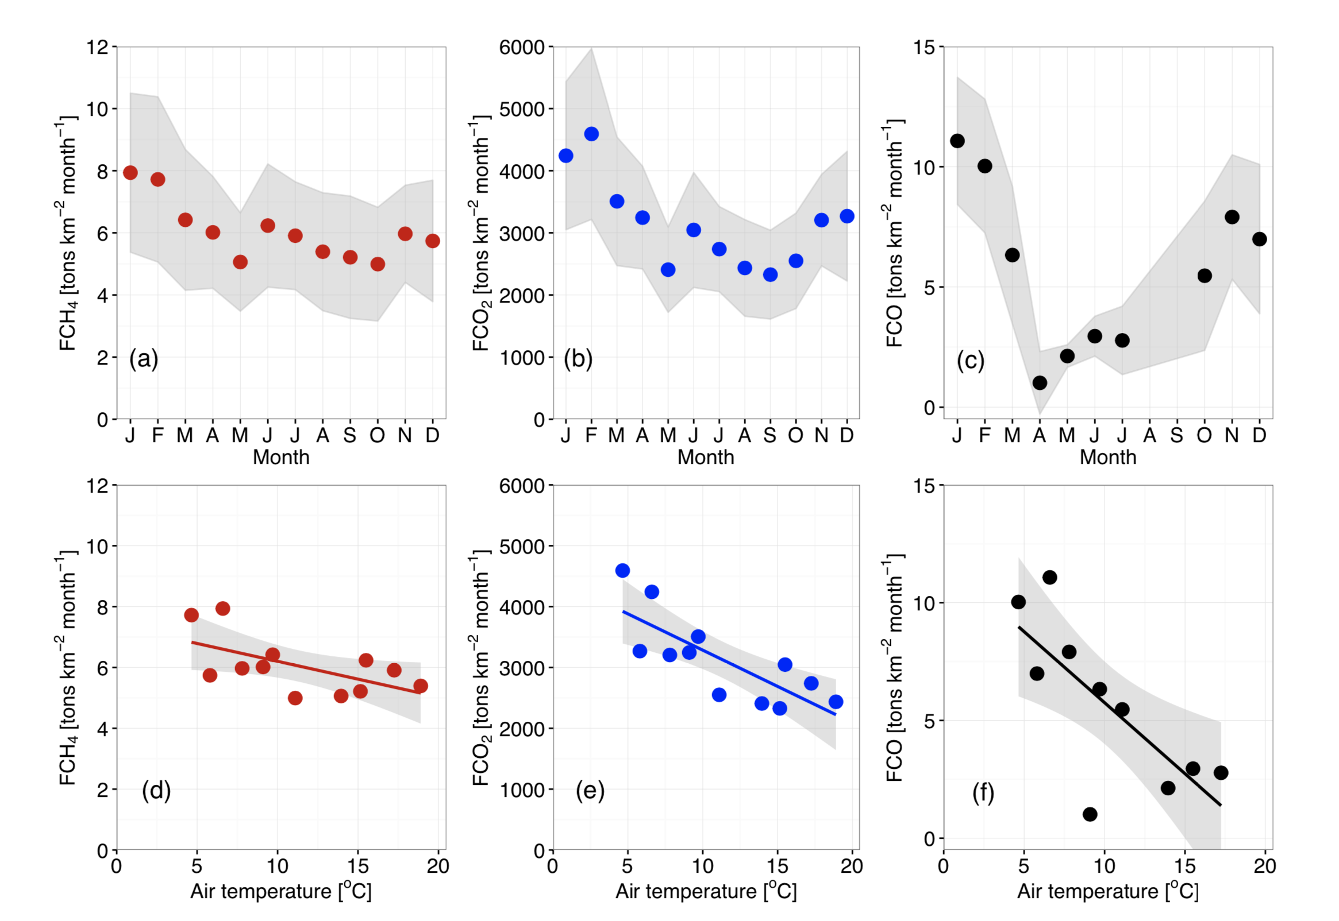
﻿Seasonality of the measured fluxes
For the measurement period September 2011 to December 2014, FCH₄, FCO₂ and FCO exhibited marked seasonal cycles with minimum emissions in summer
21% reduction
33% reduction
68% reduction

Slide 19
Seasonal controls of fluxes of CO₂ and CO
Emissions of CO from petrol cars are temperature dependent, e.g. increasing by a factor of 5-6 at ambient temperature 0 compared to 25 ◦C (Andrews et al., 2004) during the first 5–10 min following engine warm-up
Th correlation reflect the seasonal changes in domestic and commercial natural gas usage, but may also be influenced by increased photosynthetic uptake by vegetation in the footprint during the warmer months.
﻿Wintertime (DJF) emissions of CO accounted for 45% of the annual budget
This Study = -0.94 µmolm⁻² s⁻¹ C⁻¹
London = -1.95 µmolm⁻² s⁻¹ C⁻¹
Beijing = -0.34 µmolm⁻² s⁻¹ C⁻¹

Slide 20
Seasonal controls of CH₄ emissions
﻿The linear correlation of monthly averages with temperature was not statistically significant (R² = 0.31, p value=0.06).
﻿The weaker correlation of FCH4 with air temperature in London suggests that the total methane flux is due to a superposition of sources with constant and time-varying emission rates
Notes:
.

Slide 21
Seasonal controls of CH₄ emissions
N
NW
NE
W
E
SW
SE
S
When segregated by wind sector, CH₄ fluxes in the E and W were strongly correlated with air temperature suggestive of sources with highly seasonal emission rates, possibly leaks from the natural gas distribution network or emissions from sewage.
Notes:
﻿.

Slide 22
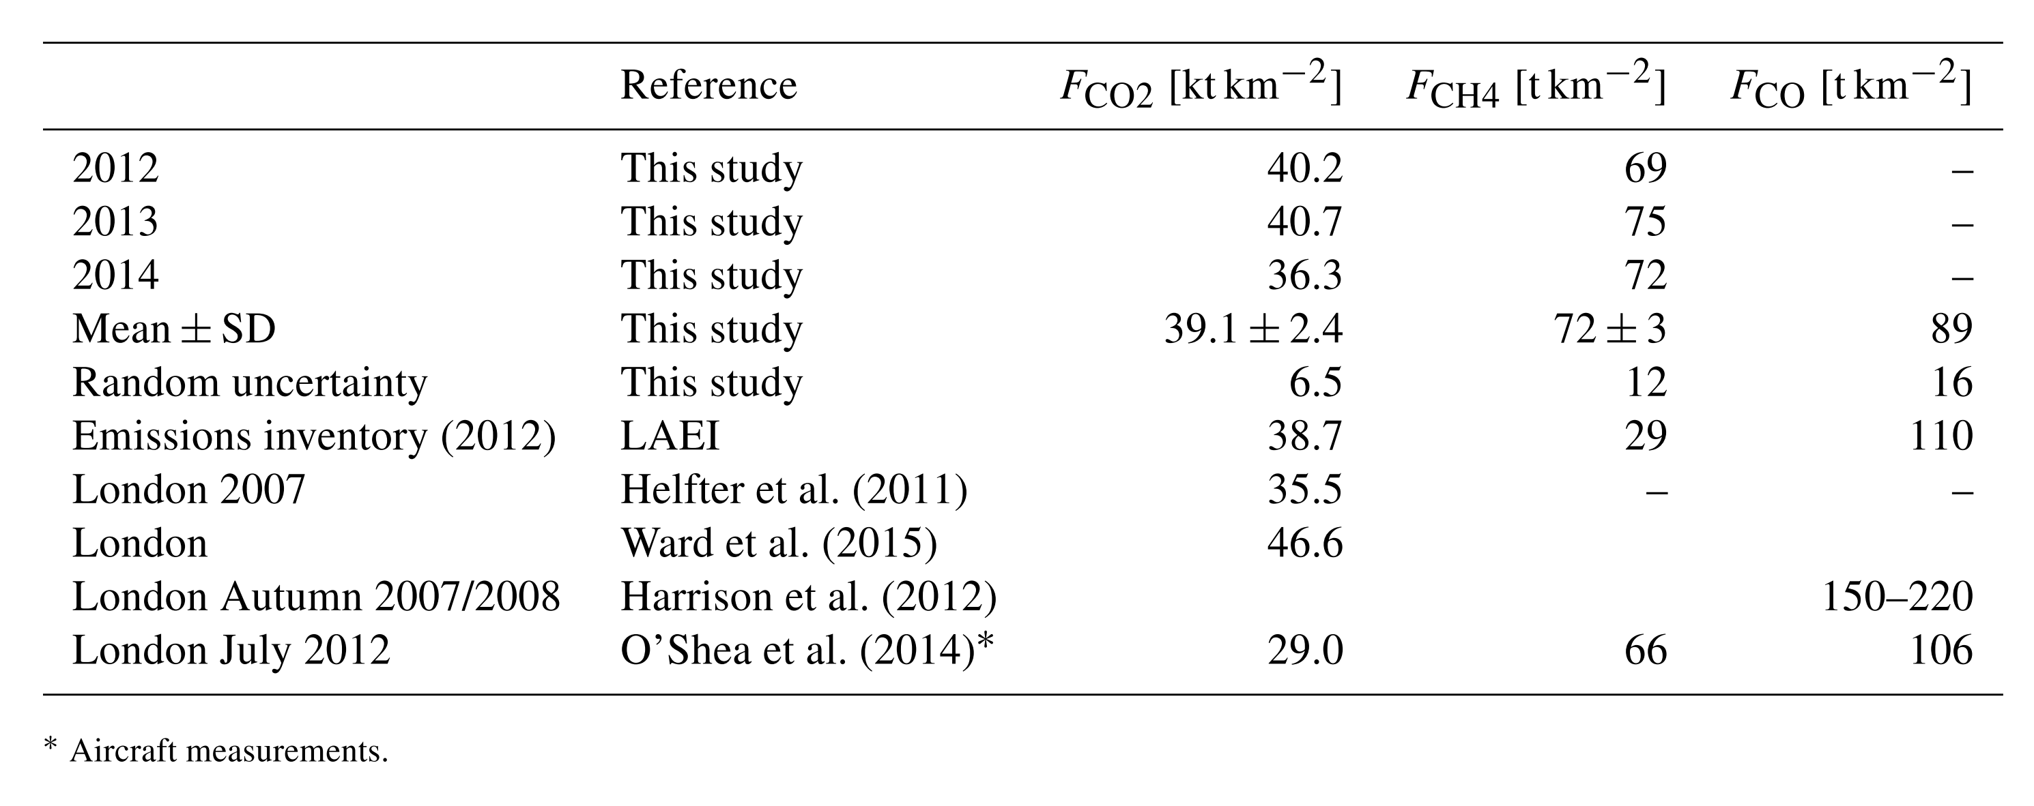
﻿Annual budgets of methane, carbon monoxide and carbon dioxide emissions
?
﻿The good agreement for CO₂ using different instrumentation provides a benchmark for subsequent comparisons between top-down measurements and bottom-up inventory estimates

Slide 23
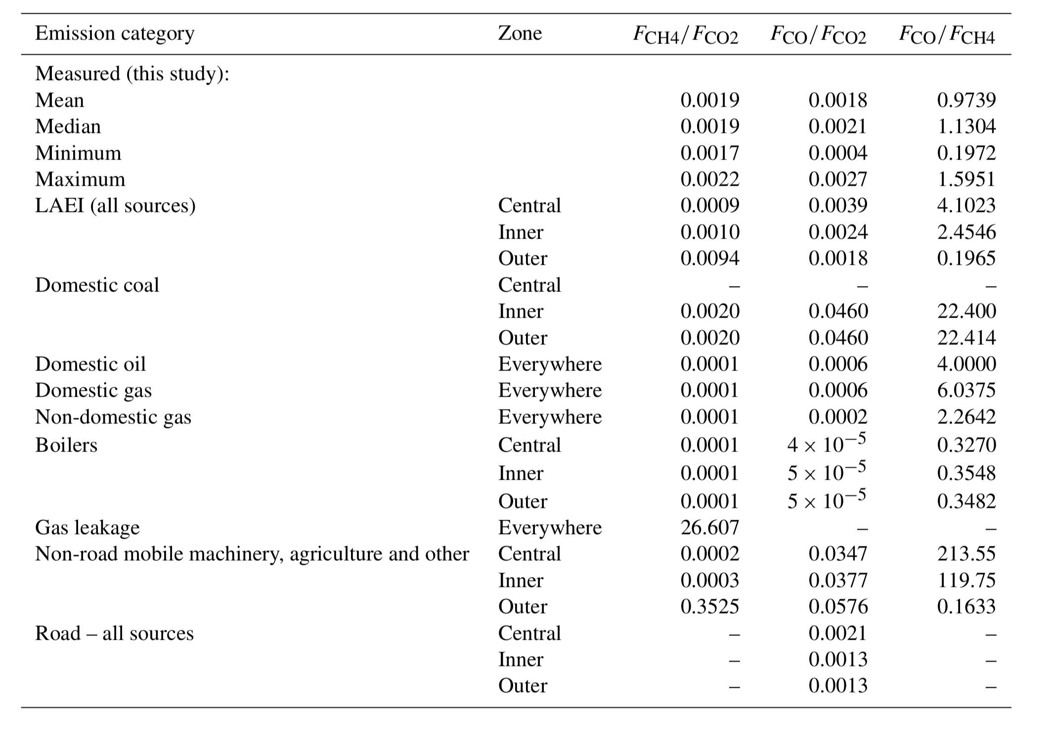
﻿Flux ratios
Flux ratios are less sensitive to limitations in vertical transport and provide an additional means of assessing the quality of the bottom-up emission inventories and identifying poorly represented sources.
This indicates that some CH₄ sources were either underestimated or unaccounted for by the LAEI
Only gas leakage has the potential to increase the CH₄/CO₂ flux ratio, but an underestimation in leakage is only a possible explanation if it follows the measured diurnal cycle.
Variations in FCH₄, and the larger FCH₄ /FCO₂ ratio could be due a contribution of temp.-sensitive CH₄ emissions perhaps of biogenic origin not included in the inventories.
Notes:
We speculate that the diurnal, seasonal and spatial variations in FCH4, and the larger FCH4 / FCO2 ratio could be due a contribution of temperature-sensitive CH4 emissions perhaps of biogenic origin (e.g. increased methanogenesis from sewerage) not included in the inventories.

Slide 24
﻿Conclusions
All three trace gases exhibited diurnal cycles consistent with anthropogenic activities (traffic, natural gas use) and a marked seasonal dynamic, with reduced emissions in the summer.
The measured annual CH4 emissions were more than double the LAEI value suggesting that sources are not as well-characterized by the inventory.
Hypothesis: the shortfall in inventoried CH4 emissions can be explained by the existence of temperature-dependent sources related to natural gas usage and perhaps also of biogenic origin (e.g. sewage).
Measured annual emissions of CO₂ and annual budget for CO were in good agreement with bottom-up estimates from the London Atmospheric Emissions Inventory (LAEI).
Confidence in the flux measurements

