Slide 1
The Circle Map
Arnolds Tongues
Modelación Ambiental
Laura Herrera

Slide 2
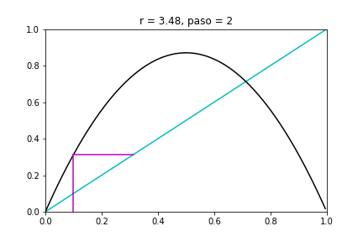
Dynamical Systems
There are two main types of dynamical systems
Iterated maps (difference equations)
Arise in problems where time is discrete
Logistic Map
“Mapas Lineales”
Circle Map
“Mapas en círcuclo”
Notes:
Differential equations are used much more widely in science and engineering, and we shall therefore concentrate on them. Later in the book we will see that iterated maps can also be very useful, both for providing simple examples of chaos, and also as tools for analyzing periodic or chaotic solutions of differential equations

Slide 3
Circle Map
Physically, the study of circle maps is motivated by the problem of coupled oscillators

Slide 4
Circle Map
Physically, the study of circle maps is motivated by the problem of coupled oscillators

