Slide 1
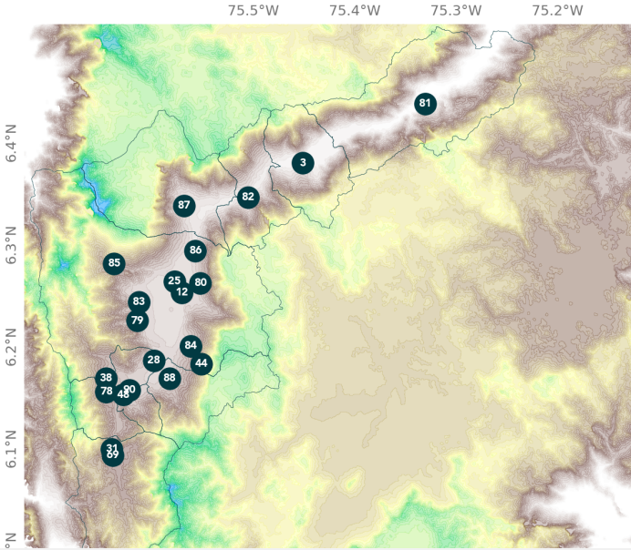
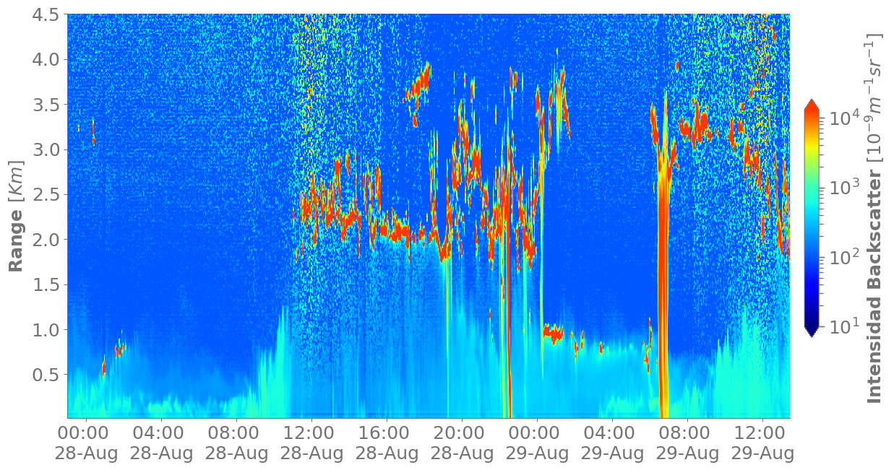
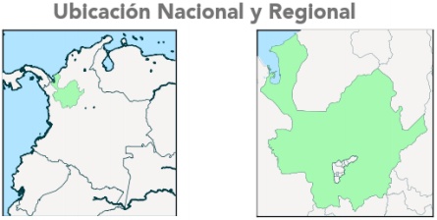
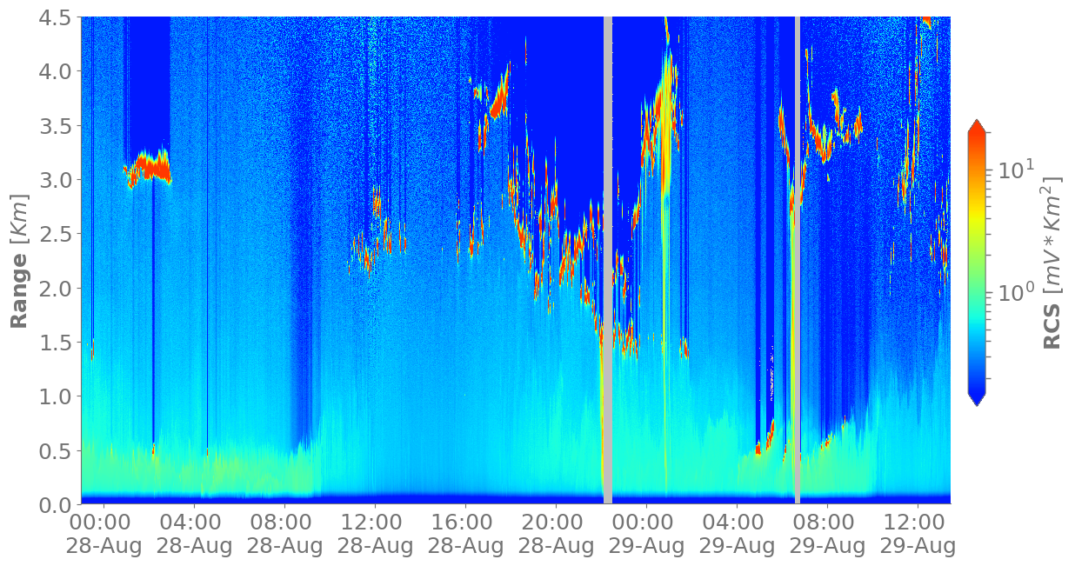
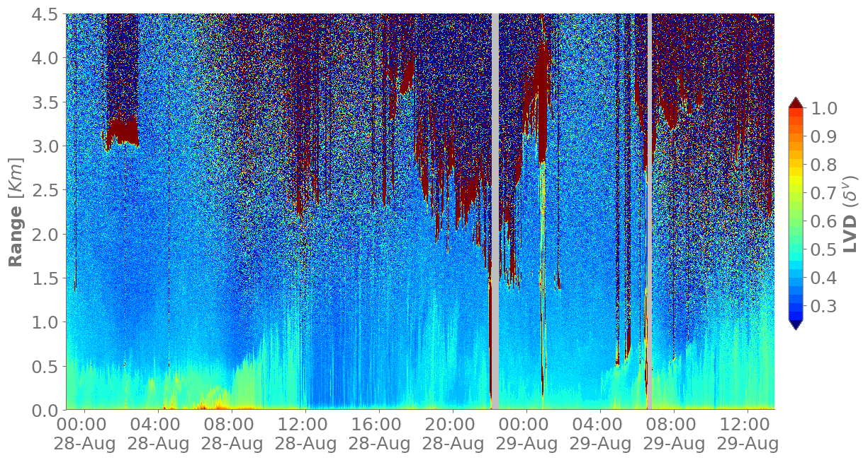
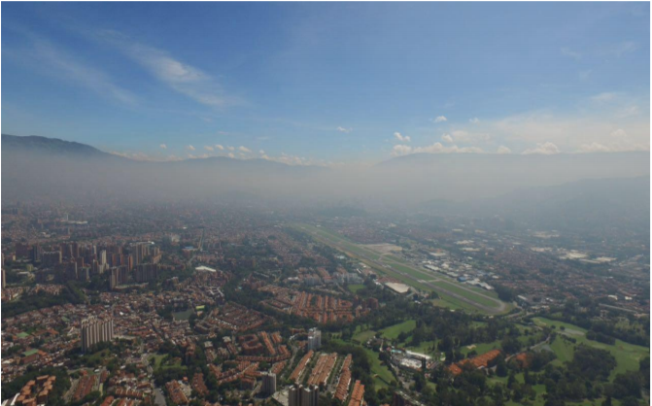
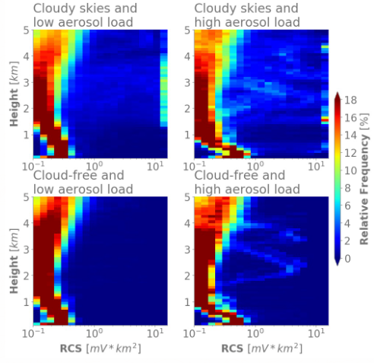
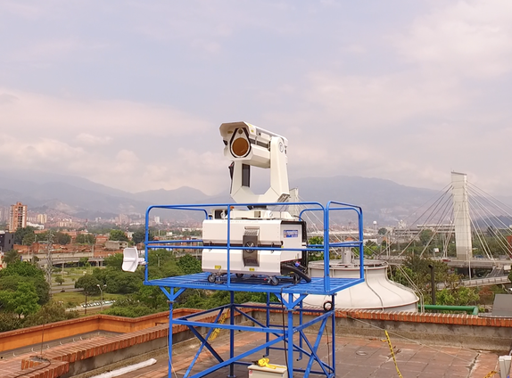
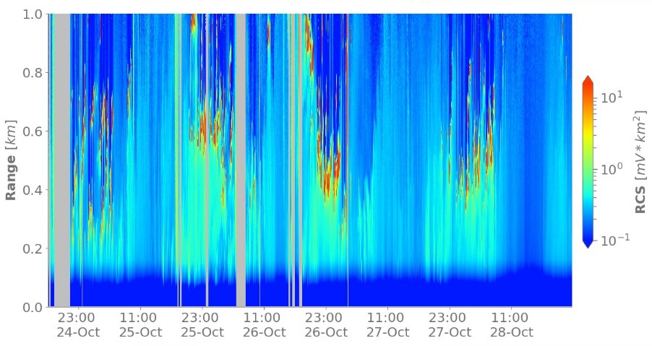
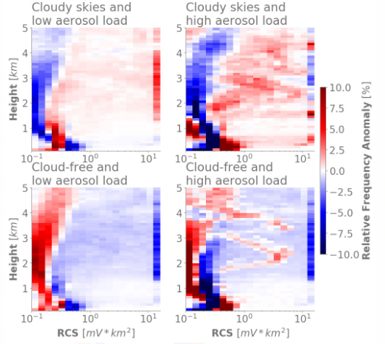
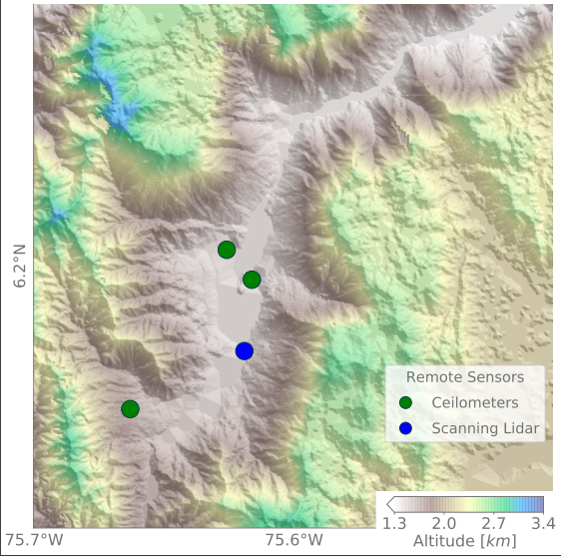
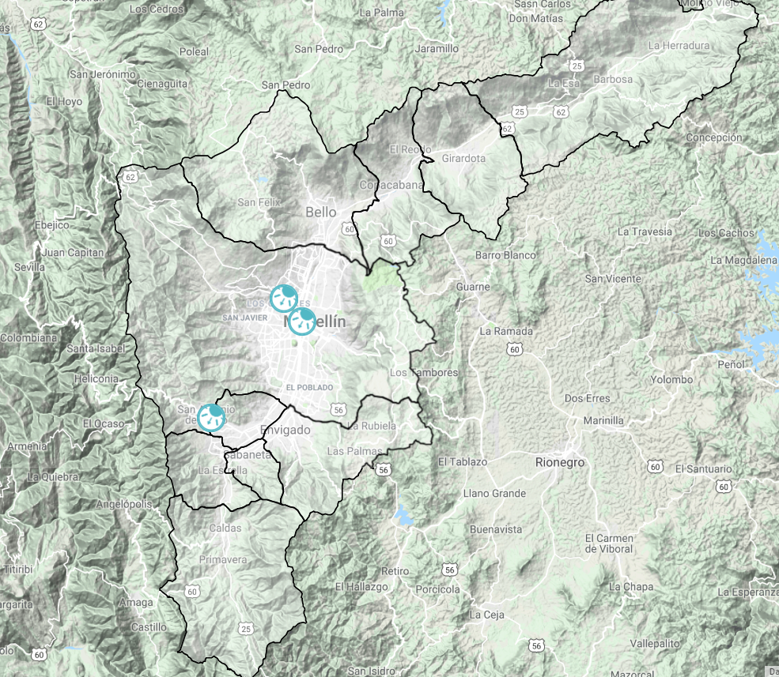
Approximation to the characterization of the spatiotemporal variability of clouds and aerosols in the Aburrá Valley from satellite and ground-based remote sensing
Santiago Jaramillo, Julián Hernández, Laura Herrera, Carlos D. Hoyos Sistema de Alerta Temprana de Medellín y Valle de Aburrá (SIATA)
Introduction
Methodology
Results
Aburrá Valley is a narrow tropical ~1000m-deep valley located in the Colombian Andes.
In recent years this region has experienced critical air quality episodes, with daily concentrations reaching historical maximum over 100 μg/m³.
Meteorological and climate variability modulates the occurrence of these episodes.
The presence of low-level clouds and the structure of the Atmospheric Boundary Layer (ABL) are critical factors for understanding the behavior of aerosols.
Scanning LIDARS are versatile tools to assess ABL dynamics in an urban environment, allowing aerosol characterization and spatiotemporal evaluation.
Lidar signal processing
Figure 6 shows how, despite their different location and laser wavelength, both types of remote sensors show a similar variability of the atmospheric spatiotemporal structure.
Considering aerosols as a ABL height tracer, time evolution of Lidar vertical profiles clearly reflects the effect of stability and convection (triggered by solar radiation) on the atmosphere structure.
The previous identification of clouds and aerosols, allowed to analyze Lidar signal under four cases with different implications for incoming radiation: (i) cloud-free and low aerosol load, (ii) cloud-free and high aerosol load, (iii) cloudy skies and low aerosol load, and (iv) cloudy skies and high aerosol load.
Figure 7 shows RCS distribution in height for each case. Scenarios (i) and (ii) shows that during the days measured, clouds usually spread between 1.5 km and 4 km over the surface but when aerosols load is high, clouds tend to be lower, concentrating at around 1.5 km height.
Lidar signal was processed from initial raw data to range corrected signal (RCS). As photon-counting records do not have good quality in first hundreds of meters due to signal saturation, analogue records were used.
64
58
35
55
60
56
The original range-depending signal $P\left(r\right)$ is processed to obtain the Range Corrected Signal (RCS):
To remove the background signal $P_{BKGD}$ it was estimated for each profile as the mean value in a far range segment (mean signal value between 18 km and 21 km):
57
58
46
68
ND
55
58
Regional Location
60
ND
56
69
$$RCS\left(r\right)=\left(P\left(r\right)−P_{BKGD}\right)r^{2}$$
56
76
71
$P_{BKGD}=$ ${\overline{P}}_{r=\left(18,21\right)[km]}$
59
Removing the background signal with this methodology allows to reduce the effect of the solar radiation daily cycle.
Altitude (km)
Fig 1. Geographic localization and topography of the Aburrá Valley. Circle values show PM2.5 daily concentration (µg/m³) for March 6th 2018 critic episode.
Measurements reached values over 55 µg/ m³ in most stations. Circle colors indicates Air Quality Index (red: unhealthy, orange: unhealthy for sensitive groups, yellow: moderate).
The Linear Volume Depolarization Ratio ($LVD$) was calculated as the ratio between the cross and parallel signals retrieved by the Lidar Transient Recorder.
$$LVD=\frac{P_{⊥}}{P_{||} }$$
Fig 2. Visible stratification of the atmosphere inside the valley under stable thermodynamic conditions.
Ceilometers data were processed by the instrument software and directly reported as attenuated backscatter signal.
Aerosols and Clouds identification
Fig 6. Atmospheric vertical profiles time evolution between August 28th – 29th expressed in a) Attenuated Backscatter Intensity measured by a Ceilometer, b) Range Corrected Signal measured by the LIDAR and c) Linear Volume Depolarization Ratio measured by the LIDAR.
To characterize and analyze the atmospheric structure, we classified vertical profiles in different cases, depending on the presence or absence of clouds and aerosols, with different impacts on incoming solar radiation.
We considered as clouds all the RCS values over $7 mVkm^{2}$. For aerosols, for each vertical profile we averaged the RCS between 200 m and 400 m (before cloud filtering). The obtained times series was smoothed with a 10 minutes rolling mean and a value $0.4 mVkm^{2}$ was set as the threshold to discriminate high from low aerosol concentration.
Once we have classified all the data as cloudy/cloud-free and high/low aerosol load, we analyzed Lidar signals to understand the atmosphere structure under each of those cases.
a)
Data
Lidar
Data from a scanning biaxial elastic Lidar located at the bottom of the Aburrá Valley were used in this work. Its Nd:YAG laser wavelength is 355 nm and emits light pulses up to 30 mJ of energy with a 20 Hz frequency. The sampling rate of the Transient Recorder is 40 MHz, thus, Lidar signal spatial resolution is 3.75 m. The profiles are averaged each 30 seconds to reduce noise in the signal while keeping good time resolution. The total overlap between the laser beam and the field of view is reached around 140 m.
The Lidar has two polarization channels and for each of them receives the signal by photon counting and analogue methods.
Vertical profiles were measured in different campaigns, collecting data from ~60 days in a span of four months.
Ceilometers
Data from three coaxial Lidar ceilometers located inside the valley were also used. Their laser wavelength is 910 nm and collect data continuously.
Fig 7.a Relative frequency of RCS values vs height for the four studied cases. The presence of clouds in Cases (i) and (ii) is represented by the high percentage of RCS values over 10 in different altitudes. Presence or aerosols in case (ii) and (iv) implies that in low altitudes RCS values tend to be higher.
Fig 7.b Relative frequency anomaly of RCS vs height for the four studied cases. It plots more explicitly the differences between four cases. Scenarios wit aerosols ((ii) and (iv)) show their tendency to decrease with height until they lose its influence on RCS around 500 m of altitude.
Fig 5. RCS for the first 1000 m of altitude during a 4-days period. The range selected to define the presence of aerosols is marked (200 m – 400 m).
b)
Fig 3. Depolarization Lidar located at the bottom of the valley
Current working in…
Conclusions
To complement the analysis of the vertical structure of the atmosphere we are on way to use CALIOP attenuated backscatter and depolarization profiles, and GOES16 spectral bands data.
Additionally, we are working to find how LDV variability is related to aerosols size, form and concentration and their possible effects on surface incoming radiation.
Both types of ground based remote sensors used (a 355 nm Lidar and three 910 nm ceilometers) identify similar spatiotemporal variability of the atmospheric vertical structure (clouds and aerosols) despite their different locations and laser wavelengths.
Although current data may not be yet statistic significative, Lidar signals (RCS and LDV) allow to characterize the atmospheric structures under different conditions, leading to a deeper understanding of their behavior and their effects on turbulent fluxes and radiation near the surface.
355 nm scanning LIDAR
LIDAR Ceilometers and pyranometers
Fig 4. Location of Scanning Lidar, Ceilometers and Pyranometers used.
Acknowledgments
This work was supported by Área Metropolitana de Medellín y de Valle de Aburrá, Municipio de Medellín, Grupo EPM, and ISAGEN under the contract CD511 of 2017.
Notes:
The Aburrá Valley is a narrow complex mountainous terrain located in the Colombian Andes. In recent years this region has experienced critical air quality episodes, with daily concentrations reaching over 100 μg/m3. Meteorological and climate variability modulates the occurrence of these episodes. The presence of low-level clouds and the structure of the Atmospheric Boundary Layer (ABL) are critical factors for the understanding of the behavior of aerosols. Scanning LIDARS (Light Detection and Ranging devices) are versatile tools to assess ABL dynamics in an urban environment, allowing aerosol characterization and spatio-temporal evaluation. In this work, we study vertical profiles of attenuated backscatter and depolarization ratio derived from a ground-based scanning LIDAR, and simultaneous profiles obtained from the space-borne CALIOP Lidar instrument onboard CALIPSO satellite to characterize the spatio-temporal variability and structure of the Aburrá Valley ABL. The profiles are also contrasted with backscatter measurements from three lidar ceilometers operating within the valley. The results suggest that both ground-based remote sensors identify similar variability of the atmospheric vertical structure, aerosols, and ABL height. In the case of CALIPSO, we do not intend to validate or calibrate the retrievals using ground-based instruments; several authors have reported aerosol profile disagreements due to random and systematic sources. Instead, we consider CALIPSO and ground-based retrievals as complementary leading to a better understanding of the atmospheric profile, and the implications of aerosol-cloud interactions feedbacks for the surface radiative balance. While the amount of data is not yet sufficient for statistically significant conclusions, the preliminary aerosol and cloud characterization and discrimination allow the clustering of four cases with different consequences for incoming solar radiation and turbulent fluxes. The cases include (i) cloud-free and low aerosol load, (ii) cloud-free and high aerosol load, (iii) cloudy skies and low aerosol load, and (iv) cloudy skies and high aerosol load scenarios.

